Slide 1
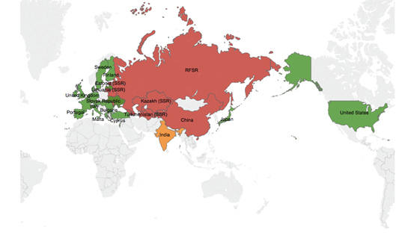
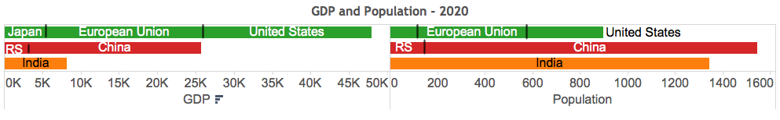
GLOBAL STRUCTURE

Slide 2
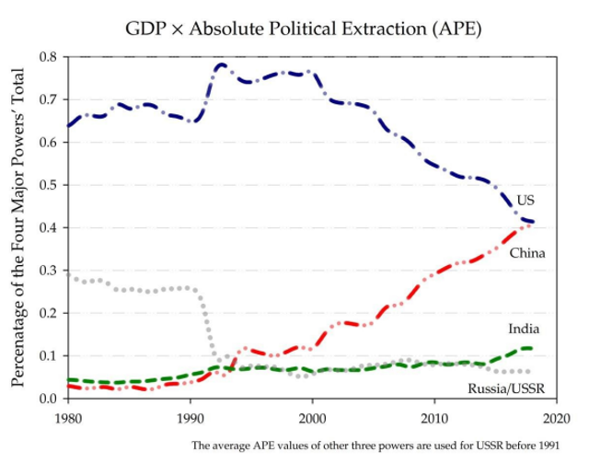
Relative Power of Global Contenders

Slide 3
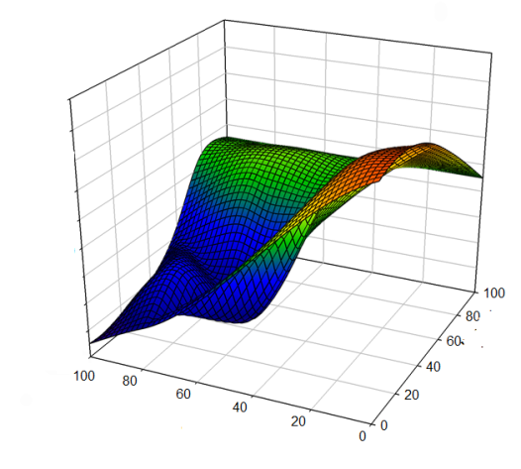
Power Transition Structure
Trust
Decreasing
Increasing
Confrontational
Conflict
Normal
Competitive
Free Trade
Power
Parity
Integration
Cooperative
Federation
Power
Satisfaction

Slide 4
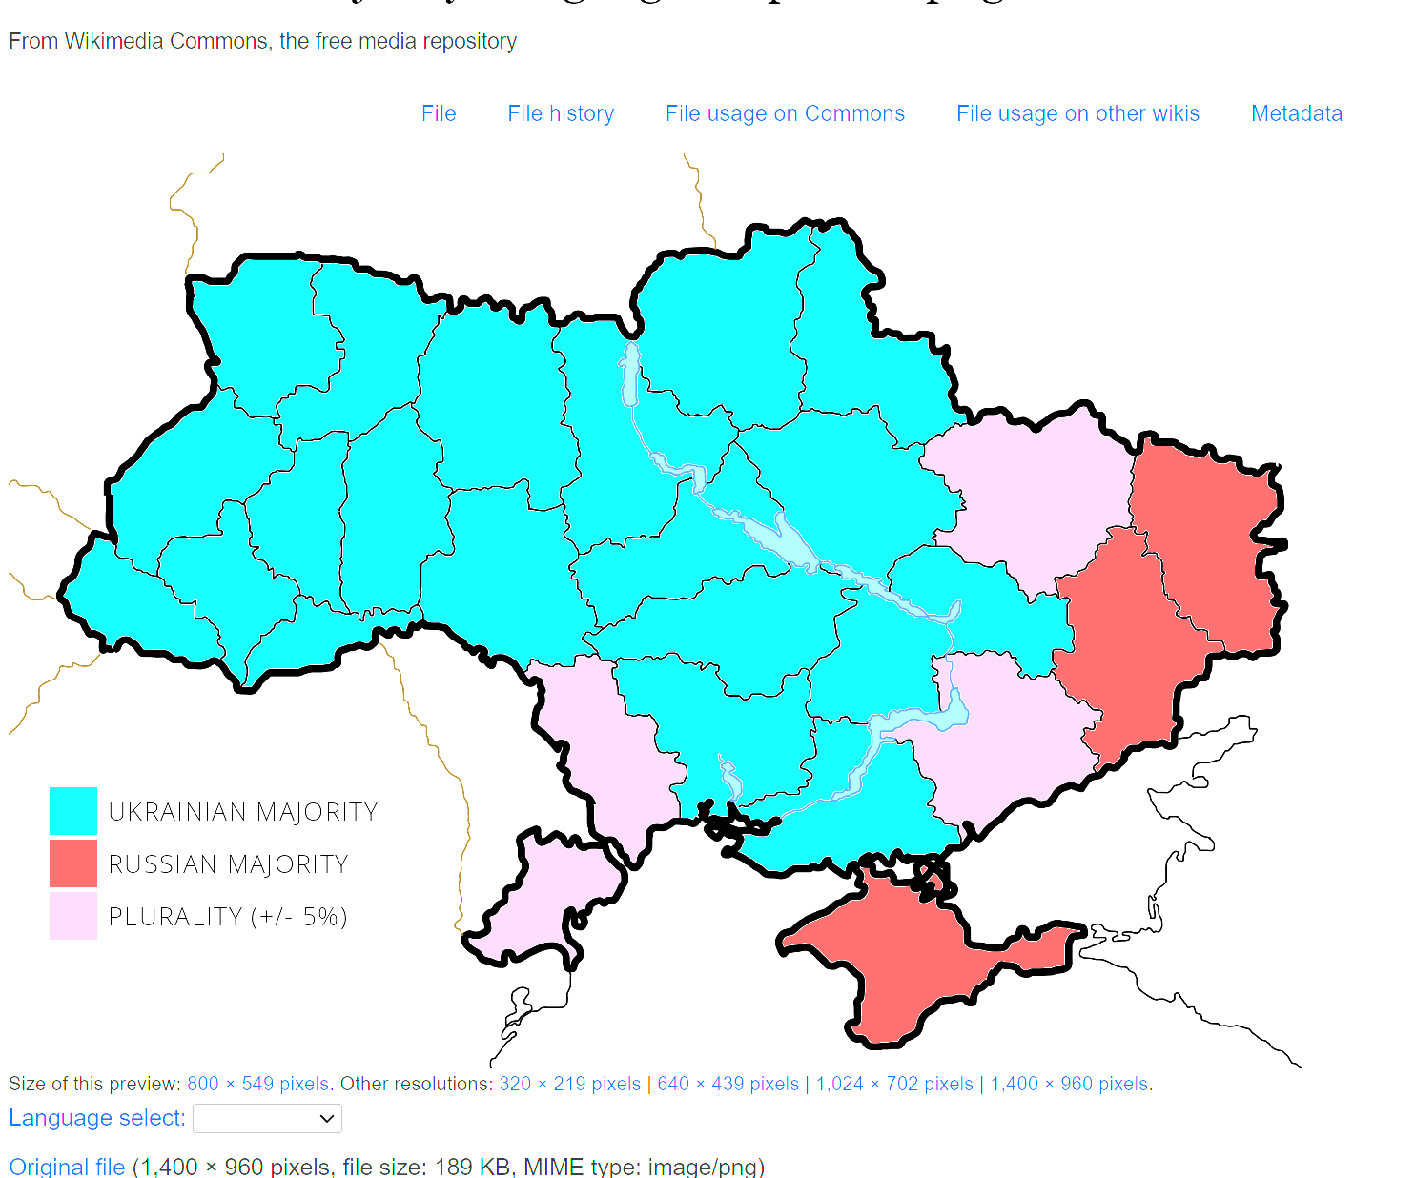
Russian –Ukrainian Population

Slide 5
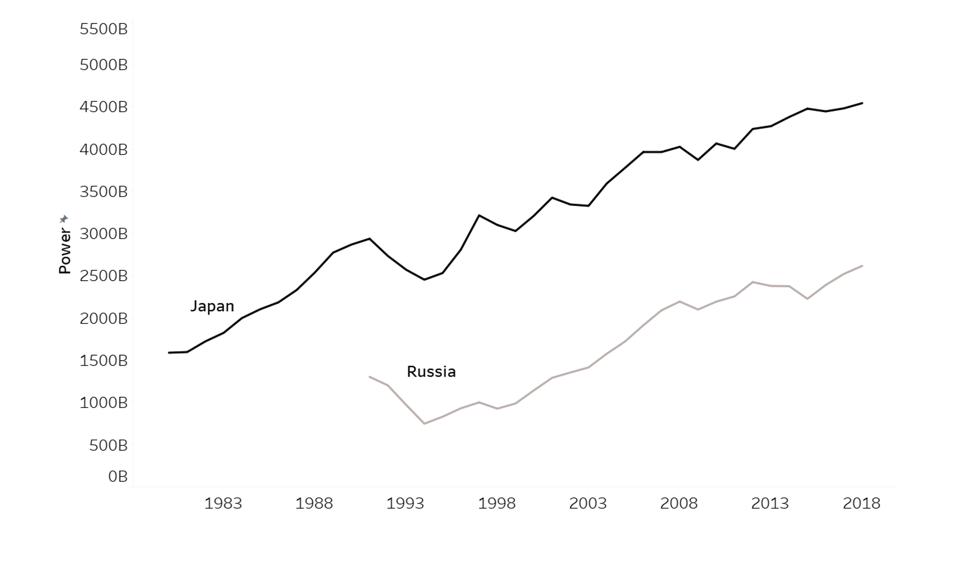
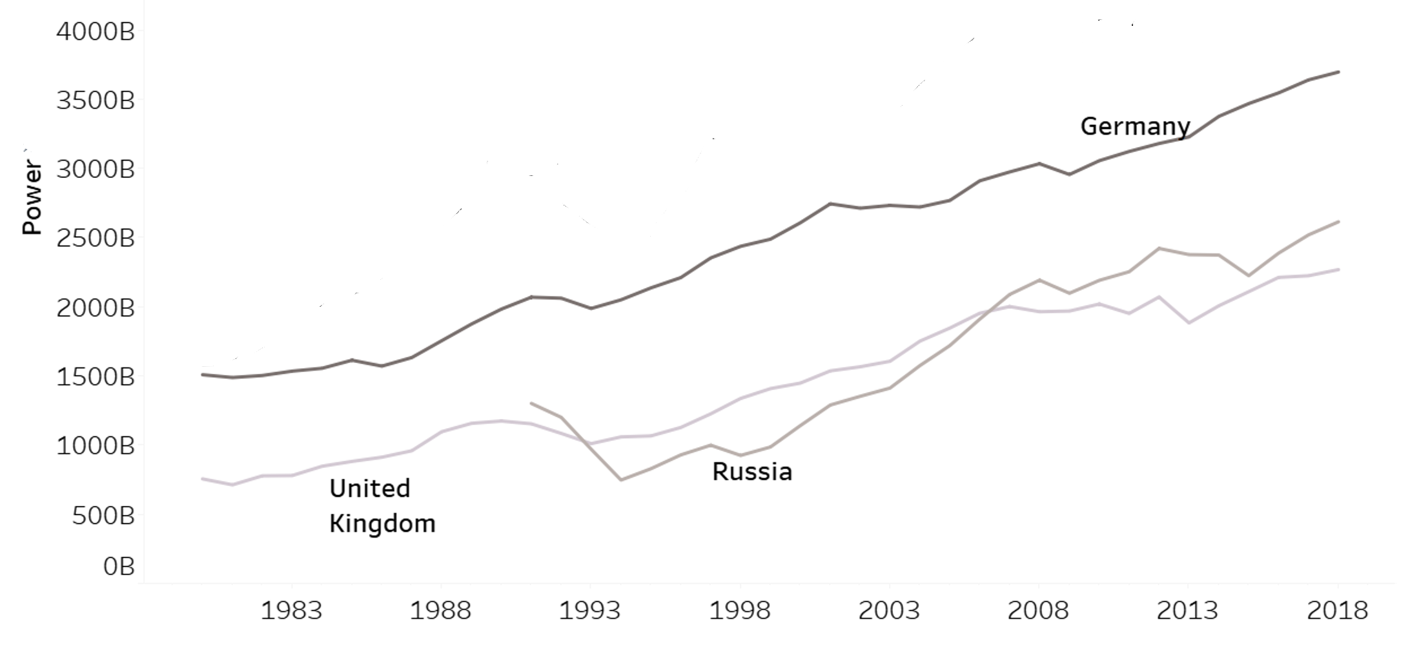
Russia Regional Standing
Russia – Germany and UK
Russia – Japan

Slide 6
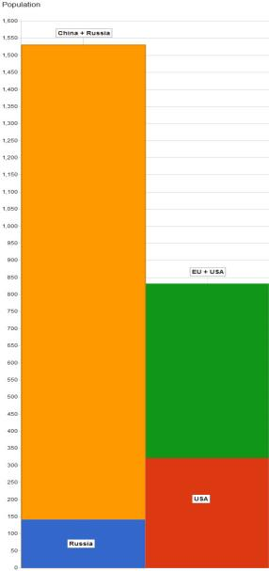
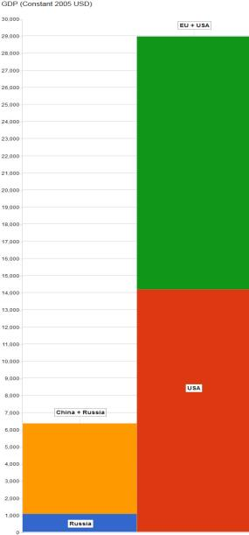
Static Comparison
Notes:
Details on the distribution of populations GDP and GDP per capita that will likely follow from Putin’s action. Affluent move away from the poor generating potential dissatisfaction and creating pre-conditions for confrontation. Dissatisfied seek to expand thus Russia as the junior partner to China at risk of absorbtion.

