Slide 1
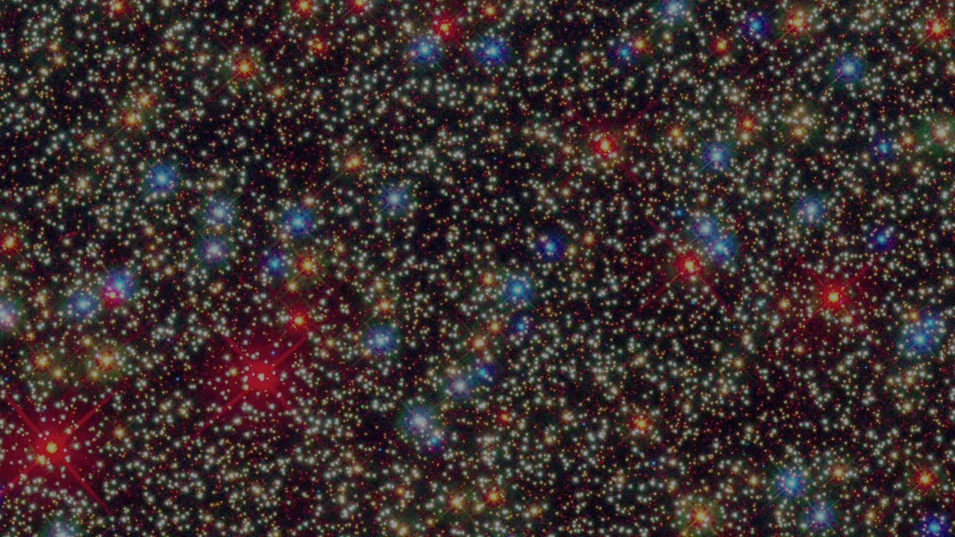
The rise and fall of a tribal species:
Why America and its universities are malfunctioning
Jonathan Haidt
NYU—Stern School of Business

Slide 2
The brain is a belief engine. From sensory data flowing in through the senses the brain naturally begins to look for and find patterns, and then infuses those patterns with meaning. …
Once beliefs are formed the brain begins to look for and find confirmatory evidence in support of those beliefs, which adds an emotional boost of further confidence in the beliefs and thereby accelerates the process of reinforcing them, and round and round the process goes in a positive feedback loop of belief confirmation.

Slide 3
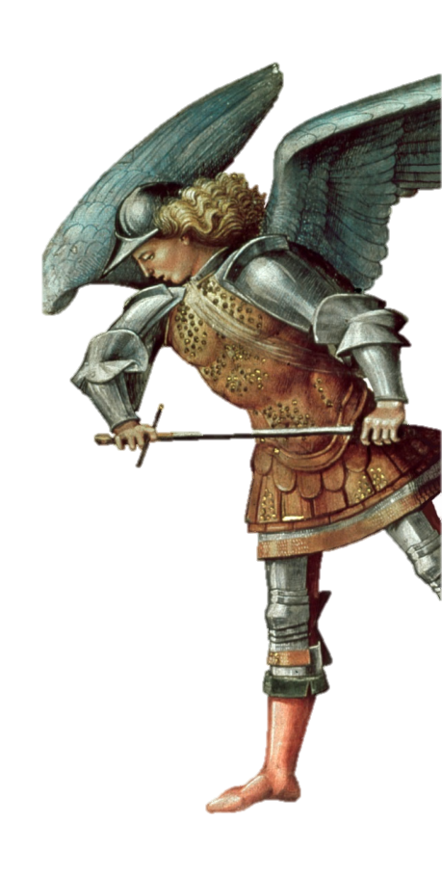
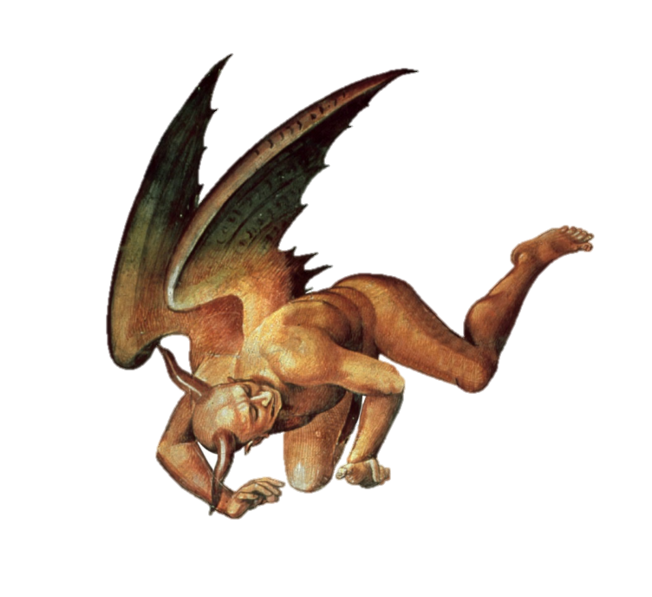
America’s Escalating Outrage
I) Things Fall Apart
II) Moral Psychology and our Polarized Nation
A) Intuitions come first
B) There are many foundations of morality
C) Morality binds and blinds
III) The Polarized Campus
IV) What YOU Can Do

Slide 4
America’s Escalating Outrage
I) Things Fall Apart
II) Moral Psychology and our Polarized Nation
A) Intuitions come first
B) There are many foundations of morality
C) Morality binds and blinds
III) The Polarized Campus
IV) What YOU Can Do

Slide 5
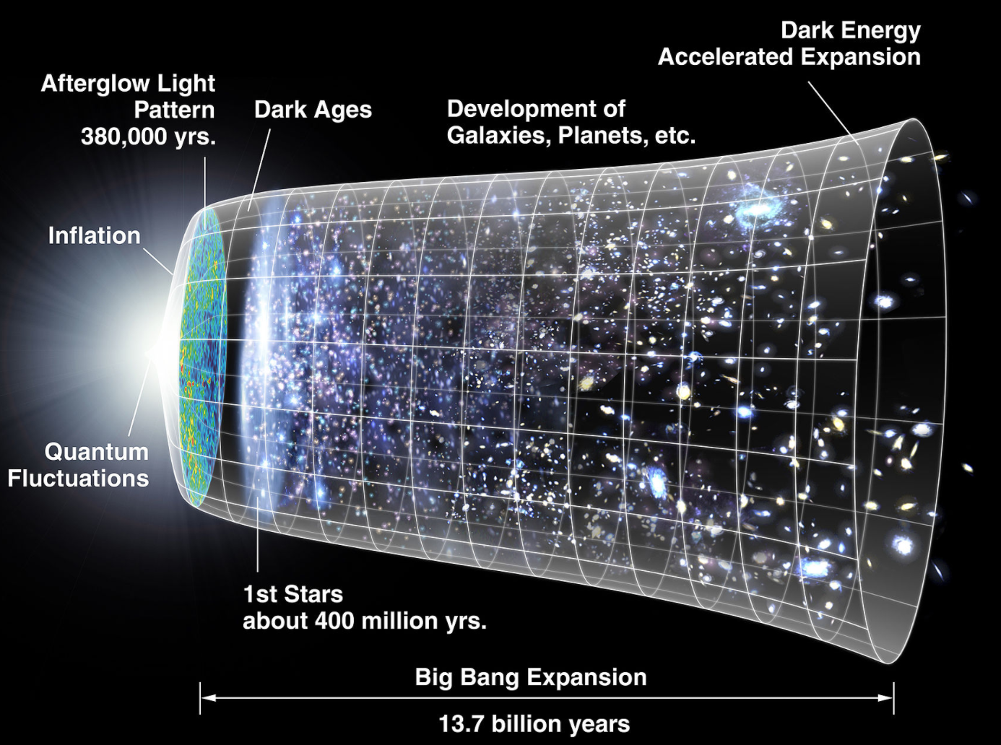

Slide 6
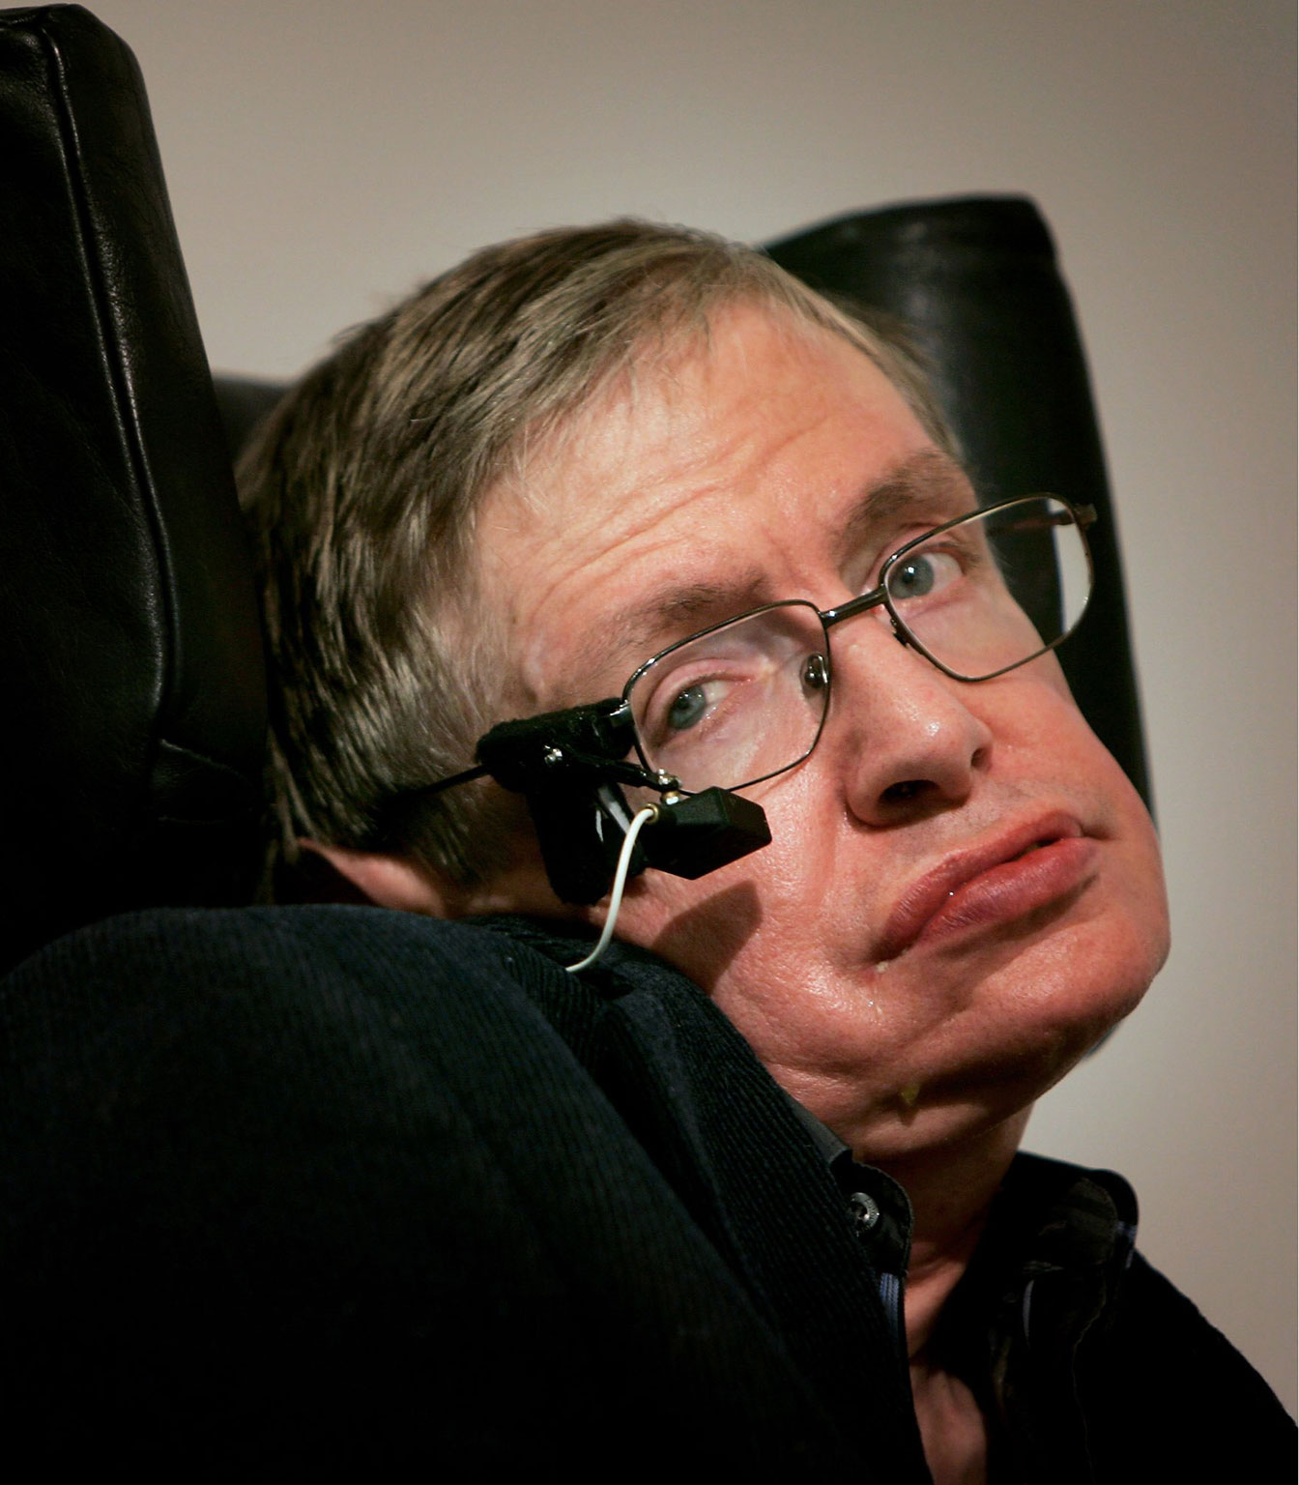
The Fine Tuned Universe
"The laws of science… contain many fundamental numbers, like the size of the electric charge of the electron and the ratio of the masses of the proton and the electron...
The remarkable fact is that the values of these numbers seem to have been very finely adjusted to make possible the development of life.”
--Stephen Hawking

Slide 7
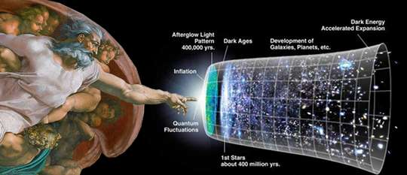

Slide 8
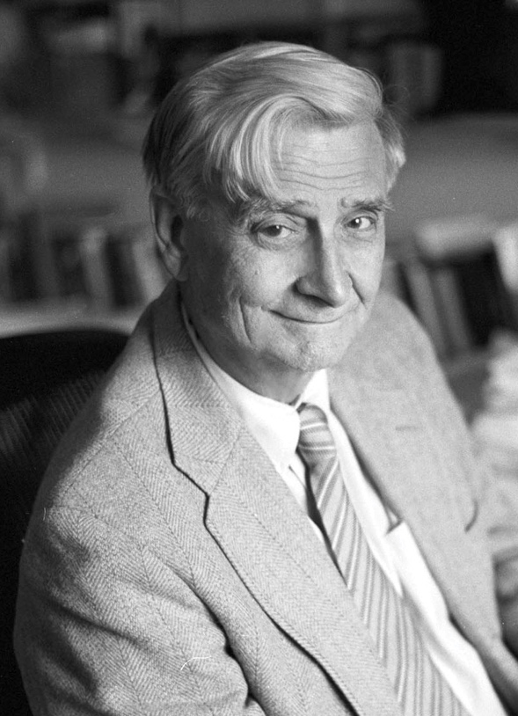
The Fine-Tuned Liberal Democracy
Humans are tribal primates evolved for life in small fission-fusion societies with intense animistic religion and violent intergroup conflict.
We are unsuited for life in large diverse secular societies, unless you get certain settings “finely adjusted to make possible the development of stable political life.”
E. O. Wilson

Slide 9
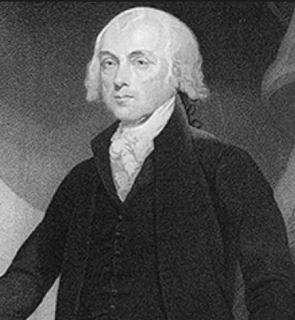
The Fine-Tuned Liberal Democracy
“A common passion or interest will… be felt by a majority of the whole… and there is nothing to check the inducements to sacrifice the weaker party or an obnoxious individual.
Hence it is that such democracies have ever been spectacles of turbulence and contention… and have in general been as short in their lives as they have been violent in their deaths."
James Madison,
Federalist 10

Slide 10
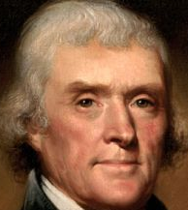
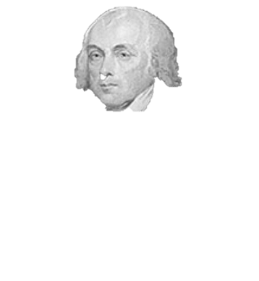
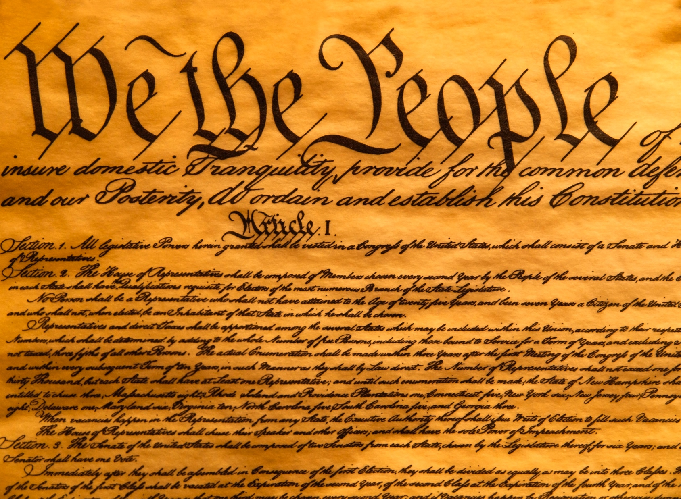

Slide 11
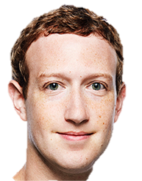


Slide 12
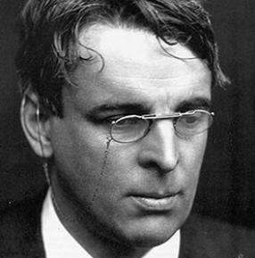
W. B. Yeats: The Second Coming
Turning and turning in the widening gyre
The falcon cannot hear the falconer;
Things fall apart; the centre cannot hold;
Mere anarchy is loosed upon the world,
The blood-dimmed tide is loosed, and everywhere
The ceremony of innocence is drowned;
The best lack all conviction, while the worst
Are full of passionate intensity.
Notes:
https://en.wikipedia.org/wiki/The_Second_Coming_(poem) The poem was written in 1919 in the aftermath of the First World War[3] and the beginning of the Irish War of Independence that followed the Easter Rising, Yeats incorporates his ideas on the gyre—a historical cycle of about 2,000 years. He first published this idea in his writing 'a vision' which predicted the expected anarchy that would be released around 2,000 years after the birth of Christ. The gyre suggests the image of a world spinning outward so that it cannot recall its own origin. These anxieties are closely tied to the traumas of a continent at war, and the rise of industrialism and militarism on a global scale.
The concluding lines refer to Yeats's belief that history was cyclical, and that his age represented the end of the cycle that began with the rise of Christianity; according to one interpretation, "the beast" referred to the traditional ruling classes of Europe who were unable to protect the traditional culture of Europe from materialistic mass movements:

Slide 14
America’s Escalating Outrage
I) Things Fall Apart
II) Moral Psychology and our Polarized Nation
A) Intuitions come first
B) There are many foundations of morality
C) Morality binds and blinds
III) The Polarized Campus
IV) What YOU Can Do

Slide 15
America’s Escalating Outrage
I) Things Fall Apart
II) Moral Psychology and our Polarized Nation
A) Intuitions come first
B) There are many foundations of morality
C) Morality binds and blinds
III) The Polarized Campus
IV) What YOU Can Do

Slide 16
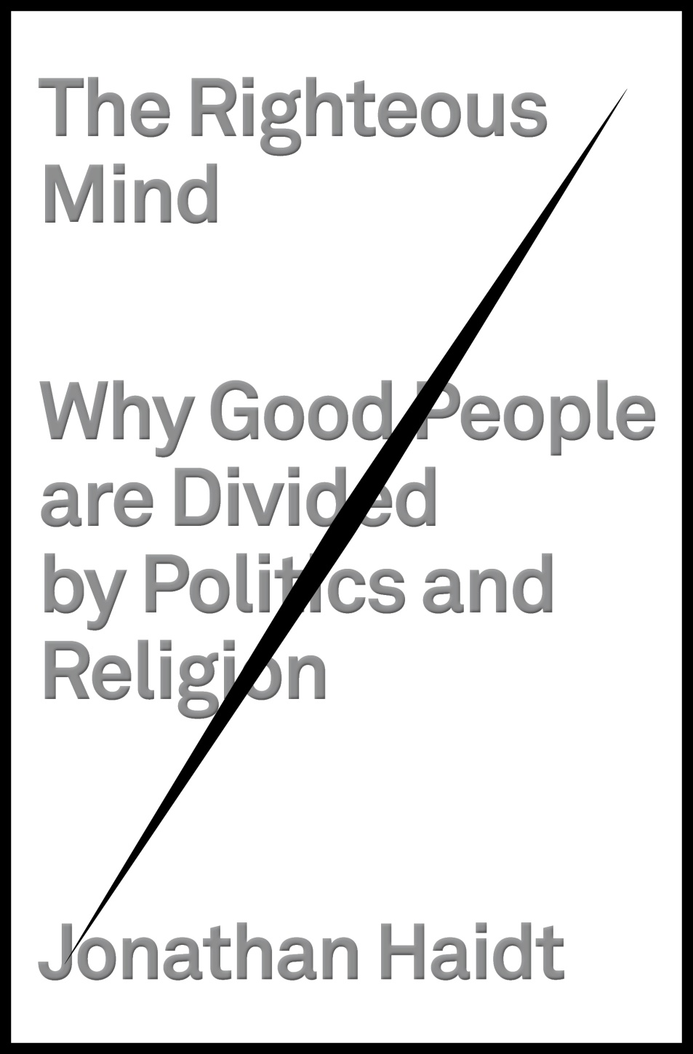
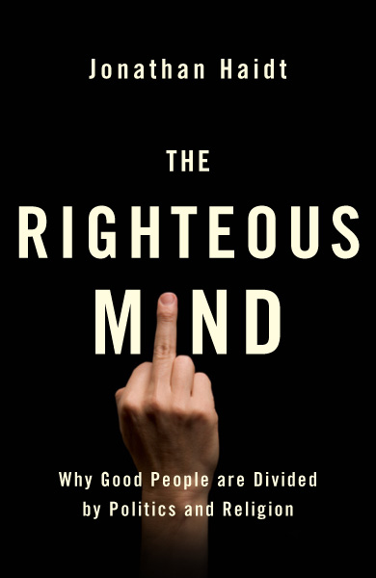
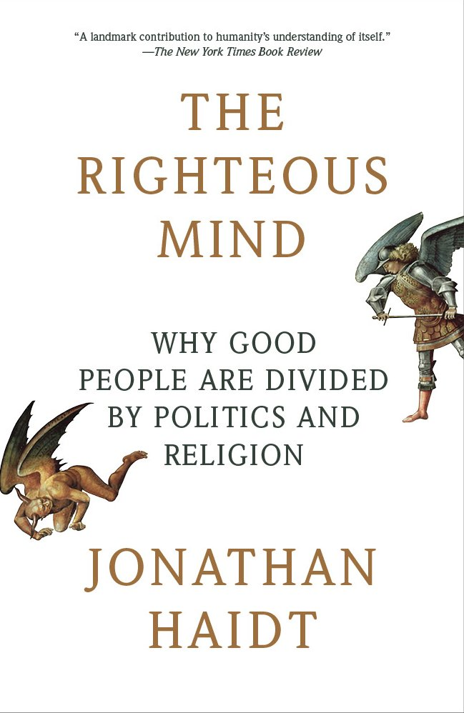

Slide 17
America’s Escalating Outrage
I) Things Fall Apart
II) Moral Psychology and our Polarized Nation
A) Intuitions come first
B) There are many foundations of morality
C) Morality binds and blinds
III) The Polarized Campus
IV) What YOU Can Do

Slide 18
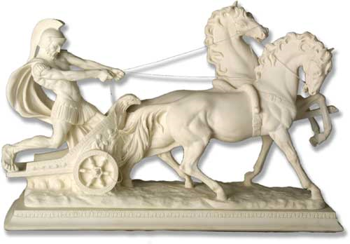
Plato: Reason is the Master
Reason can and should rule over
the passions

Slide 19
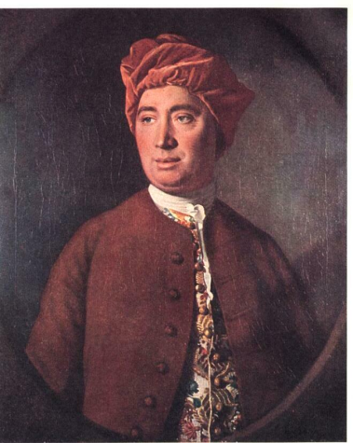

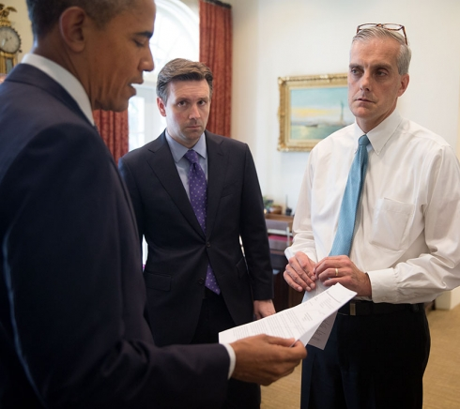
Hume: Reason is the servant
“Reason is, and ought only to be the slave of the passions, and can never pretend to any other office than to serve and obey them.”

Slide 20
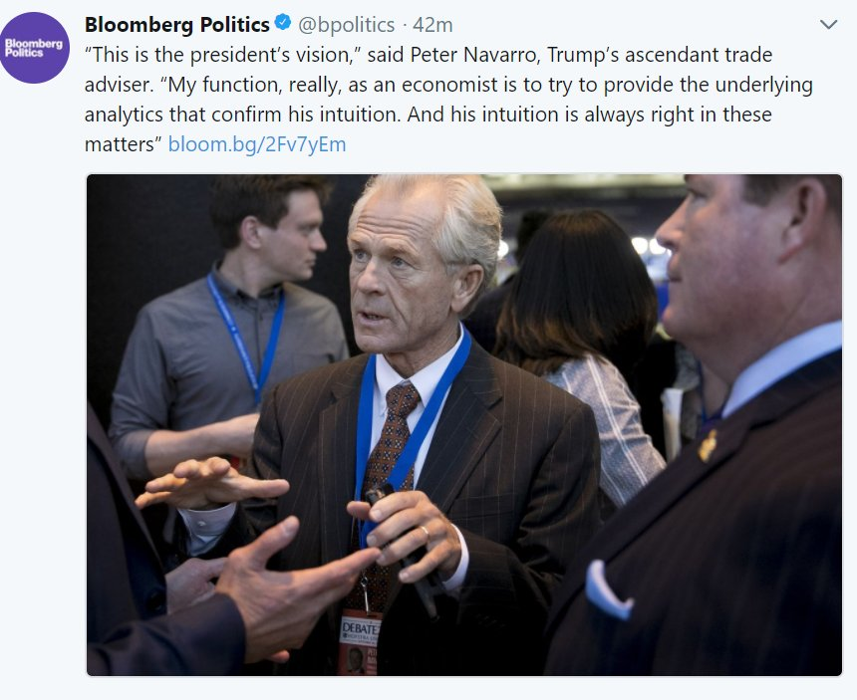
March 7, 2018
Notes:
https://www.bloomberg.com/news/articles/2018-03-08/after-defeating-cohn-trump-s-trade-warrior-is-on-the-rise-again
I’m here to

Slide 21
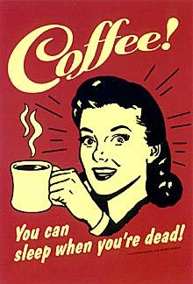

Motivated Reasoning
If we WANT to believe X, we ask: “Can-I-Believe-It?”
If we DON’T want to, we ask: “Must-I-Believe-It?”
--Gilovich (1991)
Balcetis & Dunning (2006)
Kunda (1987)
Origin of many ethical problems: “Can I believe that this is OK?”

Slide 22
Implications for Liberal Democracies
1) As passions rise on both sides, so does motivated reasoning, which is receptive to “post truth politics”
2) Social media amplifies everything; motivated reasoning on steroids; fake news
3) Leads to “trust spiral” – declining trust makes democracies throughout the world dysfunctional

Slide 23
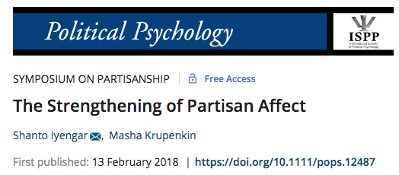
We find that while partisan animus began to rise in the 1980s, it has grown dramatically over the past two decades. As partisan affect has intensified, it is also more structured; ingroup favoritism is increasingly associated with outgroup animus. Finally, hostility toward the opposing party has eclipsed positive affect for ones' own party as a motive for political participation.

Slide 24
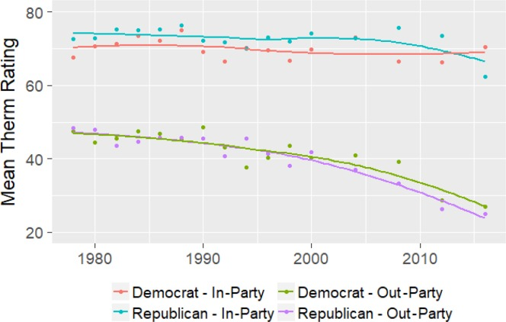
Feeling thermometers for parties
ANES data
Graphed by
Iyengar & Krupenkin
(2018)

Slide 25
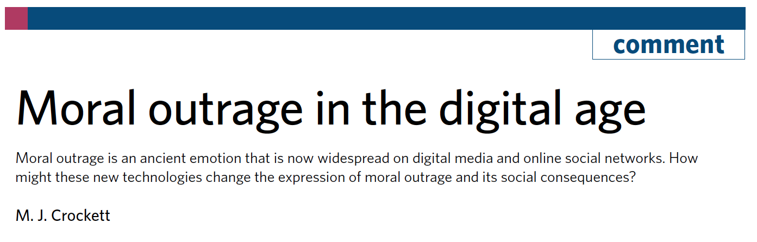
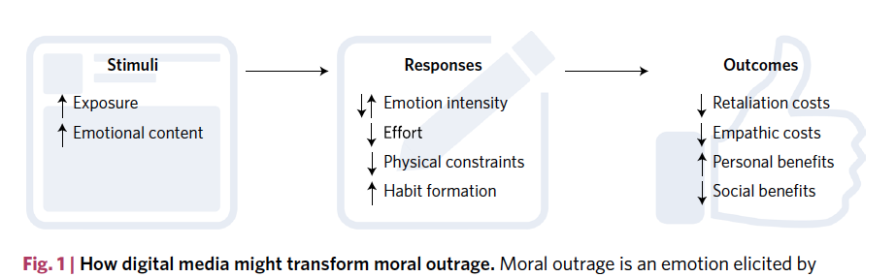

Slide 27
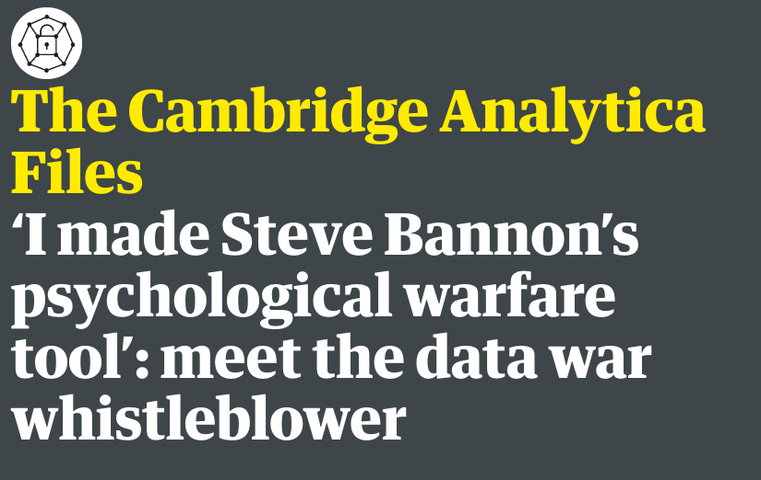
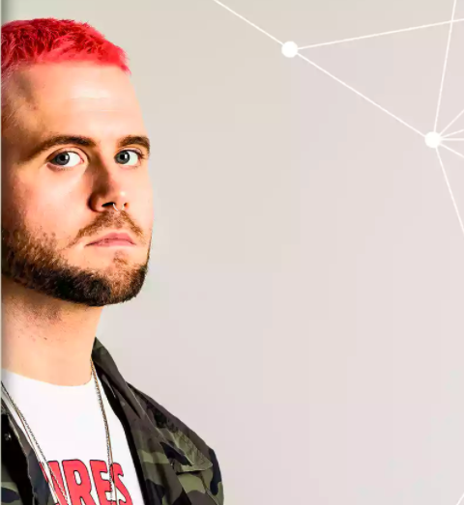

Slide 28

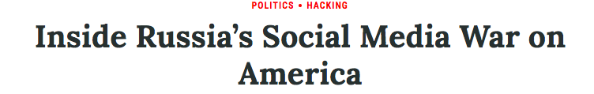
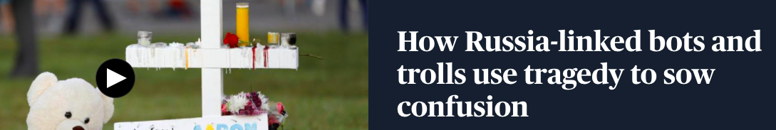

Slide 29
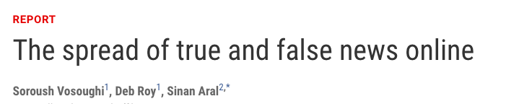

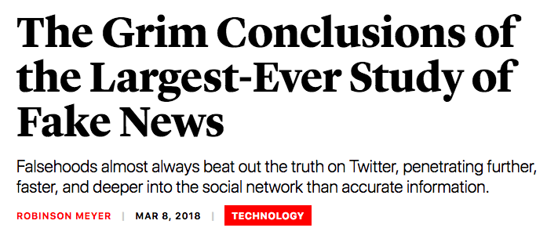

Slide 30

“Moreover, the scholars found, the spread of false information is essentially not due to bots that are programmed to disseminate inaccurate stories. Instead, false news speeds faster around Twitter due to people retweeting inaccurate news items.
‘When we removed all of the bots in our dataset, [the] differences between the spread of false and true news stood,’ says Soroush Vosoughi, a co-author of the new paper.”
Notes:
http://news.mit.edu/2018/study-twitter-false-news-travels-faster-true-stories-0308

Slide 31
America’s Escalating Outrage
I) Things Fall Apart
II) Moral Psychology and our Polarized Nation
A) Intuitions come first
B) There are many foundations of morality
C) Morality binds and blinds
III) The Polarized Campus
IV) What YOU Can Do

Slide 32
America’s Escalating Outrage
I) Things Fall Apart
II) Moral Psychology and our Polarized Nation
A) Intuitions come first
B) There are many foundations of morality
C) Morality binds and blinds
III) The Polarized Campus
IV) What YOU Can Do

Slide 33
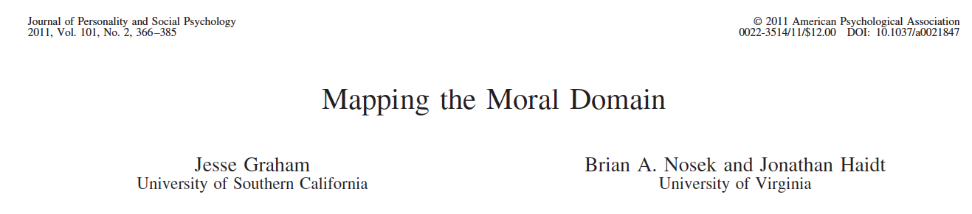
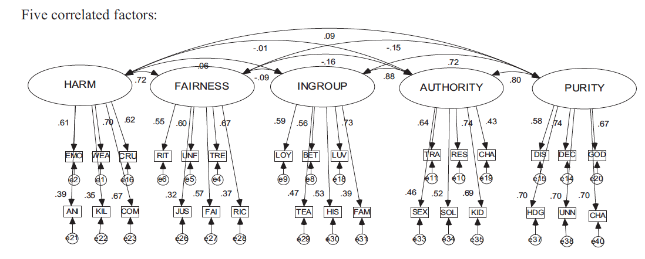
Moral Foundations Theory

Slide 34
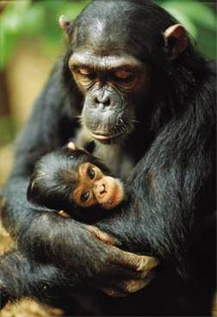
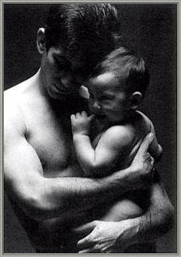
1. Care/harm

Slide 35
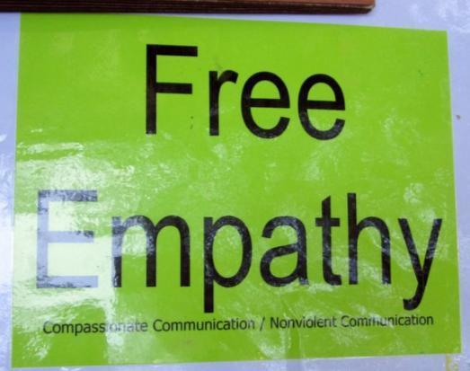
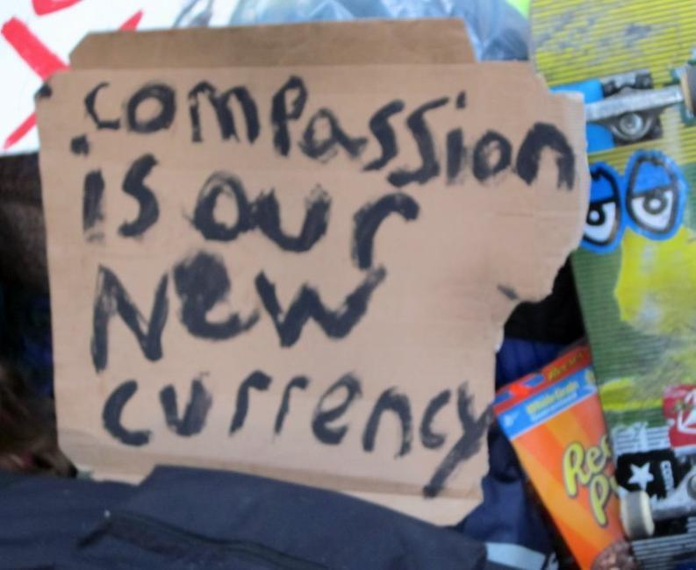
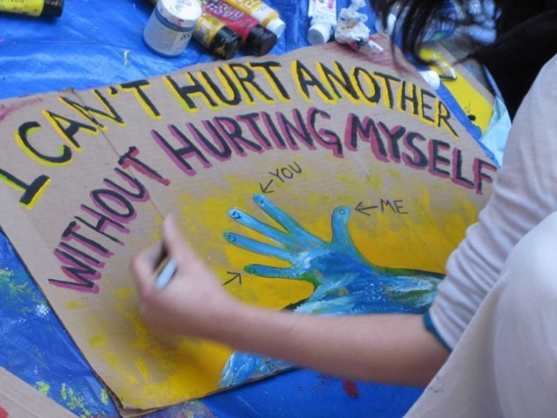
Care & Compassion are big at leftist events

Slide 36
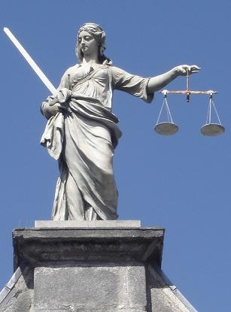
2. Fairness/cheating

Slide 37
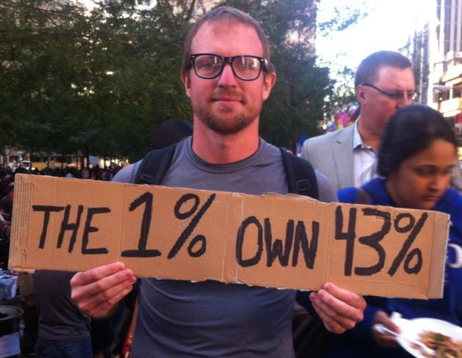
The left often sees fairness as equality

Slide 38
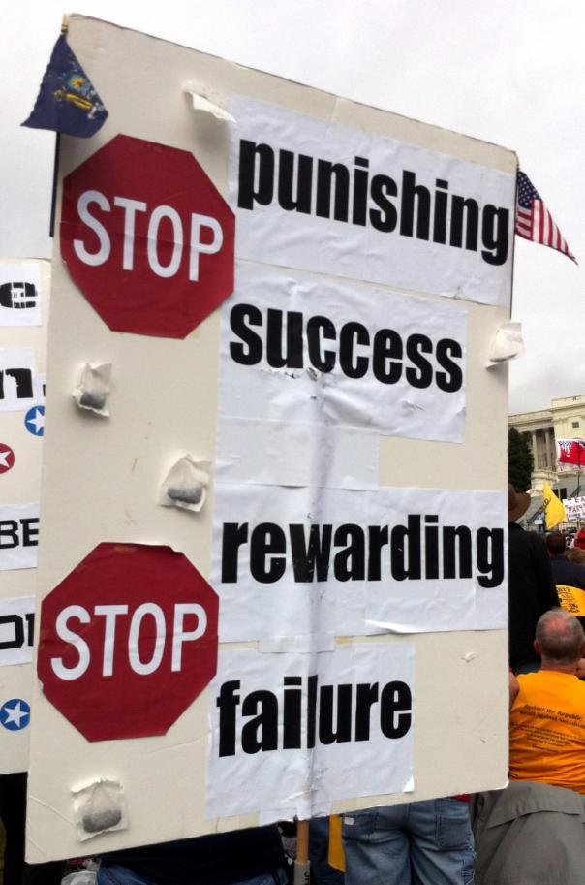
The right sees fairness as proportionality
No free riders, slackers, cheaters.
The law of Karma
Notes:
Photo by emily ekins, used with permission

Slide 39
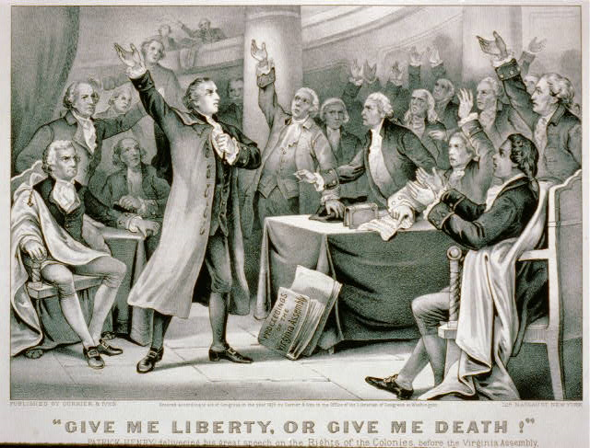
3. Liberty/oppression

Slide 40
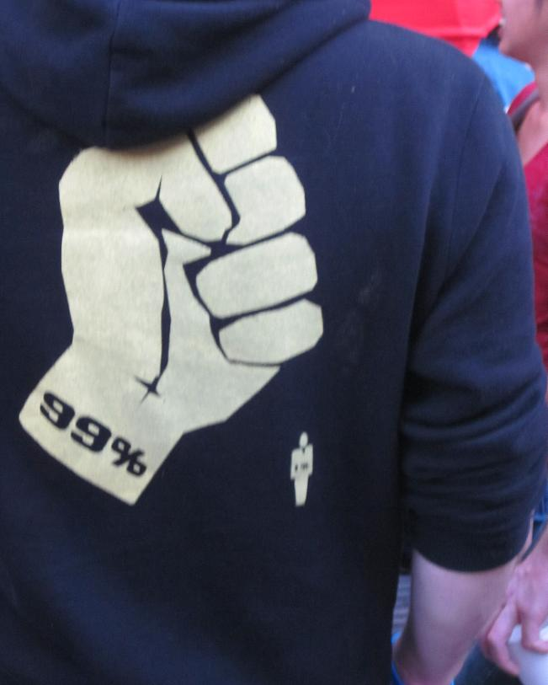

3. Liberty/oppression
On the left: the 1% and corporations are the oppressor

Slide 41
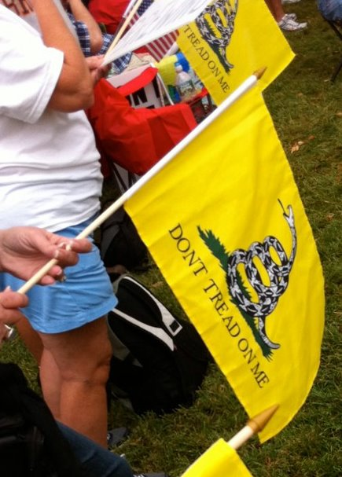
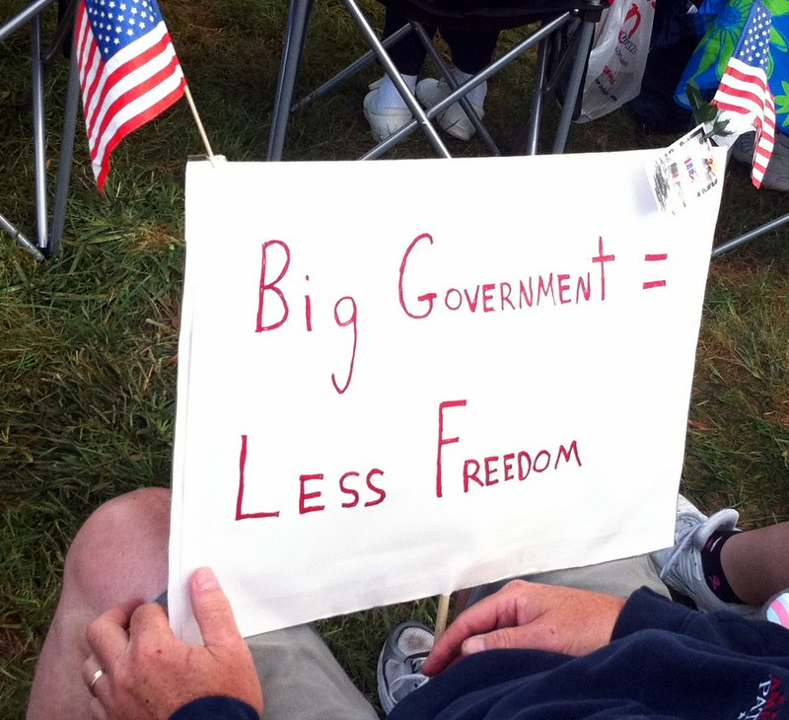
On the right: Govt. is the bully, oppressor
Constraint triggers reactance: angry resistance

Slide 42
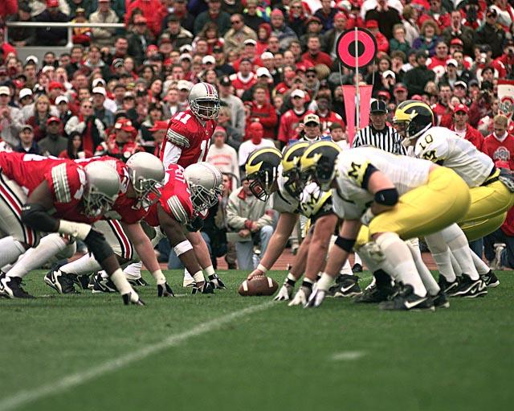
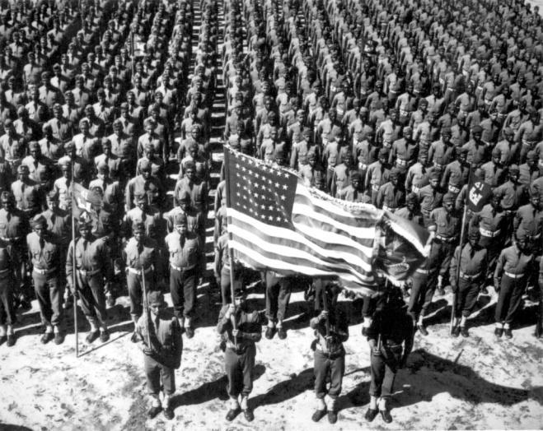
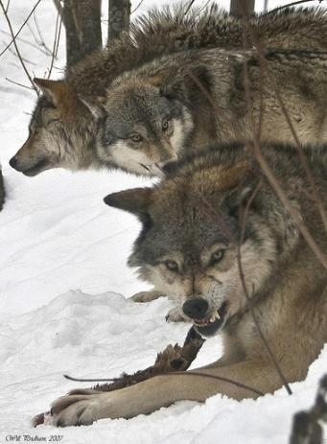
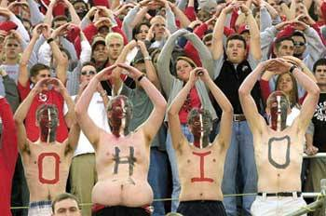
4. Loyalty/betrayal

Slide 43
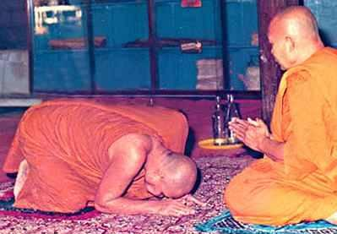

5. Authority/subversion

Slide 44

5. Authority/subversion

Slide 45

5. Authority/subversion

Slide 46




6. Sanctity/degradation

Slide 47


Slide 48

The Left-Right Divide
Care
Fairness (proportionality)
Liberty (economic)
Authority
Loyalty
Sanctity
n=3,764
YourMorals.org

Slide 49
Implications for Liberal Democracies
1) Left and right build appeals on different moral foundations, then talk past each other.
2) Left builds on care, and fairness (as equality). Right builds on fairness as proportionality, and also on loyalty, authority, sanctity foundations.
3) Leads to endless divisions and misunderstandings on immigration, sexuality, gender, race, flag….

Slide 50



Slide 51

(Basket of 10 items asked since 1994, also includes:
Govt, Environmental reg, homosexuality, and “peace through strength”)
Notes:
http://www.people-press.org/2017/10/05/1-partisan-divides-over-political-values-widen/

Slide 52

Pew, 2017:
Avg. diff On basket Of 10 attitude items

Slide 53
Pew, 2017:
Avg. diff On basket Of 10 attitude items

Slide 54
“Moreover, the scholars found, the spread of false information is essentially not due to bots that are programmed to disseminate inaccurate stories. Instead, false news speeds faster around Twitter due to people retweeting inaccurate news items.
‘When we removed all of the bots in our dataset, [the] differences between the spread of false and true news stood,’ says Soroush Vosoughi, a co-author of the new paper.”
Notes:
http://news.mit.edu/2018/study-twitter-false-news-travels-faster-true-stories-0308

Slide 55
America’s Escalating Outrage
I) Things Fall Apart
II) Moral Psychology and our Polarized Nation
A) Intuitions come first
B) There are many foundations of morality
C) Morality binds and blinds
III) The Polarized Campus
IV) What YOU Can Do

Slide 56
America’s Escalating Outrage
I) Things Fall Apart
II) Moral Psychology and our Polarized Nation
A) Intuitions come first
B) There are many foundations of morality
C) Morality binds and blinds
III) The Polarized Campus
IV) What YOU Can Do

Slide 57


Large scale cooperation is rare
Large scale cooperation
Image: Mark Osgatharp
Image: J. Brew

Slide 58


Large scale cooperation

Slide 59


We circle around sacred objects & principles

Slide 60

We circle around sacred objects & principles

Slide 61

We circle around sacred objects & principles

Slide 62

We circle around sacred objects & principles

Slide 63


Circling around shared values creates a moral electromagnet

Slide 64


Implications for Liberal Democracies
Our politics is becoming more tribal, more passionate, more dangerous, more like (fundamentalist) religion…

Slide 65

Implications for Liberal Democracies

Slide 66

Why is this happening? And why now?

Slide 67
1) Party realignment and purification, 1964-1992
2) Mass sorting of lib vs. con voters, by 1990s
3) Changes in Congress, 1995—death of friendships
4) Media fractionation (1980s) then Internet (1990s)
5) Residential homogeneity, urban v. rural, 1990s
6) End of the cold war, loss of common enemy, 1990s
7) Increasing immigration and racial diversity, 1990s
8) Increasing role of money, negative advertising, 2000s
9) Generational changing of the guard, 1990s
10) Increasing education, since 1970s

Slide 68

The existential threat to the American Experiment:
The forces holding us together are weakening;
the forces pulling us apart are strengthening

Slide 69

Be very alarmed.
Don’t take our democracy for granted.
America could be a sinking ship.
Now might be a good time to take time out from the culture war and try to save the ship

Slide 70
America’s Escalating Outrage
I) Things Fall Apart
II) Moral Psychology and our Polarized Nation
A) Intuitions come first
B) There are many foundations of morality
C) Morality binds and blinds
III) The Polarized Campus
IV) What YOU Can Do

Slide 71
America’s Escalating Outrage
I) Things Fall Apart
II) Moral Psychology and our Polarized Nation
A) Intuitions come first
B) There are many foundations of morality
C) Morality binds and blinds
III) The Polarized Campus
IV) What YOU Can Do

Slide 72

Political purification of the faculty
2:1 in
1996
5:1 by
2011
Data from HERI

Slide 73

Ratio of lib:con psychology professors
Langbert et al. 2016, 17:1
Duarte, Crawford, Stern, Haidt, Jussim & Tetlock (2015)
14:1 by
2012
4:1 in
1996

Slide 74





Slide 75

2017
Notes:
https://www.wsj.com/articles/college-facultys-new-focus-dont-offend-1488200404?elqTrackId=61eba7b9e2a64667baa9b35128af8412&elq=eb4a89fe51434a85940b2645d599f7f5&elqaid=12760&elqat=1&elqCampaignId=5232

Slide 76

Notes:
https://www.nytimes.com/2017/10/31/education/edlife/liberal-teaching-amid-partisan-divide.html

Slide 77

2016

Slide 78
During my first days at Smith, I witnessed countless conversations that consisted of one person telling the other that their opinion was wrong. The word “offensive” was almost always included in the reasoning. Within a few short weeks, members of my freshman class had quickly assimilated to this new way of non-thinking. They could soon detect a politically incorrect view and call the person out on their “mistake.” I began to voice my opinion less often to avoid being berated and judged by a community that claims to represent the free expression of ideas. I learned, along with every other student, to walk on eggshells for fear that I may say something “offensive.” That is the social norm here.

Slide 79


Slide 80



Slide 81


Slide 82



2012
This is a very precarious time for higher education!
2013

Slide 83


Slide 84
Be very alarmed.
Don’t take our universities for granted
American higher ed could be a sinking ship
Now might be a good time to take time out from the culture war and try to save the ship

