Slide 1
UUCF Summer RE 2011
Brain Glitches
Session 1: Confirmation Bias

Slide 2
Bias

Slide 3
What does “bias” mean?
Bias originally referred to a slanted or oblique line.
Bias is an inclination to present or hold a partial perspective at the expense of (possibly equally valid) alternatives
(easier) An inclination (often against), a partiality, a prejudice.

Slide 4
Cognitive Bias
A cognitive bias is the human tendency to make systematic errors in certain circumstances based on cognitive factors rather than evidence.
(Easier) A bias resulting from the way our brain works, instead of other factors.
(Easier still) A Brain Glitch

Slide 5
Decision making
What we really ought to do
What people usually do
Think through all the evidence
Use logic
Ignore irrelevant information
Pay attention
Sort out the meaningful patterns from the noise
Change our minds when there is good reason
Take mental shortcuts
Jump to conclusions
Be confused by irrelevant information
Miss important stuff
Think we see patterns everywhere
Stick to our preconceptions, even when they turn out to be wrong

Slide 6
Confirmation Bias
The tendency to seek & find confirmatory evidence for one’s beliefs, and to ignore disconfirmatory evidence
OR: “LA LA LA LA I can’t hear you!!!!”

Slide 7
Confirmation Bias
We seek out and pay attention to things that agree with what we already think.
We tune out and forget those things that disagree with us.
(Related) We remember the unusual and forget the routine.

Slide 8
Example
I am the “Rain Goddess of Camping”!
Whenever I go camping, it rains on me. It’s like the rain loves me and wants to follow me!
It works every time! (Except for that one time it didn’t, and that one doesn’t count.)

Slide 9
Another Example
My Husband’s brother Pat, when he was a teenager, said “Whenever I see another driver do something stupid, it’s always a woman! And when it’s not, he’s either black or an old guy!”

Slide 10
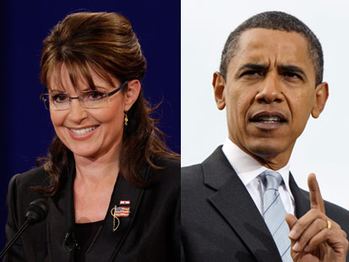
Politics
Who’s right and who’s an idiot?

Slide 11
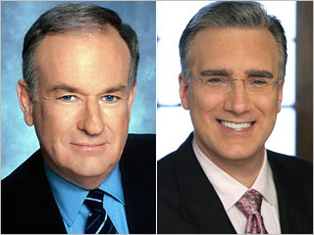
Opinion
Who’s right and who’s an idiot?

Slide 12
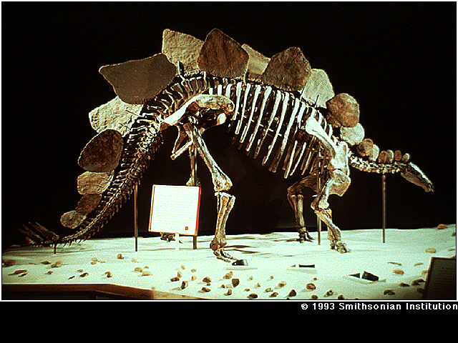
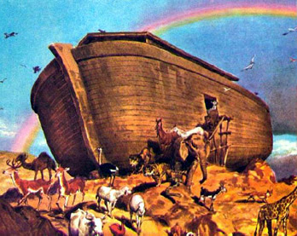
Science
Who’s right and who’s an idiot?

Slide 13
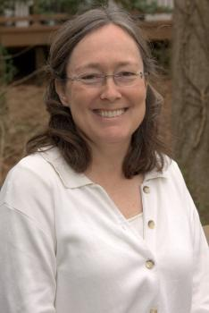
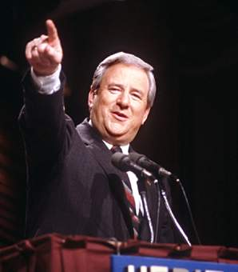
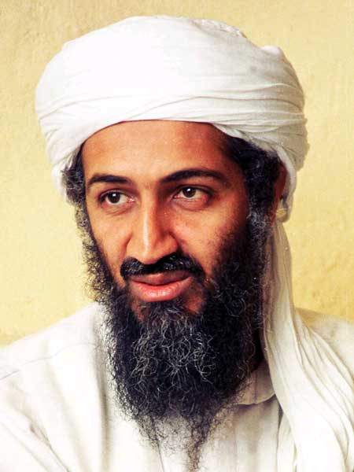
Religion
Who’s right and who’s an idiot?

Slide 14
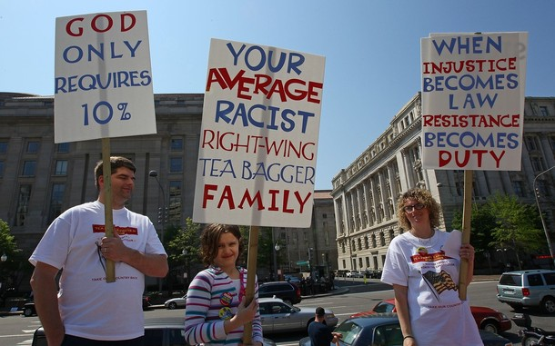
Who do they listen to?

Slide 15
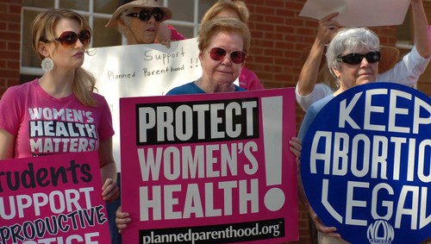
Who do they listen to?

Slide 16
Confirmation Bias
“Be careful. People like to be told what they already know. Remember that. They get uncomfortable when you tell them new things. New things…well, new things aren’t what they expect. They like to know that, say, a dog will bite a man. That is what dogs do. They don’t want to know that man bites a dog, because the world is not supposed to happen like that. In short, what people think they want is news, but what they really crave is olds…Not news but olds, telling people that what they think they already know is true.”
Terry Pratchett through the character Lord Vetinari from his novel, “The Truth: a novel of Discworld

Slide 17
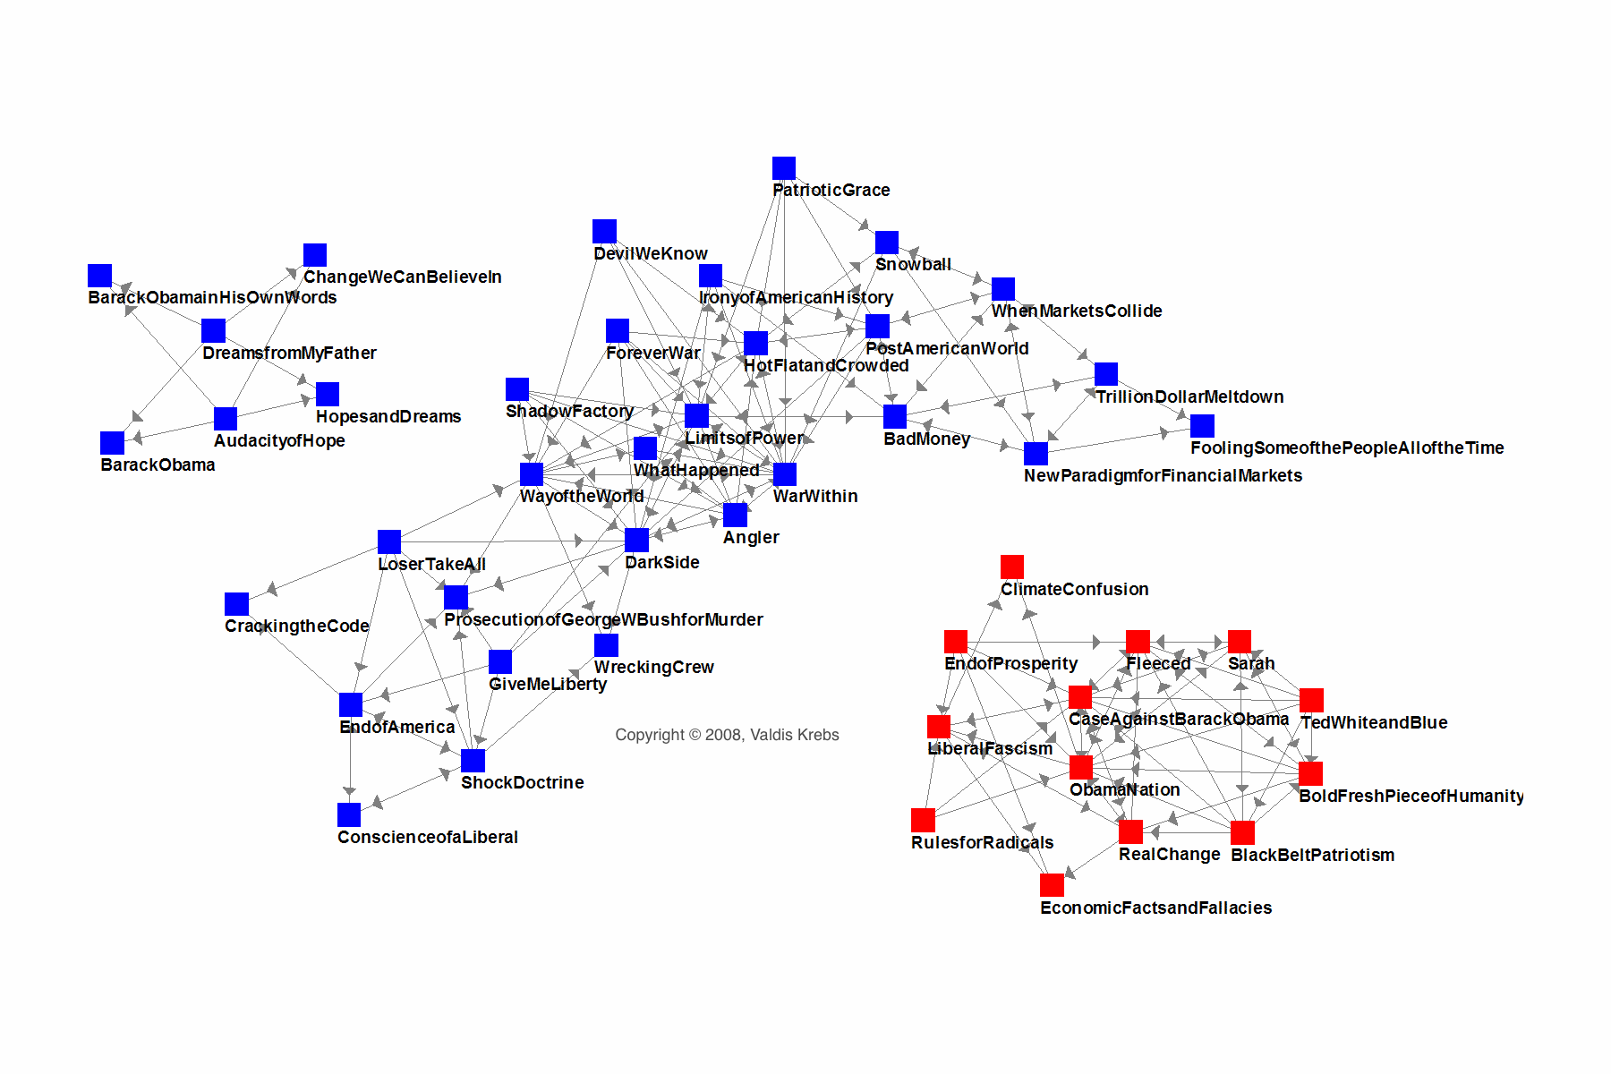
Book Buying Patterns: Amazon.com, October 2008

Slide 18
The confirmation bias game
http://hosted.xamai.ca/confbias/index.php

Slide 19
The Backfire Effect
The Misconception: When your beliefs are challenged with facts, you alter your opinions and incorporate the new information into your thinking.
The Truth: When your deepest convictions are challenged by contradictory evidence, your beliefs get stronger.

Slide 20
A recent study
In 2006, Brendan Nyhan and Jason Reifler at The University of Michigan and Georgia State University created fake newspaper articles about polarizing political issues. The articles were written in a way which would confirm a widespread misconception about certain ideas in American politics.

Slide 21
As soon as a person read a fake article, researchers then handed over a true article which corrected the first. For instance, one article suggested the United States found weapons of mass destruction in Iraq. The next said the U.S. never found them, which was the truth.

Slide 22
Those opposed to the war or who had strong liberal leanings tended to disagree with the original article and accept the second. Those who supported the war and leaned more toward the conservative camp tended to agree with the first article and strongly disagree with the second.

Slide 23
These reactions shouldn’t surprise you. What should give you pause though is how conservatives felt about the correction. After reading that there were no WMDs, they reported being even more certain than before there actually were WMDs and their original beliefs were correct.

Slide 24
Probability
When we don’t understand the probability of an event happening, we’re more likely to see it as significant.
Just because a specific event was unlikely does not mean that it’s significant or part of a pattern. Unlikely things happen all the time.

Slide 25
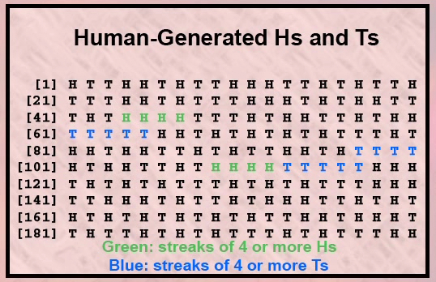
Humans trying to emulate random sequences will almost never place more than four heads (or tails) in a row.

Slide 26
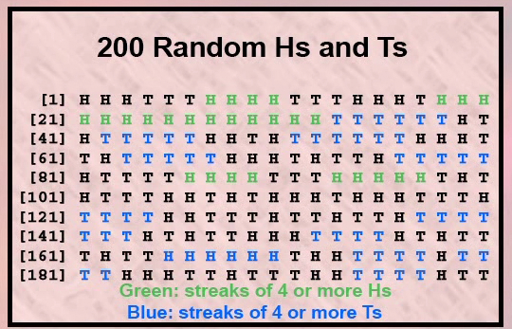
In a true random generation, the probability of at least one string of 5 or more identical outcomes is 0.999 and for a sequence of 6 it is 0.96!

Slide 27
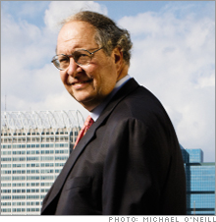

The greatest money manager of our time
What do ant colonies, novels and river systems have to do with making money? Ask Bill Miller, the man who's topped the market 15 years running.
Fortune managing editor Andy Serwer reports.
November 15 2006: 4:07 PM EST

Slide 28
“Odds of beating S&P for 13 years straight are 1 in 149,012”
“Odds of beating S&P the 14th year are 1 in 372,529”
“Greatest fund feat in past 40 years”

Slide 29
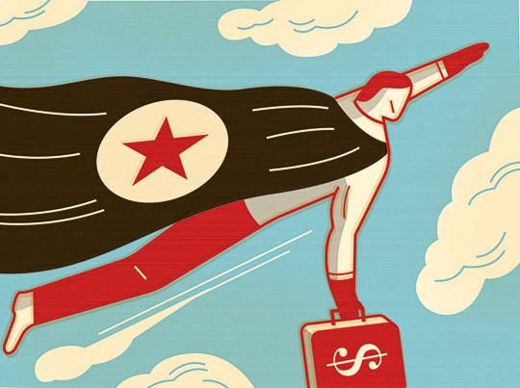
The Scientific View:
Assume random 1 in 2 chance
of beating S&P per fund manager,
each year…
Probability of
Bill Miller
beating the S&P 15 years in a row starting in 1991 = 1 in 32,768…

Slide 30
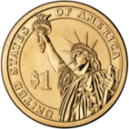
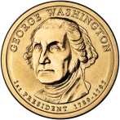
Thousands of Managers:
…
…
…
…
…
.
.
.

Slide 31
Assume random 1 in 2 chance
of beating S&P per fund manager,
each year…
Probability of Someone among all the managers beating the S&P 15 or more years in a row starting any year in the last 40 years = ???... 3/4 or .75

Slide 32
Headline should NOT be:
The greatest money manager of our time
By Andy Serwer, Fortune managing editor
November 28 2006: 10:58 AM EST
But rather…
Expected 15-year run finally occurs
Bill Miller lucky beneficiary!!
By Andy Serwer, Fortune managing editor November 28 2006: 10:58 AM EST

Slide 33
Miracles = 1 in a million odds
We see & hear things happen about 1/second
30,000 seconds in one 8-hour day
1 million events per month
Most are insignificant
We should expect about 1 miracle to happen, on average, once a month
Confirmation bias:
we remember the unusual, forget the usual

Slide 34
Death Dreams
5 dreams/day = 1,825 dreams/year
1/10 remembered dreams = 182.5/year
295 million Americans = 53.8 billion remembered dreams/year
Each of us knows about 150 people fairly well
Network grid of 44.3 billion personal relationships
Annual U.S. death rate = .008 = 2.6 million/year
Inevitable that some of those 53.8 billion remembered dreams will be about some of these 2.6 million deaths among the 295 million Americans and their 44.3 billion relationships.
It would be a miracle, in fact, if some death premonition dreams did not come true

Slide 35
Birthdays
Two people in your classroom have the same birthday. That seems like an unlikely event.
What are the odds, really?

Slide 36
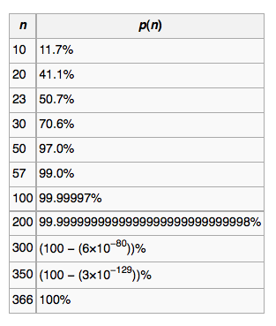

The Birthday Probability Game
The odds of
getting 2
people with
the same
birthday is
better than
50% with
only 23
people.

Slide 37
False positives
One reason we make mistakes in the first place

Slide 38
A Type I error, or a false positive, is believing a pattern is real when it is not (finding a nonexistent pattern).
A Type II error, or a false negative, is not believing a pattern is real when it is (not recognizing a real pattern).

Slide 39
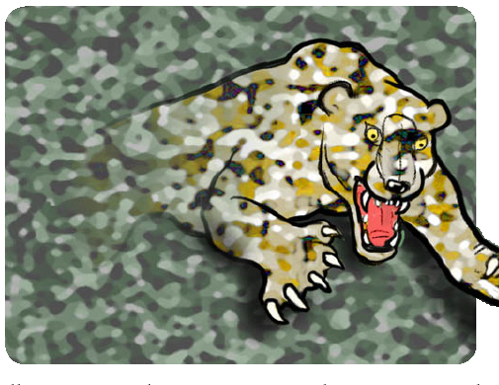
A Type I error: believe that the rustle in the grass is a dangerous predator when it is just the wind (low cost).
Rustle
Rustle
Rustle

Slide 40
A Type II error: believe that the rustle in the grass is just the wind when it is a dangerous predator (high cost).

Slide 41
Rustle in the Grass
Really I think | There’s no tiger | There’s a tiger!
Help, it’s a tiger!! Run!!! | OK, I ran away when I didn’t need to. No big. (Type I error) | Correct answer! Yay, I didn’t get eaten!
Ho, Hum, Just the wind. Don’t panic, there’s no tiger. | Correct Answer. Yawn. | RAWR! (Type II error)

Slide 42
The Downside of False Positives
Suppose that about one in a thousand people has the dreaded lethal disease creeping uvulitis, and doesn’t even know it. Suppose we have a test that is 99% accurate in diagnosing this dread ailment.
What happens if we test a whole bunch of people for the disease?

Slide 43
Creeping Uvulitis, we test 100,100 people, 100 of them are sick
Really 99% accurate Test shows | All Clear 100,000 people | Disease 100 total
Disease | 1,000 people get the bad news that they’re sick, when they’re not. (Type I error) | Correct answer! 99 people are treated and don’t die.
All Clear | Correct Answer. 99,000 people get the good news that they’re fine. | One guy is told he’s fine. He dies. (Type II error)

Slide 44
The results
100,100 people are tested with a 99% accurate test.
1,099 get results that say they are sick. 9% of these people actually are.
Understand probabilities before you jump to conclusions.

