Slide 1
Darwinian Arts and Beauty
Amanda Limongi
Notes:
This presentation is about art and aesthetics from an evolutionary standpoint. Many people think that art is simply a product of one’s culture or the time period in which they live. But while culture does have a big influence on the style or medium of the art, I’m trying to argue that the desire to create, and the pleasure we derive from experiencing art, is part of our nature and can be explained scientifically through evolution.

Slide 2
Universal Signatures
Expertise
Non-utilitarian Pleasure
Style
Criticism
Imitation
Special Focus
Imagination
Dutton, 2000
Notes:
In order to make this claim, we have to show that there are characteristics of art that span over cultures and throughout history. An evolutionary psychologist named Denis Dutton put together a list of what he calls “Universal Signatures” that apply to art of all kinds.
1. Expertise- The making or performing of the piece should require a certain technical or artistic skill that is hard to imitate or fake.
2. Non-Utilitarian Pleasure- Works of art typically don’t have practical use. We enjoy art for art’s sake.
3. Style- This is where culture has the biggest influence- Art forms are made in some recognizable style according to rules of form and composition. This style can come from the artist’s culture or family, or can be an invention of his own.
4, Criticism- Simply by existing, a work or art is giving itself up to be criticized or praised. People make a point of appreciating and interpreting works of art.
5. Imitation- Art objects represent or imitate, or are at least inspired by some aspect of the real world- we take pleasure both in what the artist is representing, and how well it’s presented.
6. Special focus- Work is sort of set apart from real life- like the ornate frames in museums or spotlights and curtains on a stage, works of art should command special focus. it should be obvious that the work is not another mundane, everyday detail.
7. Imagination- The last, which he thinks is most important, is the imaginative experience for both the artist and audience member.

Slide 3
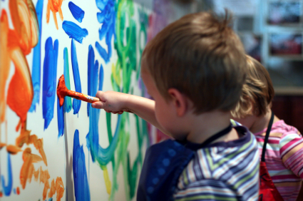
Art as an Adaptation
Cross-Cultural Existence
Ancestry
Young Children
Sources of Pleasure
Costly
Notes:
So if there is art that fits this criteria in every known culture in history, there has to be a reason human beings first started creating art, and a reason we continue to. There are a few theories that try to explain this, the first and main one being that art is an evolved adaptation.
This theory suggests that art came about as an adaptation that aided in survival of our ancestors. Evidence includes:
Cross cultural- Art exists in cultures of all types and sizes, all around the world.
Ancestry- It exists throughout the evolved history of homo sapiens, from at least 2 million years ago when the first stone tools were carved.
Young Children- Some aspects of art can be observed in infants and young children- the way kids play pretend, or the way a baby moves to music, or when children paint on walls, etc.
Pleasure- Art, both in its creation and its experience, tends to bring a sense of pleasure like other adaptive behaviors such as mating, parenting, eating, and sleeping. We have evolved to find pleasure in things that promoted the survival of our ancestors.
Costly- There are many different costs that can come from creating a piece of art- time, money, metabolic costs, physical and psychological effort- costs that could be allocated to help ensure survival more directly.

Slide 4
Art’s Adaptive Function?
Cognition
Propaganda
Sexual Display
Sociality
Stress Reduction/Coping
Notes:
The theory of art as an adaptation implies that art has an adaptive function- something that will increase one’s chances of survival or reproduction. So what adaptive functions does art provide? In other words, if art has no utility, then what justifies all of those costs?
Cognition- Being exposed to art- either by creating or consuming it, improves our cognition and problem-solving skills. For example a painting might improve our depth-perception or color distinction, or a piece of fiction can enhance foresight and empathy.
Propaganda- The arts are often used to manipulate people or send a certain message- transmit traditions or stereotypes. It is believed that visual arts and dance originated when our female sub-Saharan ancestors painted their bodies red to send the message of fertility in order to attract a mate.
Sexual Display- Art is a good way to send signals of fitness to potential mates.
Sociality- The arts enhance group cohesion and cooperation. Art forms are often created or enjoyed in a group, and this shared enjoyment strengthens the group dynamic.
Coping- The creation/performing of art has stress-relieving qualities, especially when combined with physical movement such as dance.

Slide 5
Art & Natural Selection
Sociality
Improvement of Skills
Appreciation of Skills
Notes:
If art is an evolved adaptation, and has these adaptive functions, then it must be that art plays a role in natural selection.
Art has social implications because it is traditionally produced or consumed in groups (ex. Performing in a play, attending an art gallery) . More social people have a higher chance of finding a mate and thus continuing their genes.
Art is also marked by an improvement in certain skills such as hand-eye coordination, speed, perception, empathy and problem solving skills, all of which have implications on survival.
Appreciation of skills- To put it simply, humans appreciate things that are done well- whether that be in art, sports, academics, cooking- we can all appreciate skill and talent when we see it. Skills in these areas probably correspond in skill in areas that are more directly necessary for survival such as hunting ability or craftiness.

Slide 6
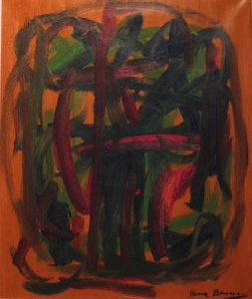
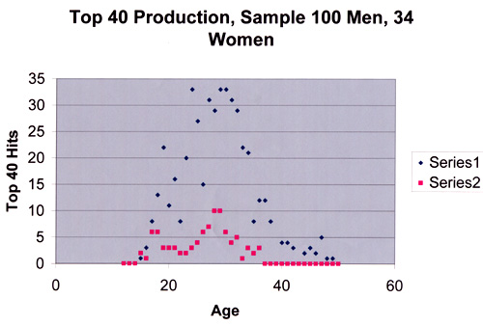
Art & Sexual Selection
Display Hypothesis
Costly Signaling
Status and Hierarchy
“Artistic Eye”
Notes:
There is an even stronger relationship between art and sexual selection. Art and creativity first came to be in the Pleistocene era. Evidence of this “display hypothesis” is shown by sex differences in the production of artwork. During the ages where they typically procreate, men tend to increase the volume and creativity or the art they produce. It can be inferred that this is done to draw attraction and find a mate.
The most important and most obvious is the fact that art serves as a costly signal to potential mates- just like the peacock’s feather does. Art is costly to produce, and doing it well signals fitness and creative ability. This helps explain for example, why poetry is the language of love. Being able to produce prose signals intelligence and creativity, which are attractive traits to potential mates.
Art can also send signals not through its production, but through its consumption. People often buy expensive pieces to signal monetary wealth and personal taste. It can also signal intelligence or creativity when, for example, a person spends a lot of money on a painting that appears as if it could have been painted by a child. The fact that I purchased the piece signals not only that I can afford it, but that I have the mental capacity to appreciate its beauty or depth.
This painting by is done by a 4 year old Chimpanzee named Peter. As a sort of social experiment, a Swedish journalist exhibited Peter’s paintings under the name Pierre Brassau, and art critics praised the works.

Slide 7
Pinker: Art as an
Adaptive By-Product
Hunger for Status
Aesthetic Pleasure
Ability to Design Artifacts
Notes:
Steven Pinker has another theory on the origins of the arts. He posits that art is not itself an adaptation, but a byproduct of other evolved adaptations. The three he talks about in The Blank Slate are-
Hunger for Status
Aesthetic Pleasure
Ability to design/produce artifacts
He looks at art as a “pleasure technology”- a direct, artificial, condensed way to stimulate pleasure, much like drugs do.
One especially powerful analogy he used is the music is “auditory cheesecake” in that both are crafted deliberately to satisfy as many of our brain’s pleasure centers as possible. He’s basically arguing that these needs came first, and the arts came to be as a result of these universal needs.

Slide 8
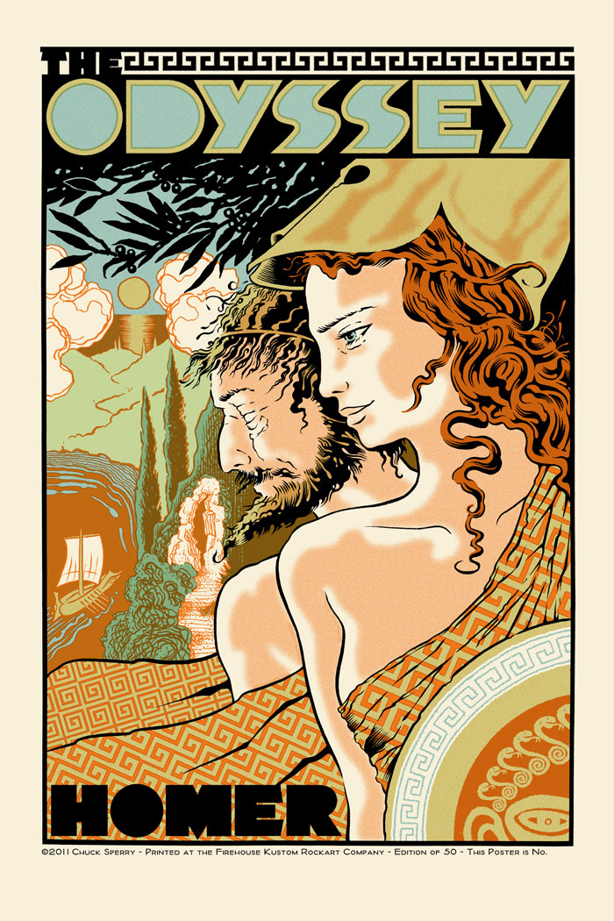
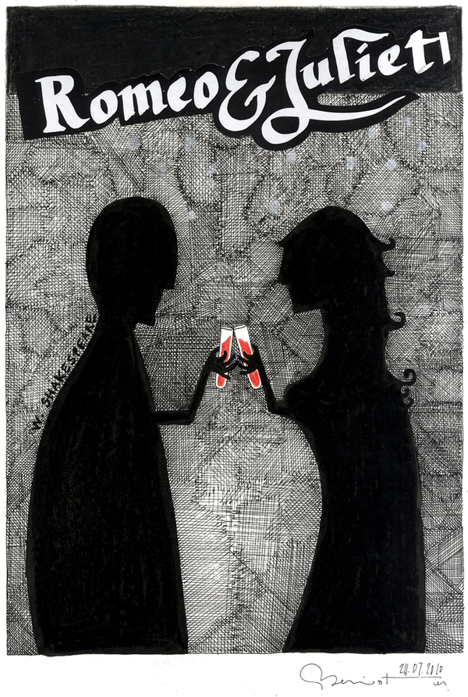
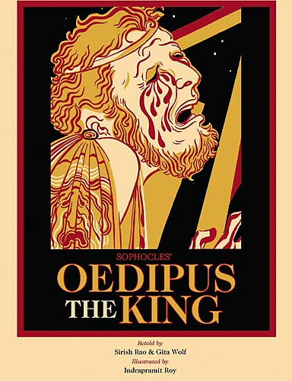
Special Case: Fiction
“To instruct and to delight”
Four main themes:
  Love
  Sex
  Personal Threat
  Threat to Kin
Notes:
Pinker points out that works of fiction are a special case.
Because humans have the evolved skill of empathy, they can put themselves in someone else’s shoes, even if it’s just a character in a play or the narrator of a novel. Fiction allows us to put ourselves in hypothetical situations consequence-free. Plus, the audience member can learn from the character’s mistakes, or can improve his chance of survival by remembering and applying something that the character did right.
A vast majority of fiction falls into 1 of 4 main themes: love, sex, personal threat, and threat to kin. It isn’t a coincidence that all 4 of these themes have implications on survival or reproduction, which is why we find fiction so fascinating.

Slide 9
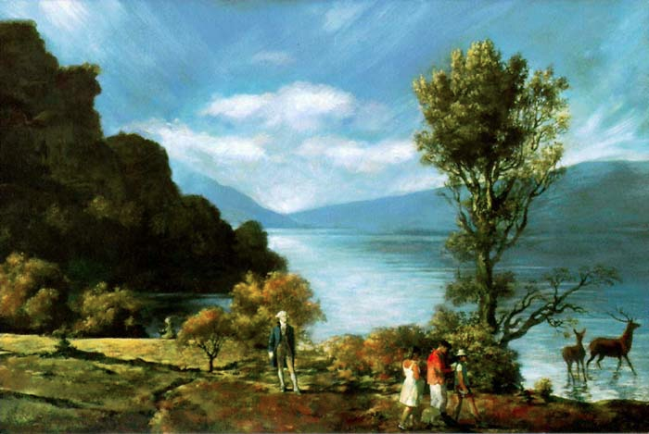
Evolved Aesthetics
Komar and Melamid – “America’s Most Wanted”
Notes:
Although we may not have a definitive theory on the evolutionary origins of art, we can certain agree that art is an inherent part of human nature. So now I want to explore the pleasure we derive from creating and consuming art, and see if there is a universality of tastes just as there is a universality of art across cultures.
I’ll start with an experiment done by Vitaly Komar and Alexander Melamid, called the People’s Choice Project. They used market research polls and focus groups to study the artistic preferences of people from 10 different countries-
In these polls, the asked about the respondents’ favorite colors, subject matter, style. They then, half satirically, lumped all the preferences into one painting, and this is the result-
As you can see, there is a preference for the color blue, and landscapes with visible water and mountains. Americans also said they liked to see historical figures in artwork, so they included George Washington. They also showed a liking for children and wild animals in paintings, which is also represented.
Komar and Melamid did a “most wanted” and a “least wanted” painting for each of the countries.

Slide 10
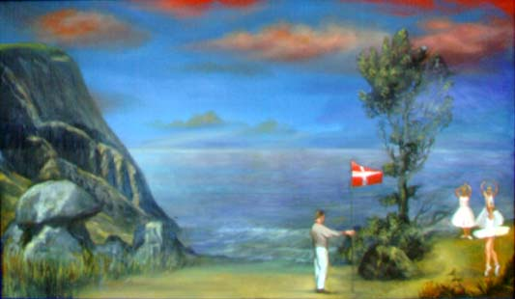
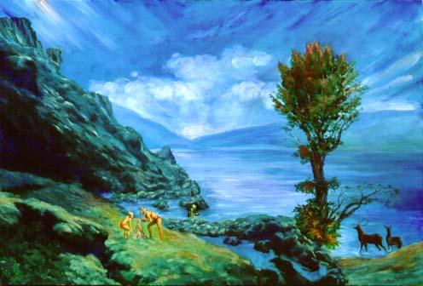
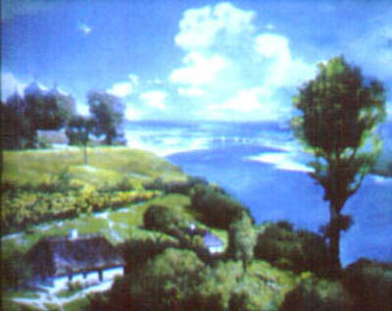
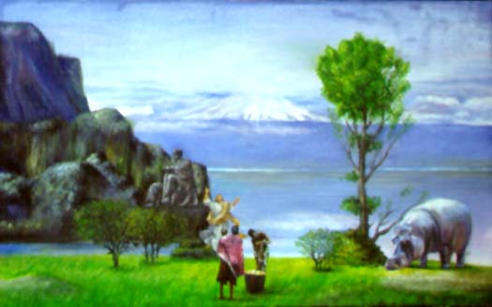
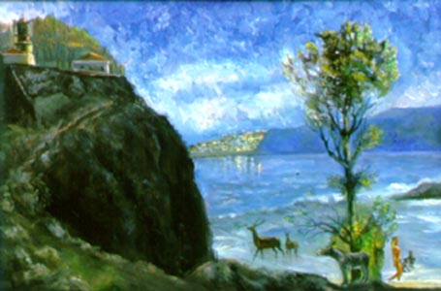
Evolved Aesthetics
Denmark
Iceland
Kenya
Portugal
Ukraine
Notes:
And the results show that artistic tastes are very similar worldwide. Even in places like Kenya and Iceland where you wouldn’t expect landscapes like this to exist, citizens gravitate toward this Hudson River School style of painting.
Just as we’ve evolved to take pleasure in mating and eating, imperative for the survival of our genes, we’ve evolved to take pleasure from visual representations of optimal landscapes for survival.
The “Savannah Hypothesis” says that we prefer landscapes like this because they have a lot in common with the East African Savannahs and woodlands where a lot of human evolution occurred. It also has characteristics that improve our chances of survival- available water, low-hanging trees that humans can climb to escape a predator or seek out food. Woods for animals (potential meals) to hide in, hills or mountains as vantage points.
Aesthetics has evolved because the source of beauty is also a source of genetic survival. For example, we find symmetry beautiful because physical symmetry in a person signifies health and therefore potential reproduction.

Slide 11
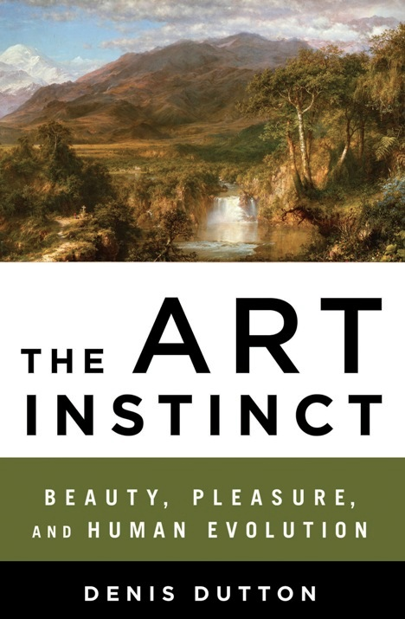
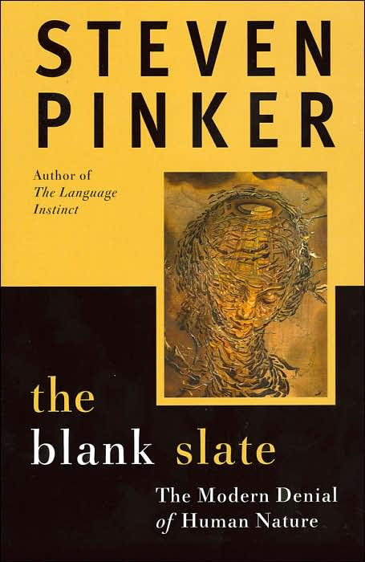
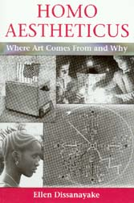
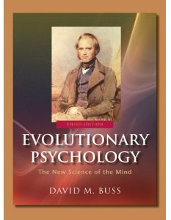
Sources

