Slide 1
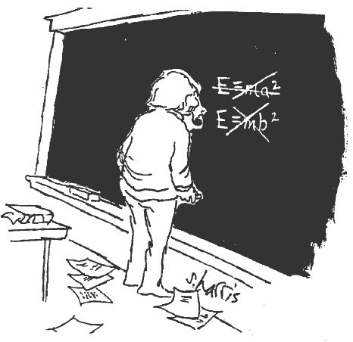
Making Mistakes and Being Wrong
Presented by Veronika Alexander

Slide 2
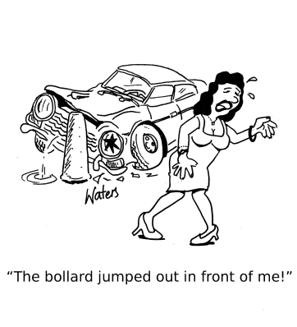
To err is human
When something goes wrong, the cause is overwhelmingly attributed to human error:
  Airplane crashes (70%)
  Car wrecks (90%)
  Workplace accidents (90%)
Notes:
Note: Cartoon reprinted with permission from www.cartoonstock.com
We all know the cliché “To err is human.” To most extent, this is true – human error is the cause of 70% of airplane crashes, 90% of car-wrecks, and 90% of workplace accidents. In most cases, however, these mistakes are not our fault though, at least not entirely. We are all afflicted by systemic biases in the way how we see, remember, and perceive the world around us. For example, our brains are not able to multitask very well (a lot of plane crashes happen because the pilots’ attention is caught by something else happening), we tend oversimplify things, and have inattentional blindness (when we fail to see the stimulus in plain sight).
What’s a bit troubling though is that when something goes wrong, most people start looking somebody/something to blame and, more often than not, come up with a wrong cause. This misattribution of blame is one reason that we make the same mistakes over and over again.

Slide 3
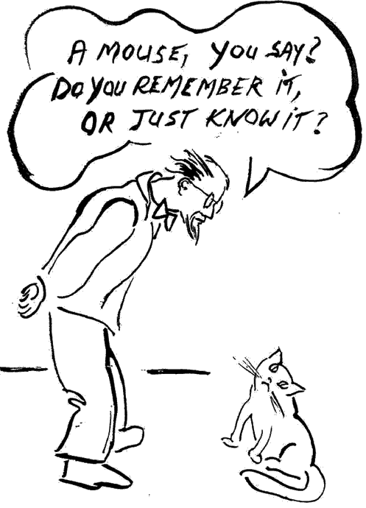
Do we believe or know?
Is our memory reliable?
Are knowledge and error compatible? Or is it just beliefs?
Notes:
Franz von Liszt, a professor of the University in Berlin, one of the first people to study reliability of eyewitness reports, staged an experiment, in which a heated argument between two students got out of hand, one pulled the gun on the otherThe studies show that as high as fifty percent of convictions may be based on testimony of eyewitnesses. However, plenty of research also shows that it matter quite a bit how people are questioned. For example, if people were asked the question “how much glass there was when the two cars crashed into each other,” rather than “was there any glass when the two cars bumped into each other,” the answers they give are quite different.
The idea of knowledge and the idea of error are fundamentally incompatible. When we claim that we know something, we are essentially saying that we can’t be wrong. If we could contend with the possibility that we could be wrong, then the idea of knowledge won’t serve us; we need to embrace the idea of belief instead.
As Kathryn Schulz argues, it is the belief rather than knowledge that is by far the broader, more complex, and more interesting category. It is belief, she says, that is the atomic unit of our intelligence – the thing that differentiates us from machines, and that lets us navigate the world as deftly as we do.

Slide 4
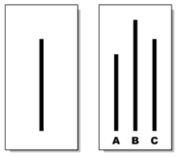
Groupthink
Groupthink is the “deterioration of mental efficiency, reality checking, and moral judgment that results from in-group pressures” -- Psychologist Irving Janis
Solomon Asch conformity
experiment:
Notes:
Psychologist Irving Janis defined groupthink to be the “deterioration of mental efficiency, reality checking, and moral judgment that results from in-group pressures.”
Solomon Asch, in his famous experiments on conformity, asked people to compare the lines shown. So, is the line on the left equal to A, B, or C? The trick was that a group consisted of only one real participant, with the rest being experimenter’s confederates, all of whom gave the wrong answer. It turned out that a large majority of people (~75%) also gave the wrong answer after hearing everybody else’s wrong responses. What’s even more interesting, is the fact that when debriefed, some subjects said that they believed that the wrong answer was actually the right one.
Groupthink often arises from the parts of disagreement deficit: disproportionate exposure to support for our beliefs, underexposure to the opposition, a tendency to discount that opposition even if we do encounter it, and from the suppression of doubt or differences of opinion within a community.
In 1990, an Afghan man named Abdul Rahman, converted to Christianity. Such conversion is extremely rare for Afghanistan, which is 99% Islamic. But Rahman was working for a Catholic charity that provided medical assistance to the refugees, and came to believe in the religion of his colleagues. What happened afterwards? The whole world as he knew it collapsed around him. First, his wife, who remained a devout Muslim, divorced him on the grounds that he was an infidel. Then he lost a custody batter over his two daughters, for the same reason. “Because he has converted from Islam to another religion, we don’t want him in this house.”
In 2006, he was arrested by the Afghan police on charges of apostasy and imprisoned. In accordance with Hanafi school of sharia law, the prosecutors asked for the death penalty. The Afghan attorney general seconded that opinion. It’s only after tremendous international pressure that Rahman was finally released from prison. Under a threat of death, he was granted asylum in Italy and fled his native country.
If a single person breaking the ranks on a single belief can threaten the cohesion of a whole community, it can also threaten the entire nature of believing. (The story is taken from “On being wrong” by Kathryn Schultz)

Slide 5
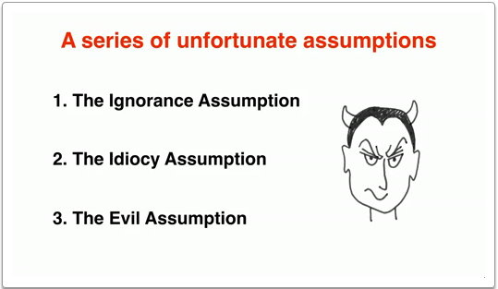
Others are wrong, I’m right
Cognitive dissonance
3 assumptions
Notes:
A slide from Kathryn Schulz TED talk
In the book called “Mistakes were made,” the authors write that people tend to start justify themselves when they are faced with cognitive dissonance. Cognitive dissonance refers to a state of tension that occurs whenever a person holds two cognitions (ideas, attitudes, beliefs, opinions) that are psychologically inconsistent, for example, “Smoking is a dumb thing to do because it could kill me” and “I smoke two packs a day.” It produces mental discomfort, ranging from minor pain to deep anguish; people don’t rest easy until they find a way to reduce it. As most people hold a reasonably positive self-concept, believing themselves to be smart, competent, and moral, their efforts at reducing dissonance will be directed at preserving that positive self-images.
Kathryn Schulz, in her book “Being Wrong,” describes three main assumptions people tend to make when somebody disagrees with them:
1) The Ignorance Assumption: Since we think that our own beliefs are based on facts, we conclude that people who disagree with us just haven’t yet been exposed to the right information and thus exposure would inevitably bring them to our team. (It also could be the case that we can be wrong – the facts may contradict our own beliefs).
2) The Idiocy Assumption: after a failing attempt to enlighten others, we too often proceed to the second assumption – that their brains just aren’t good enough to comprehend the truth. (This one also fails quite often since it’s often the case that the “disagreeing” people can be very smart).
3) The Evil Assumption: the last, the most disturbing one as it often provokes violent conflict – is the evil assumption. That is, it’s not the fact that others don’t have the right facts or unable to comprehend them that leads them to disagree with us, it’s that they are willfully turning their backs on doing the right thing.
These three assumptions may make it very difficult for people to accept their own fallibility. After all, if we assume that people who are wrong are ignorant, or idiotic, or evil, it’s not hard to imagine why they themselves would prefer not to confront the possibility of being wrong themselves.

Slide 6
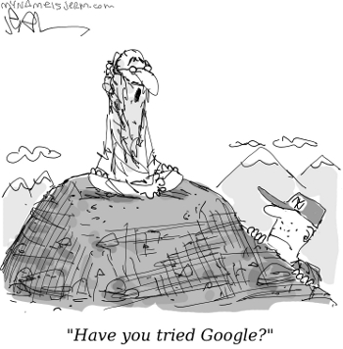
Where does good judgment come from?
A man travels many miles to consult the wisest guru in the land. When he arrives, he asks the wise man:
"Oh, wise guru, what is the secret of happy life?"
"Good judgment,” says the guru.
"But oh, wise guru,” says the man, "how do I achieve good judgment?"
"Bad judgment,” says the guru.
Notes:
Making mistakes is central in education – be it for scientists or artists: it gives people the freedom to experiment, try some idea, take a risk, be willing to get a wrong answer.
In Carol Dweck’s experiments, she observed significant behavioral difference in two groups of children: one that was praised for effort, and the other – for their inherent intelligence. In the first group, where efforts were praised, the kids were more likely to regard mistakes and criticism as useful information that would help them improve. In contrast, children who were praised for their natural ability to learn, seemed to care more about how competent they looked to others than about what they were actually learning. They were more likely to become defensive about not doing well or about making mistakes, and that sat them up for a self-defeating cycle: If they don’t do well, then to resolve the ensuing dissonance (“I’m smart and yet I screwed up”), they simply lost interest in what they were learning or studying (“I could do it if I wanted to, but I don’t want to”).
But a lot of the times, it’s mistakes that lead us to interesting inventions or new ways to look at a problem. Some of the famous examples include discovery of penicillin, invention of microwave oven, pacemaker, post-it notes, potato chips, scotchguard, ink-jet printer, and others.
So, with such a ubiquity of error, it would also make sense to be a bit more forgiving of others when we face somebody who disagrees with us or makes a mistake.

Slide 7
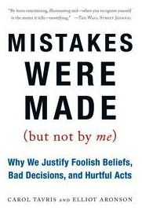
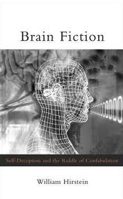
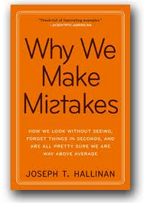
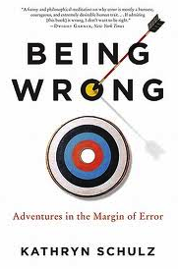
Selected references

