Slide 1
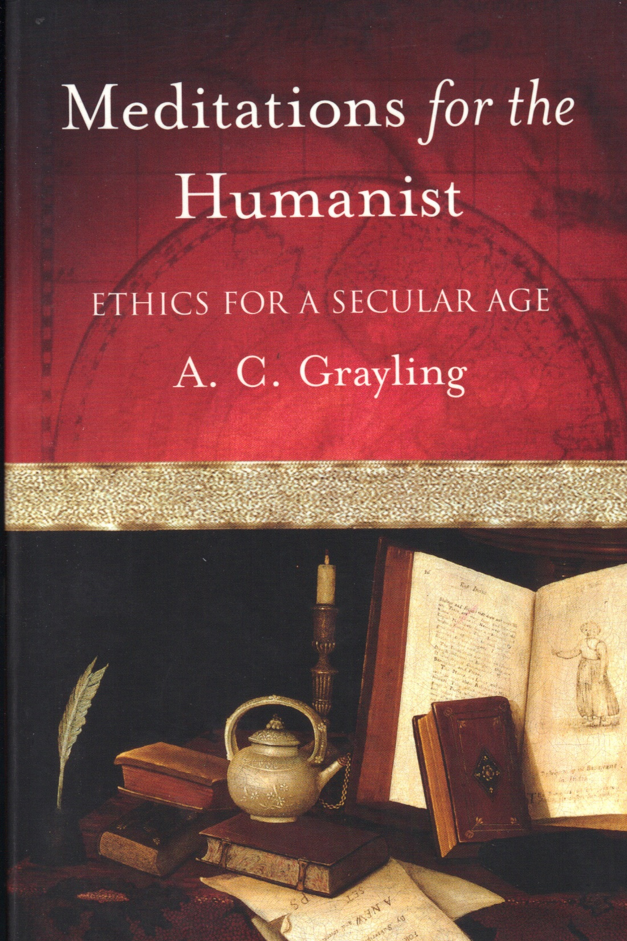
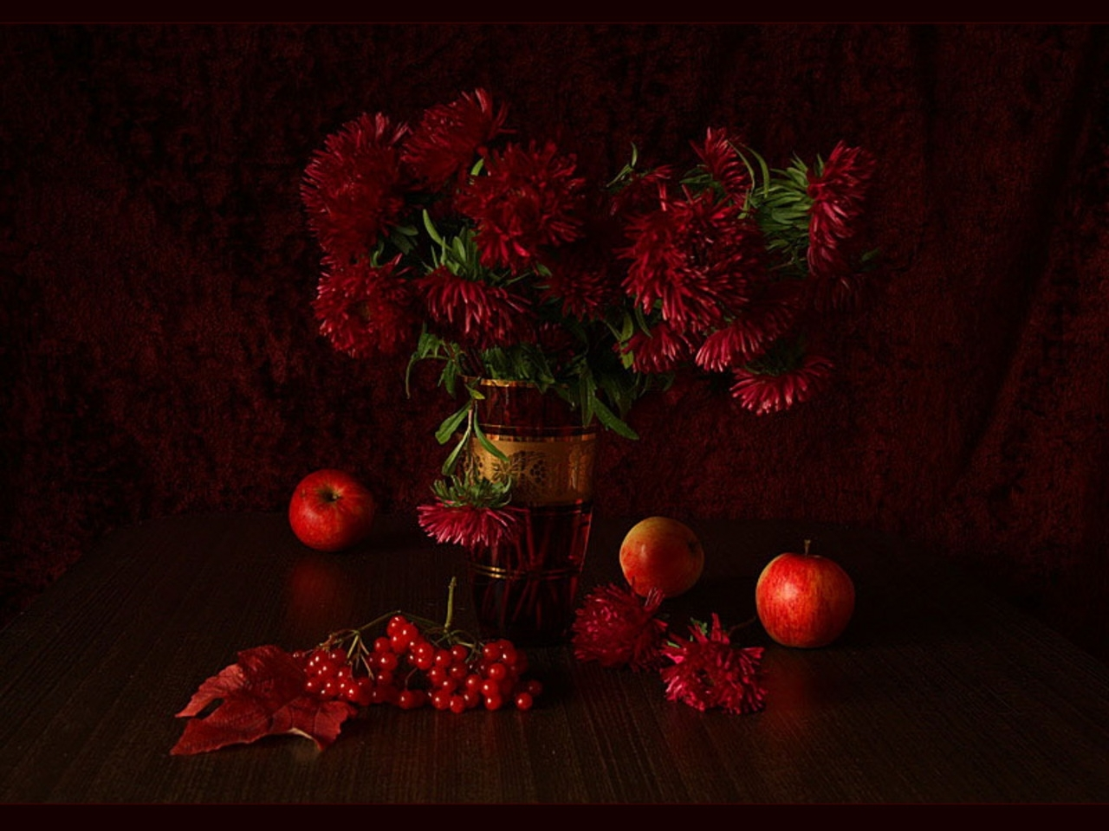
Personal Reflections II Essay
Bb

Slide 2
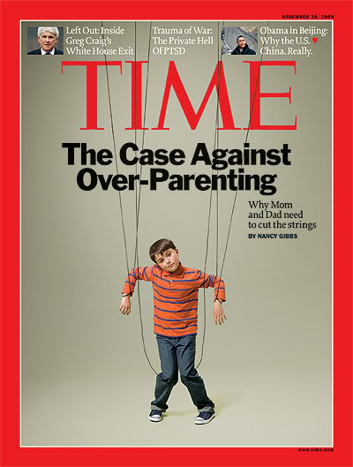
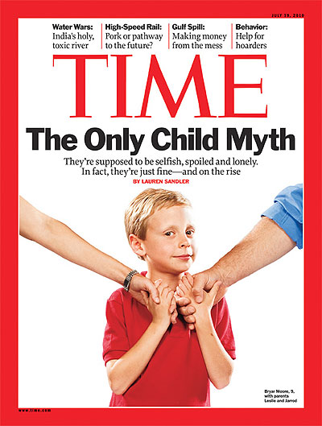
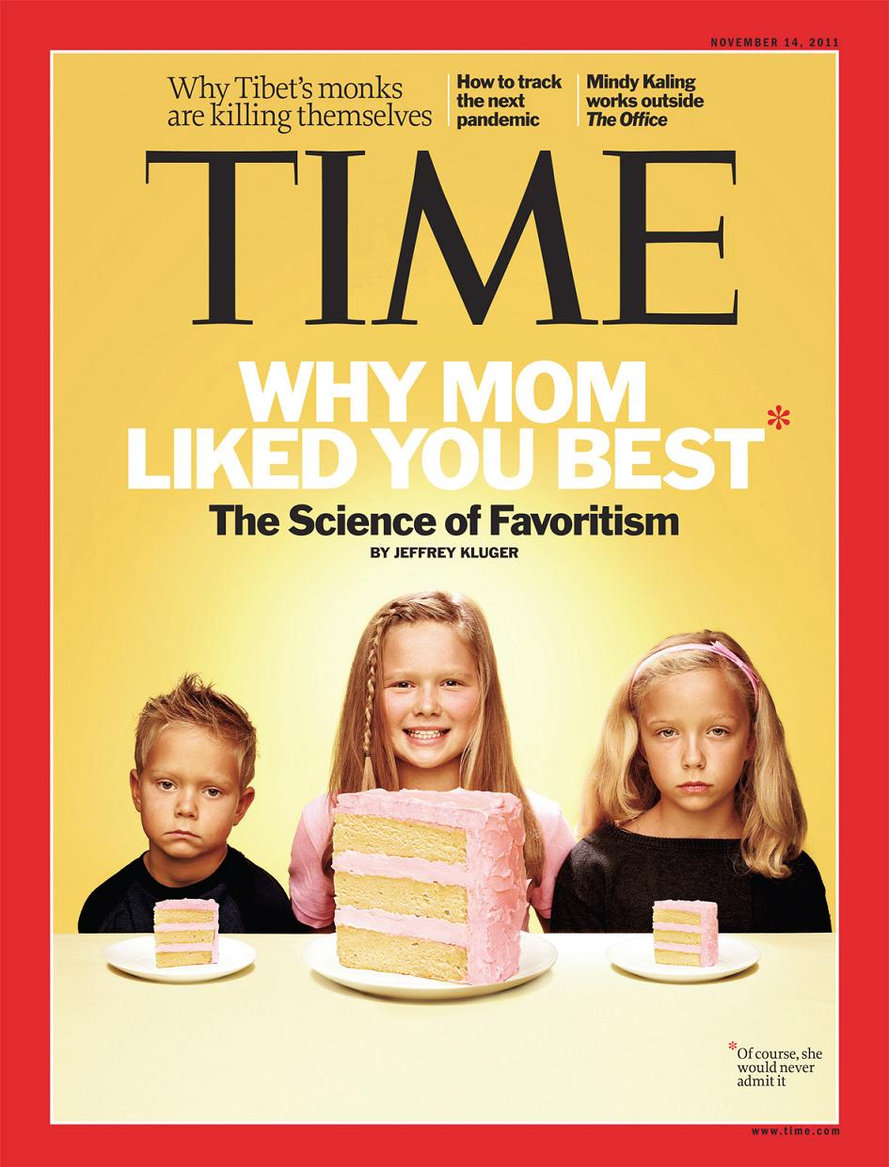

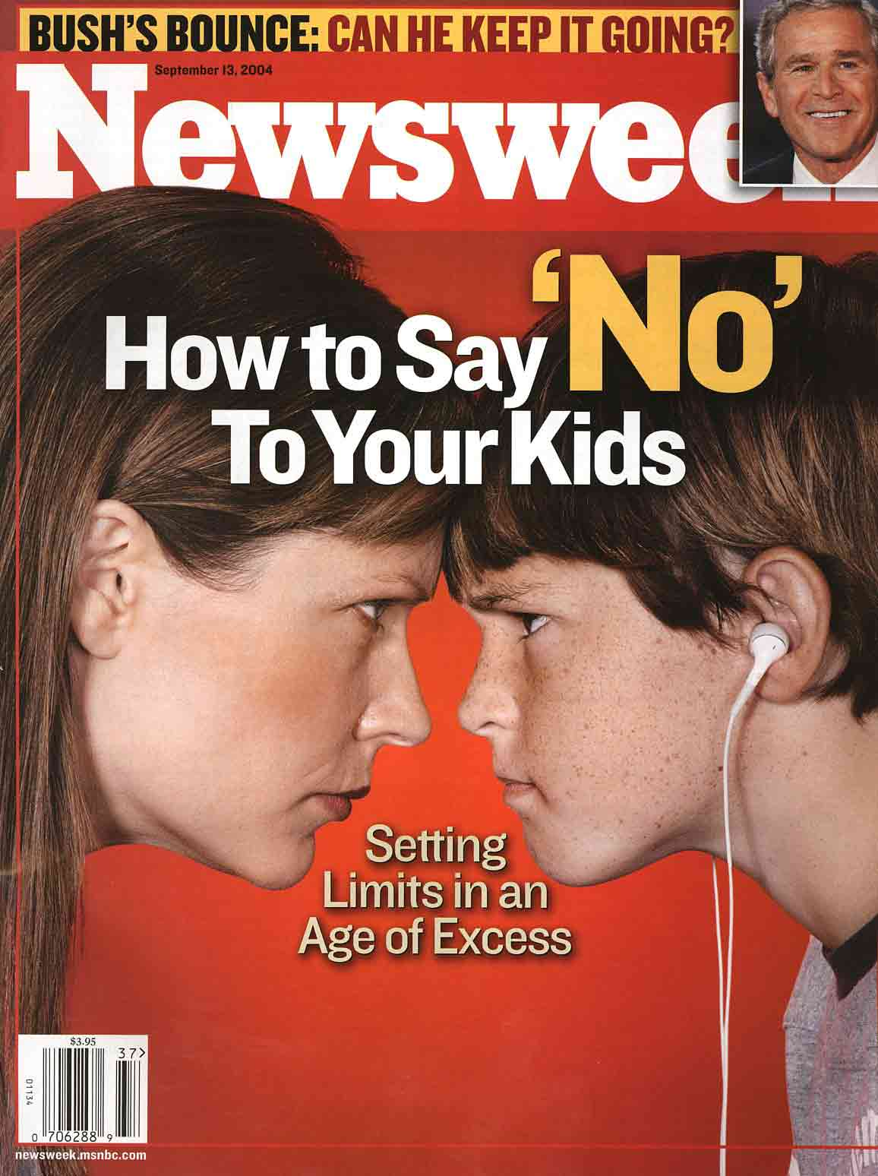

Slide 3
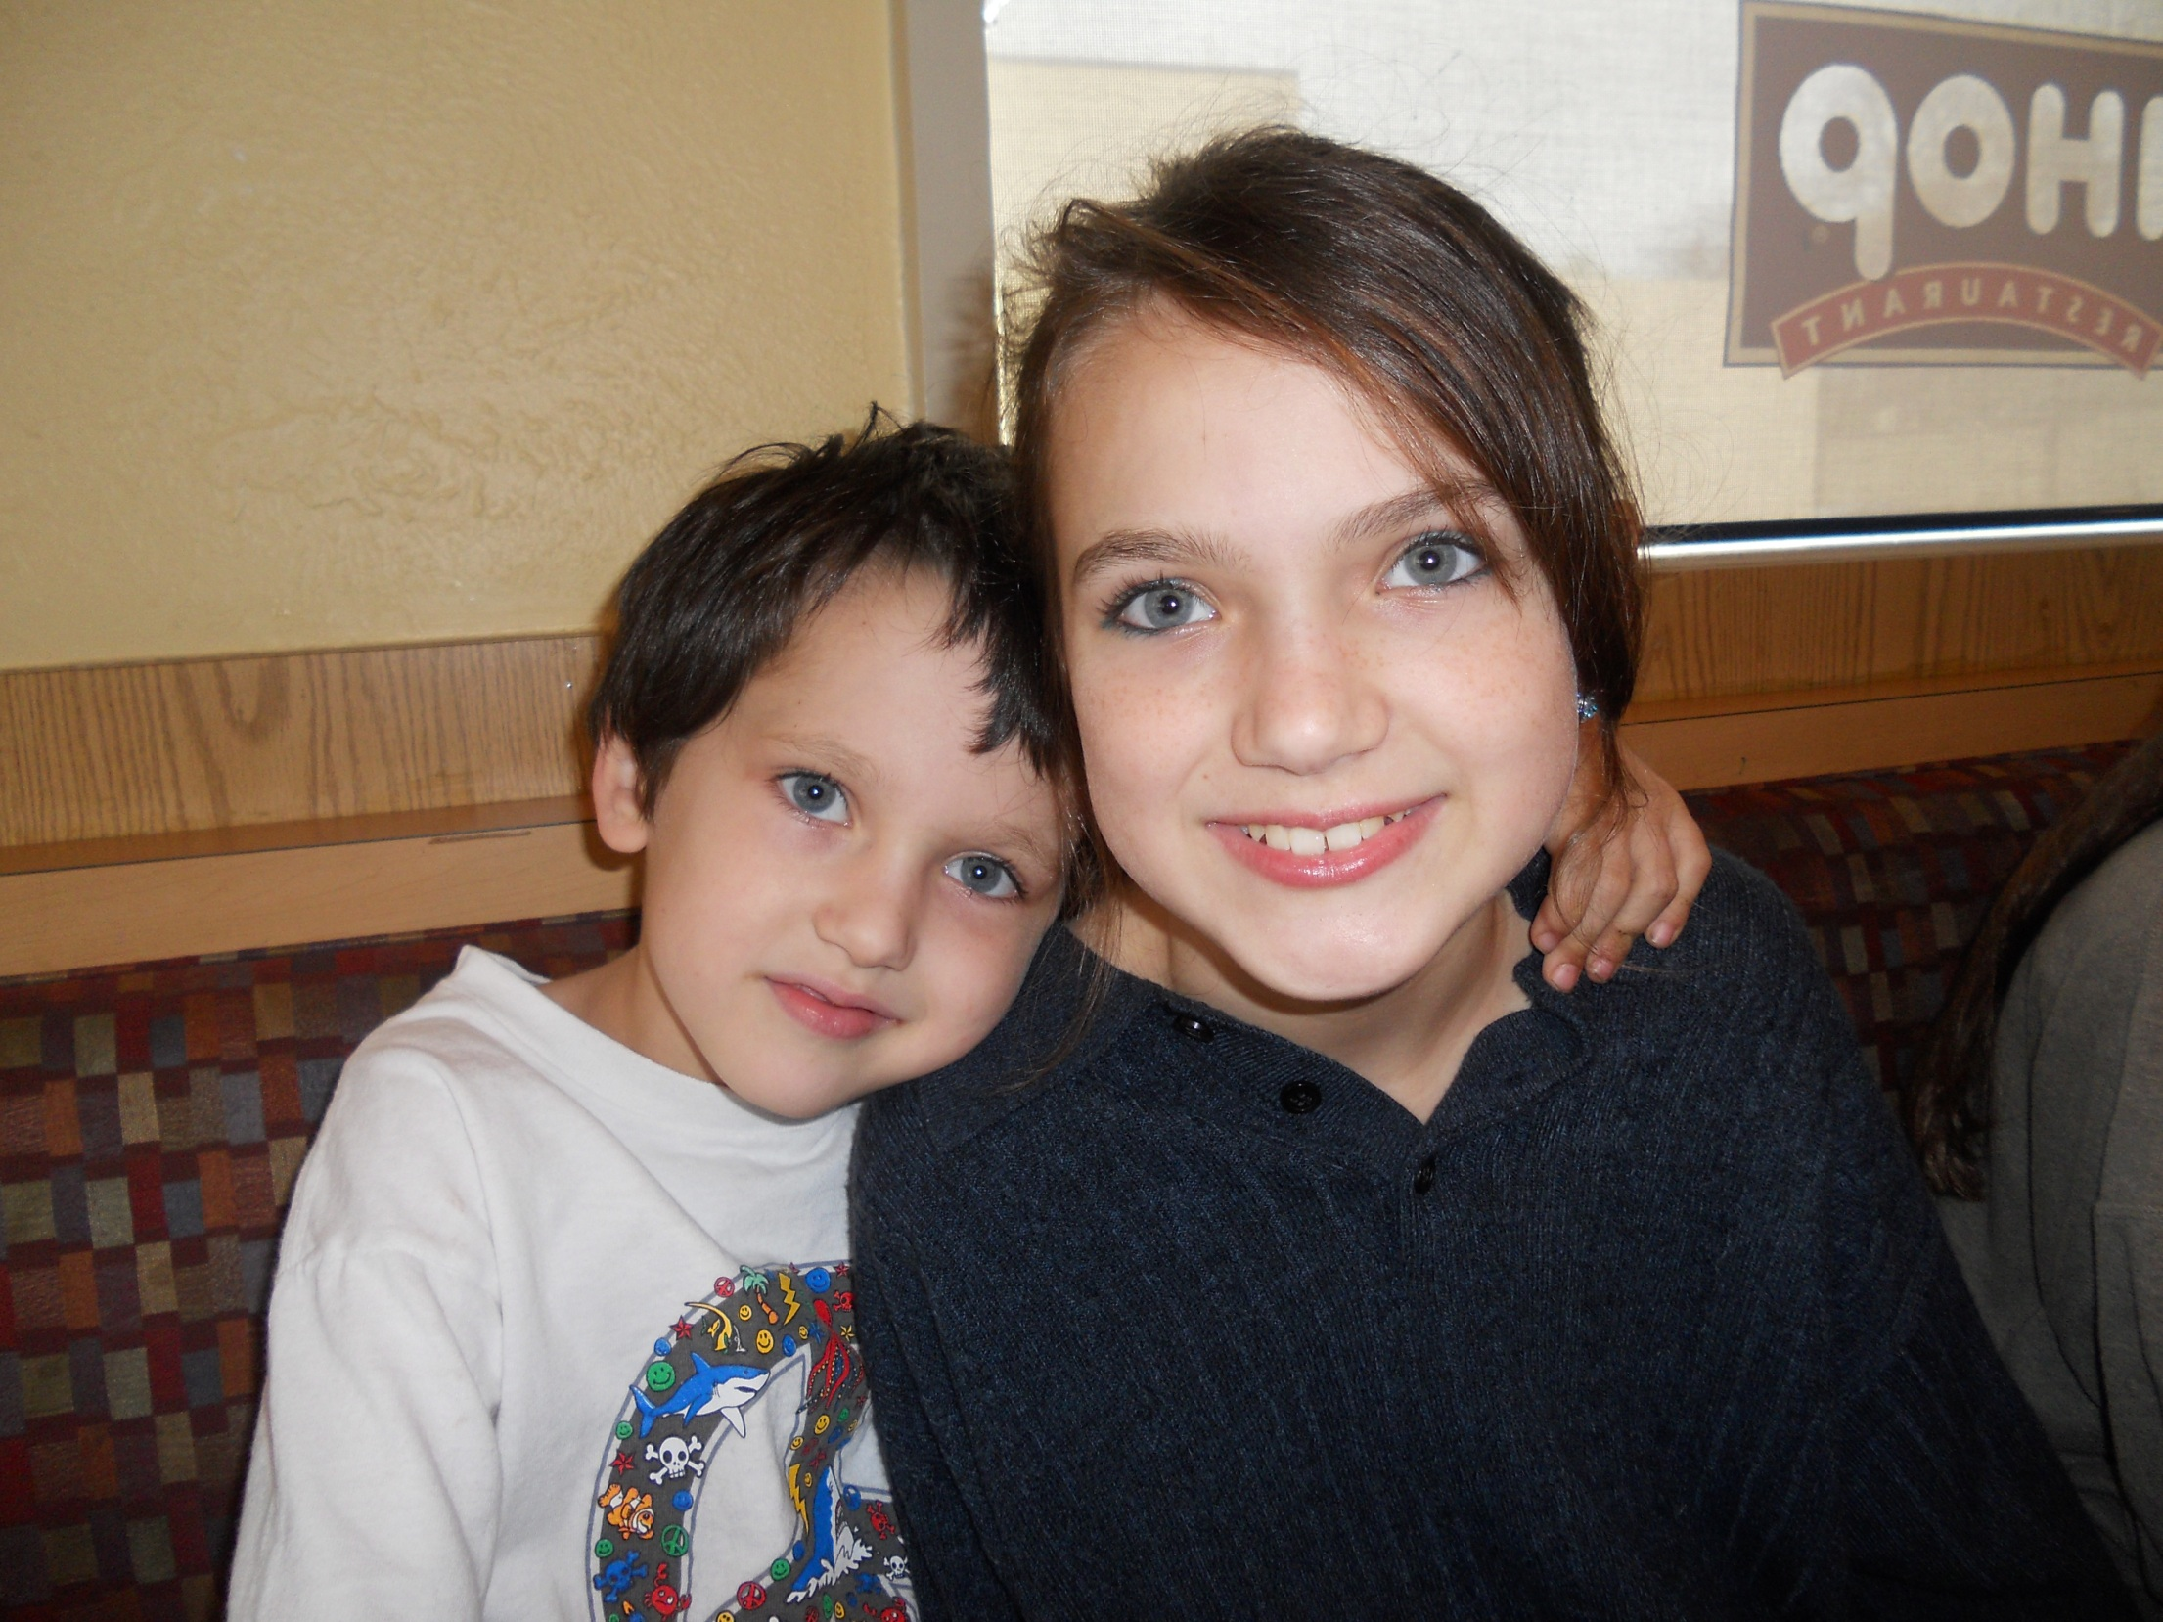

Slide 4
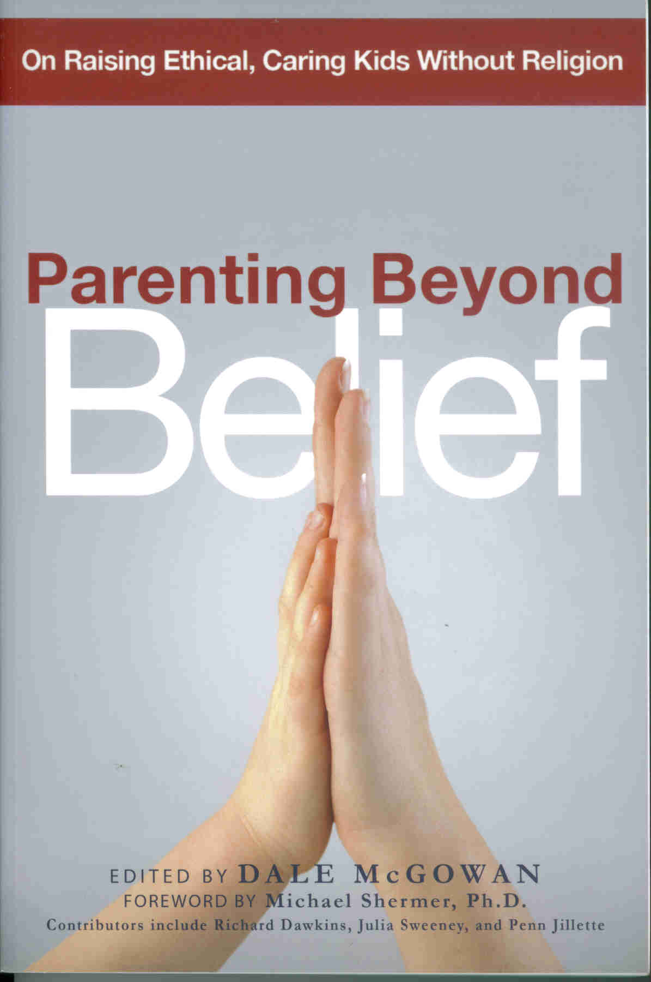

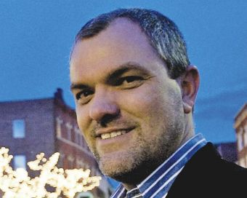

Slide 5
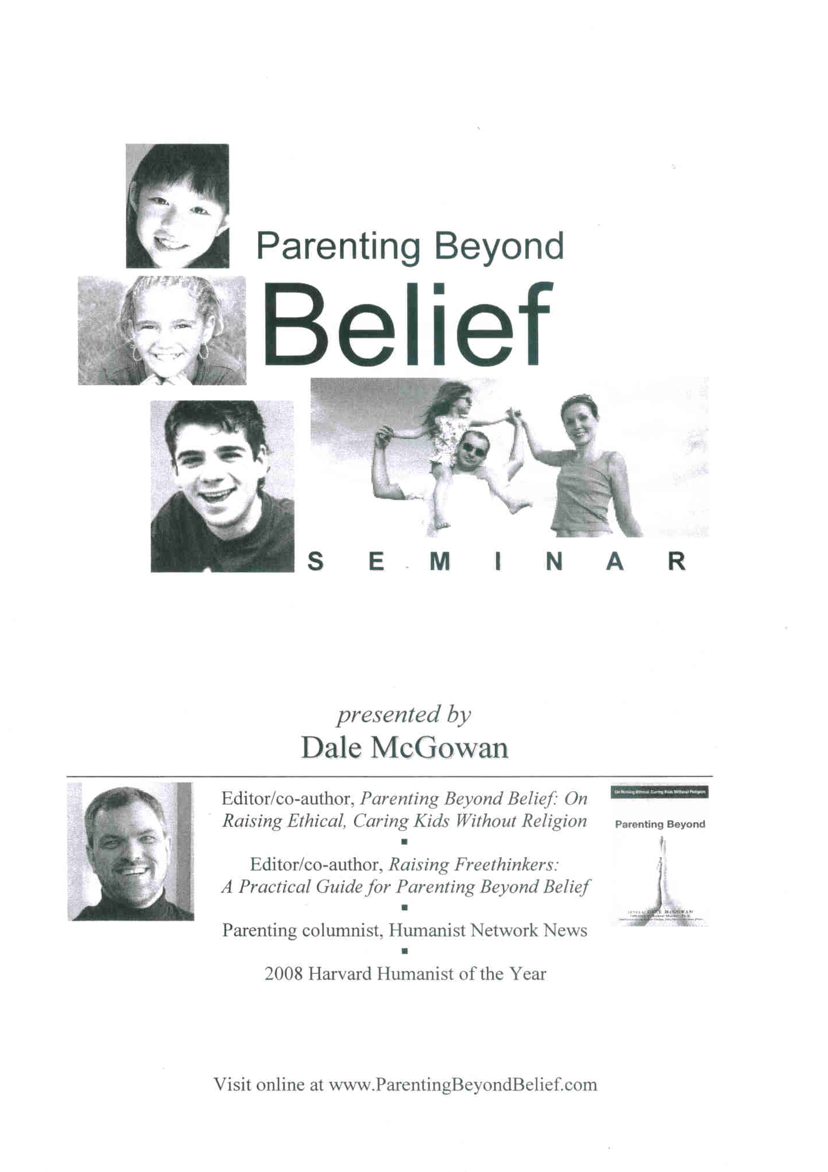
December 13, 2008

Slide 6
Preview
Attitudes towards Atheists
Evolved tendency toward moral behavior
Labeling
Seven Secular Values
Meaning of Life
Death & Life
Best Practices

Slide 7

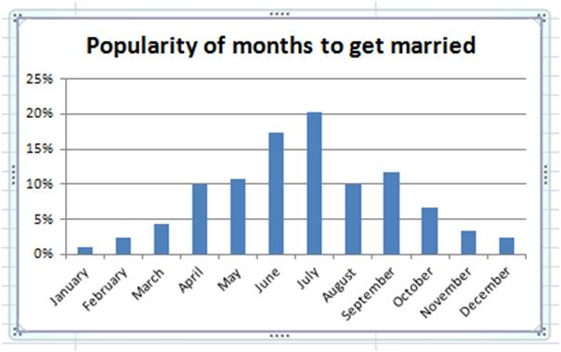

Slide 8
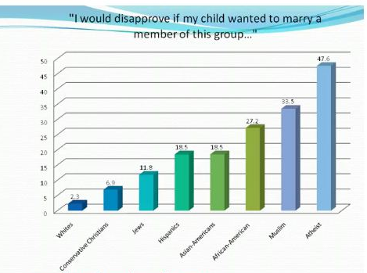
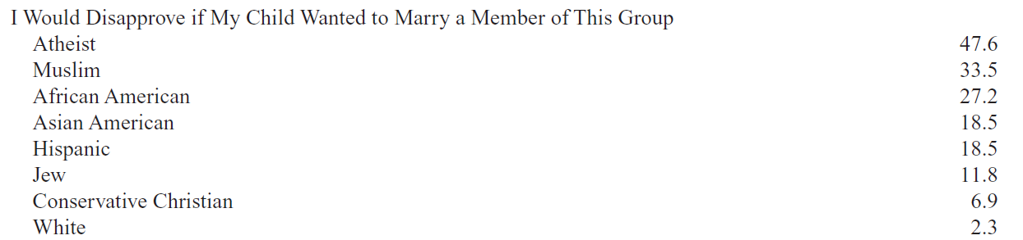

Slide 9

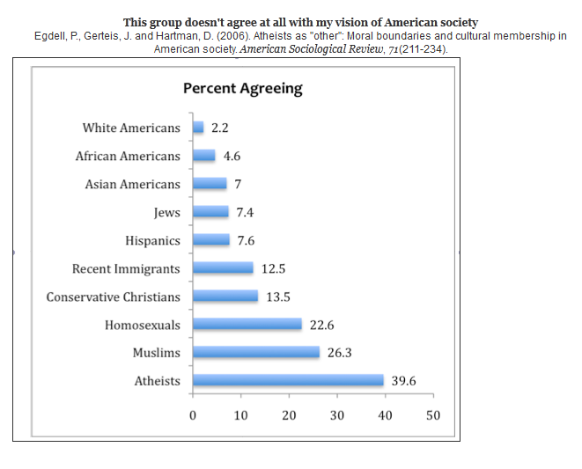

Slide 10

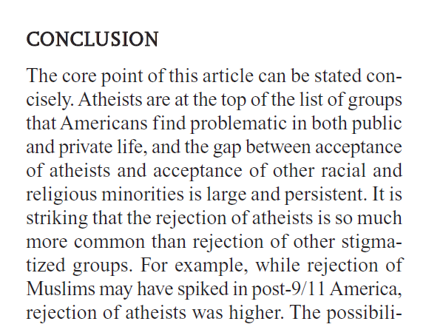

Slide 11
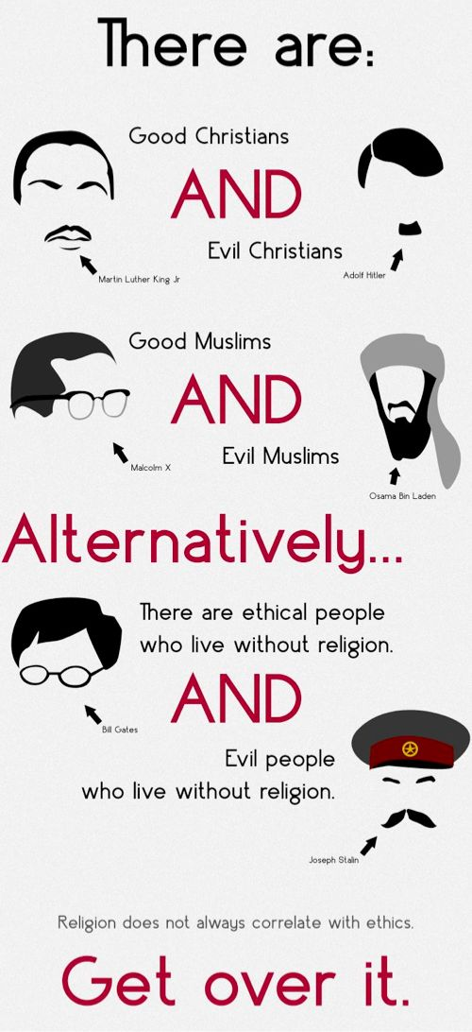

Slide 12
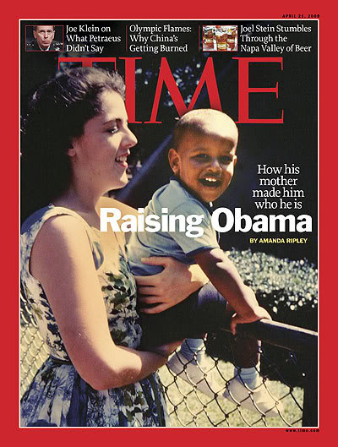
Ann Dunham

Slide 13
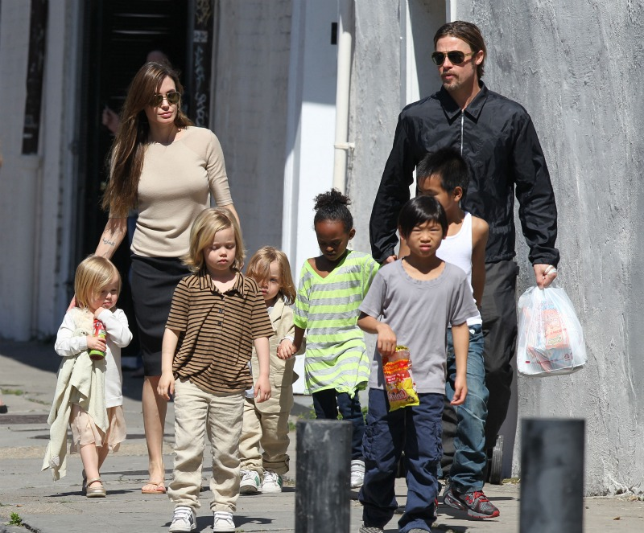

Slide 14
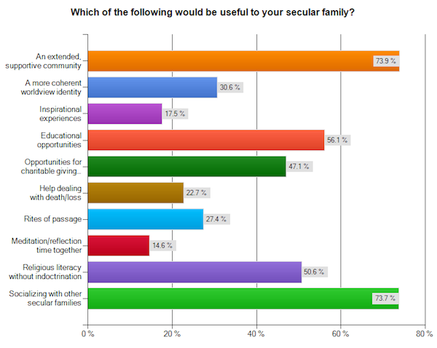

Slide 15
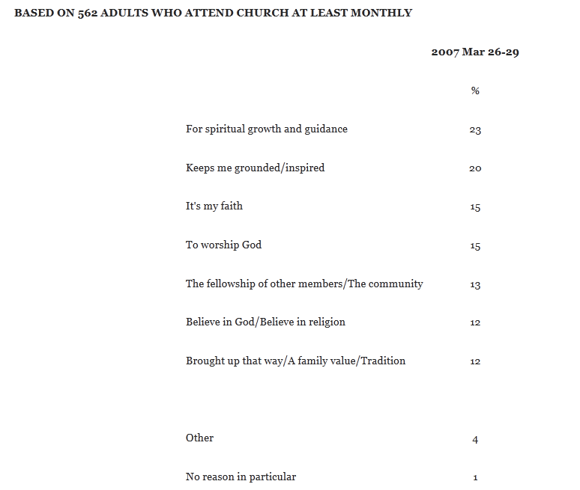
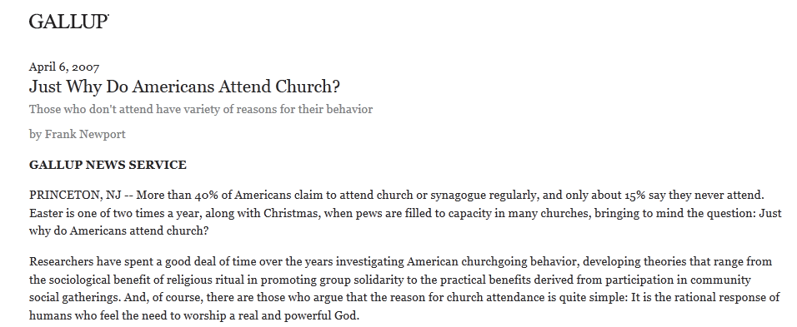
Only 27% of churchgoing US respondents mentioned God when asked for main reason they attend church

Slide 16
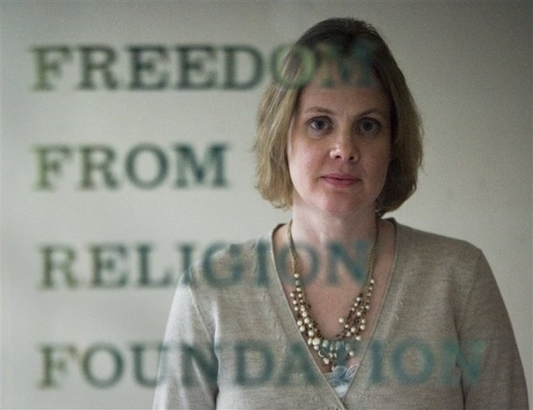
The kneejerk reaction of most religionists is that
atheists and agnostics do not even have a moral sense of right and wrong

Slide 17
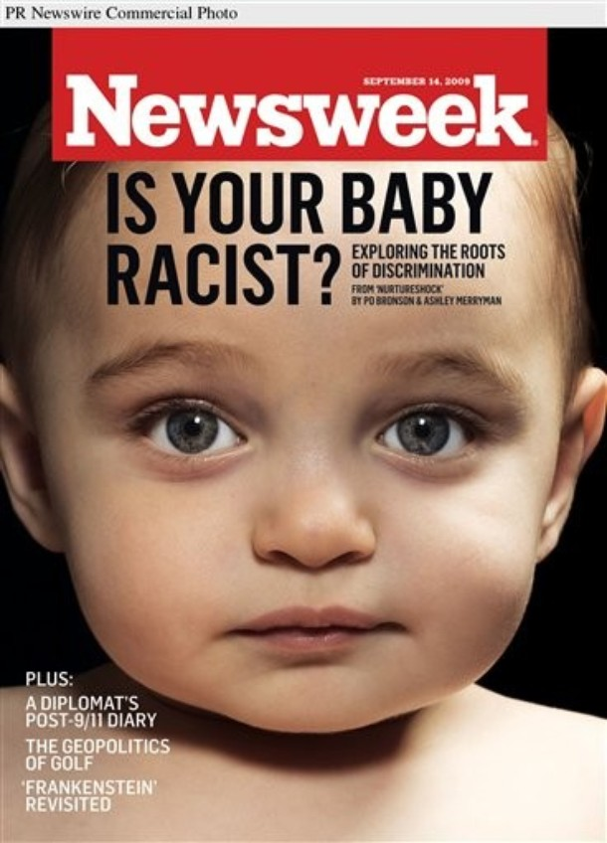
Just as we would take steps to prevent our children from growing up homophobic, violent, racist, or sexist, we do not want our children to fall prey to superstition and religious dogma

Slide 18
Ensuring that your child grows up free from religion—from such unwholesome ideas as original sin or everlasting punishment—might be the greatest gift you can offer

Slide 19
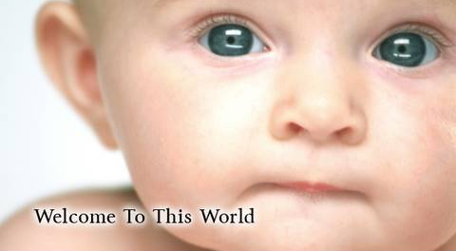
Welcome To This World

Slide 20
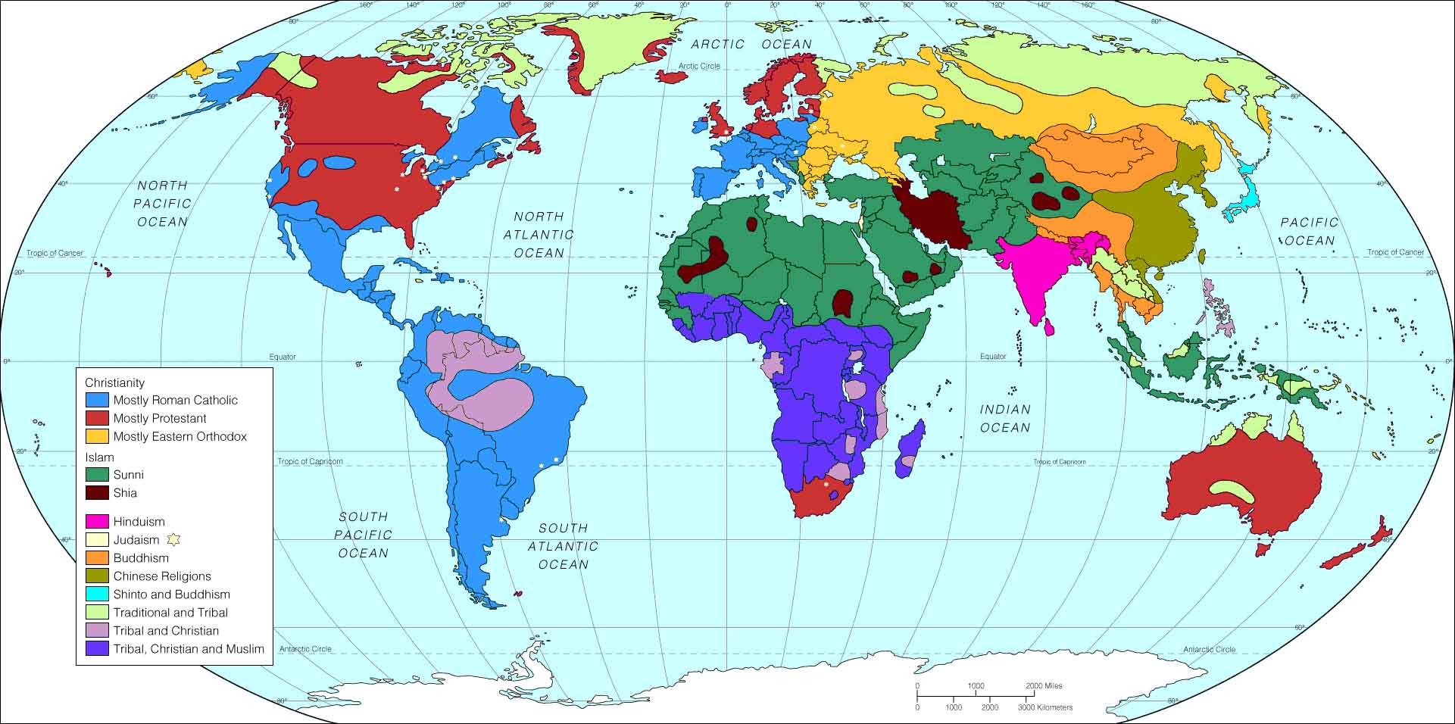
Religion = Accident of Birth

Slide 21

Children across cultures maintain a set of common moral concerns for fairness and human welfare independent of cultural conventions and religious norms

Slide 22
Children around the world develop moral attitudes at around the same age

Slide 23
3-4 children “universally selfish”
7-8 develop “strong sense of fairness”

Slide 24
Indoctrination impedes moral development
At the heart of indoctrination is the distrust of reason

Slide 25
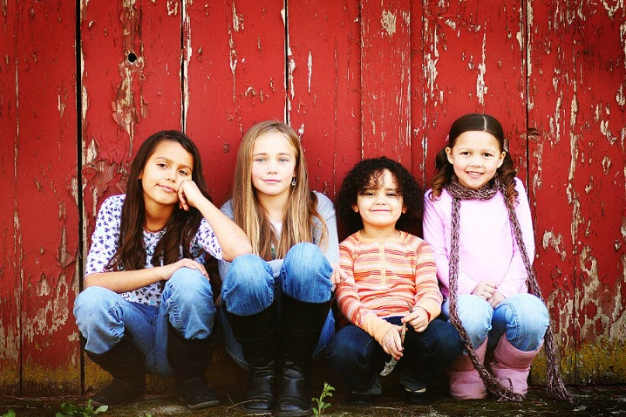
Basic moral development is not about knowing right from wrong …

Slide 26
It is about developing the desire to do what you already know is right

Slide 27
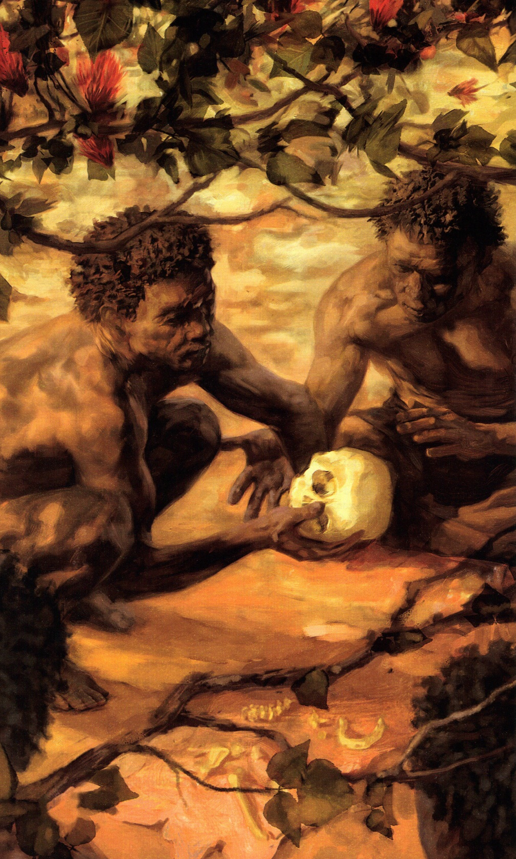
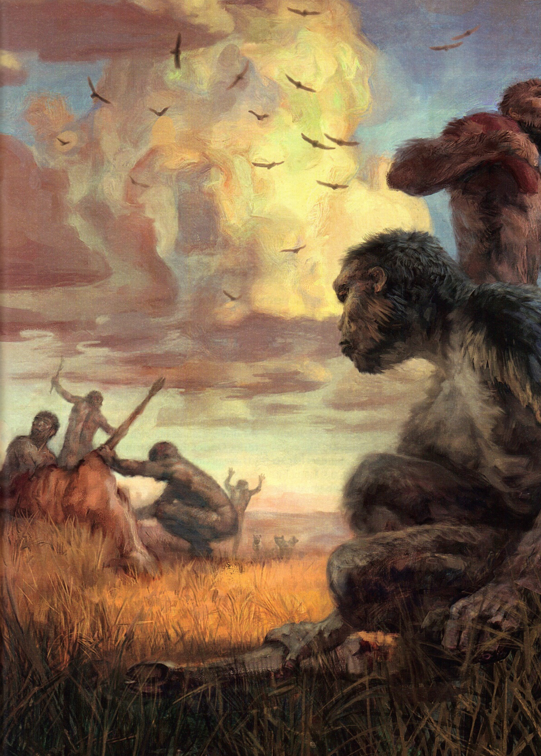

Physical Survival required Social Survival

Slide 28
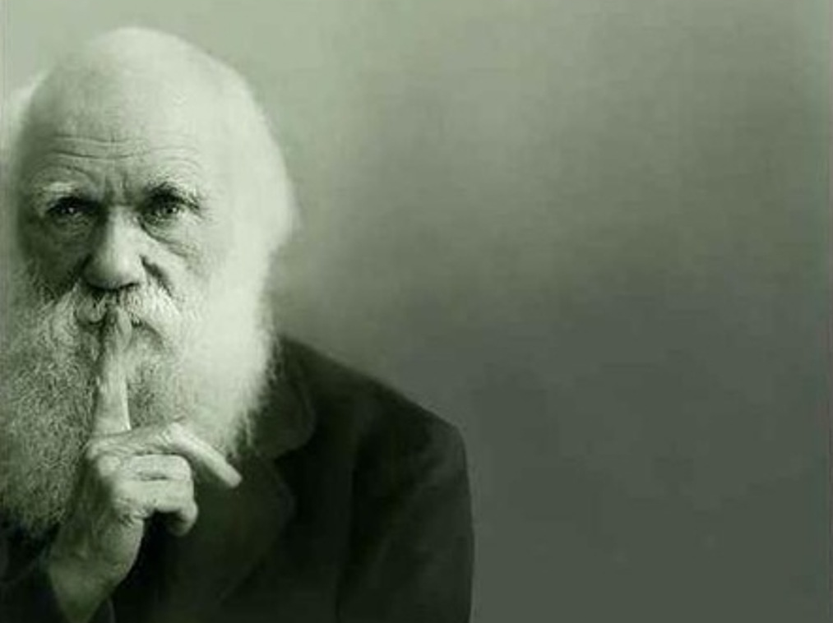
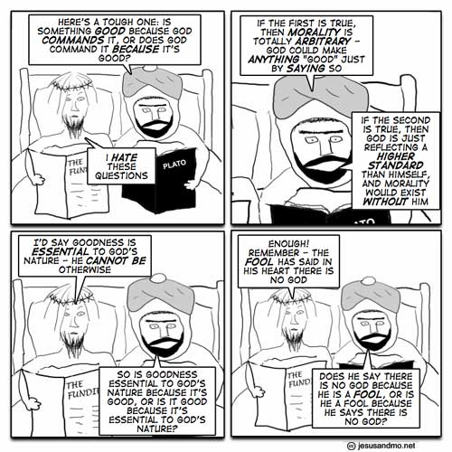

Slide 29
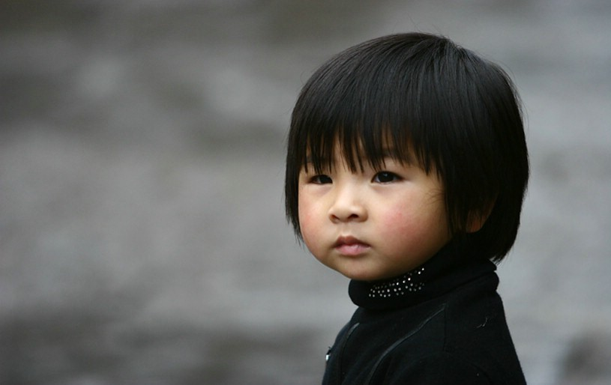

Children spontaneously adopt concept of god & created world

Slide 30
Children natural born dualists (mind/body)
Mind = disembodied spirit that inhabits body
Children are natural born teleologists
Assign purpose to everything

Slide 31
Dualism & Teleology predispose us to religion
HADD = Hyperactive Agent Detection Device
Averse to the idea that “stuff happens”
Overassume conscious intent (tsunami)

Slide 32

Belief comes naturally & quickly

Slide 33
Disbelief requires effort

Slide 34

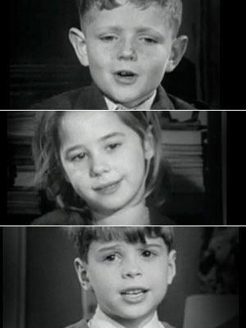
Jesuit Motto
“Give me a child until he is seven and I will give you the man”

Slide 35


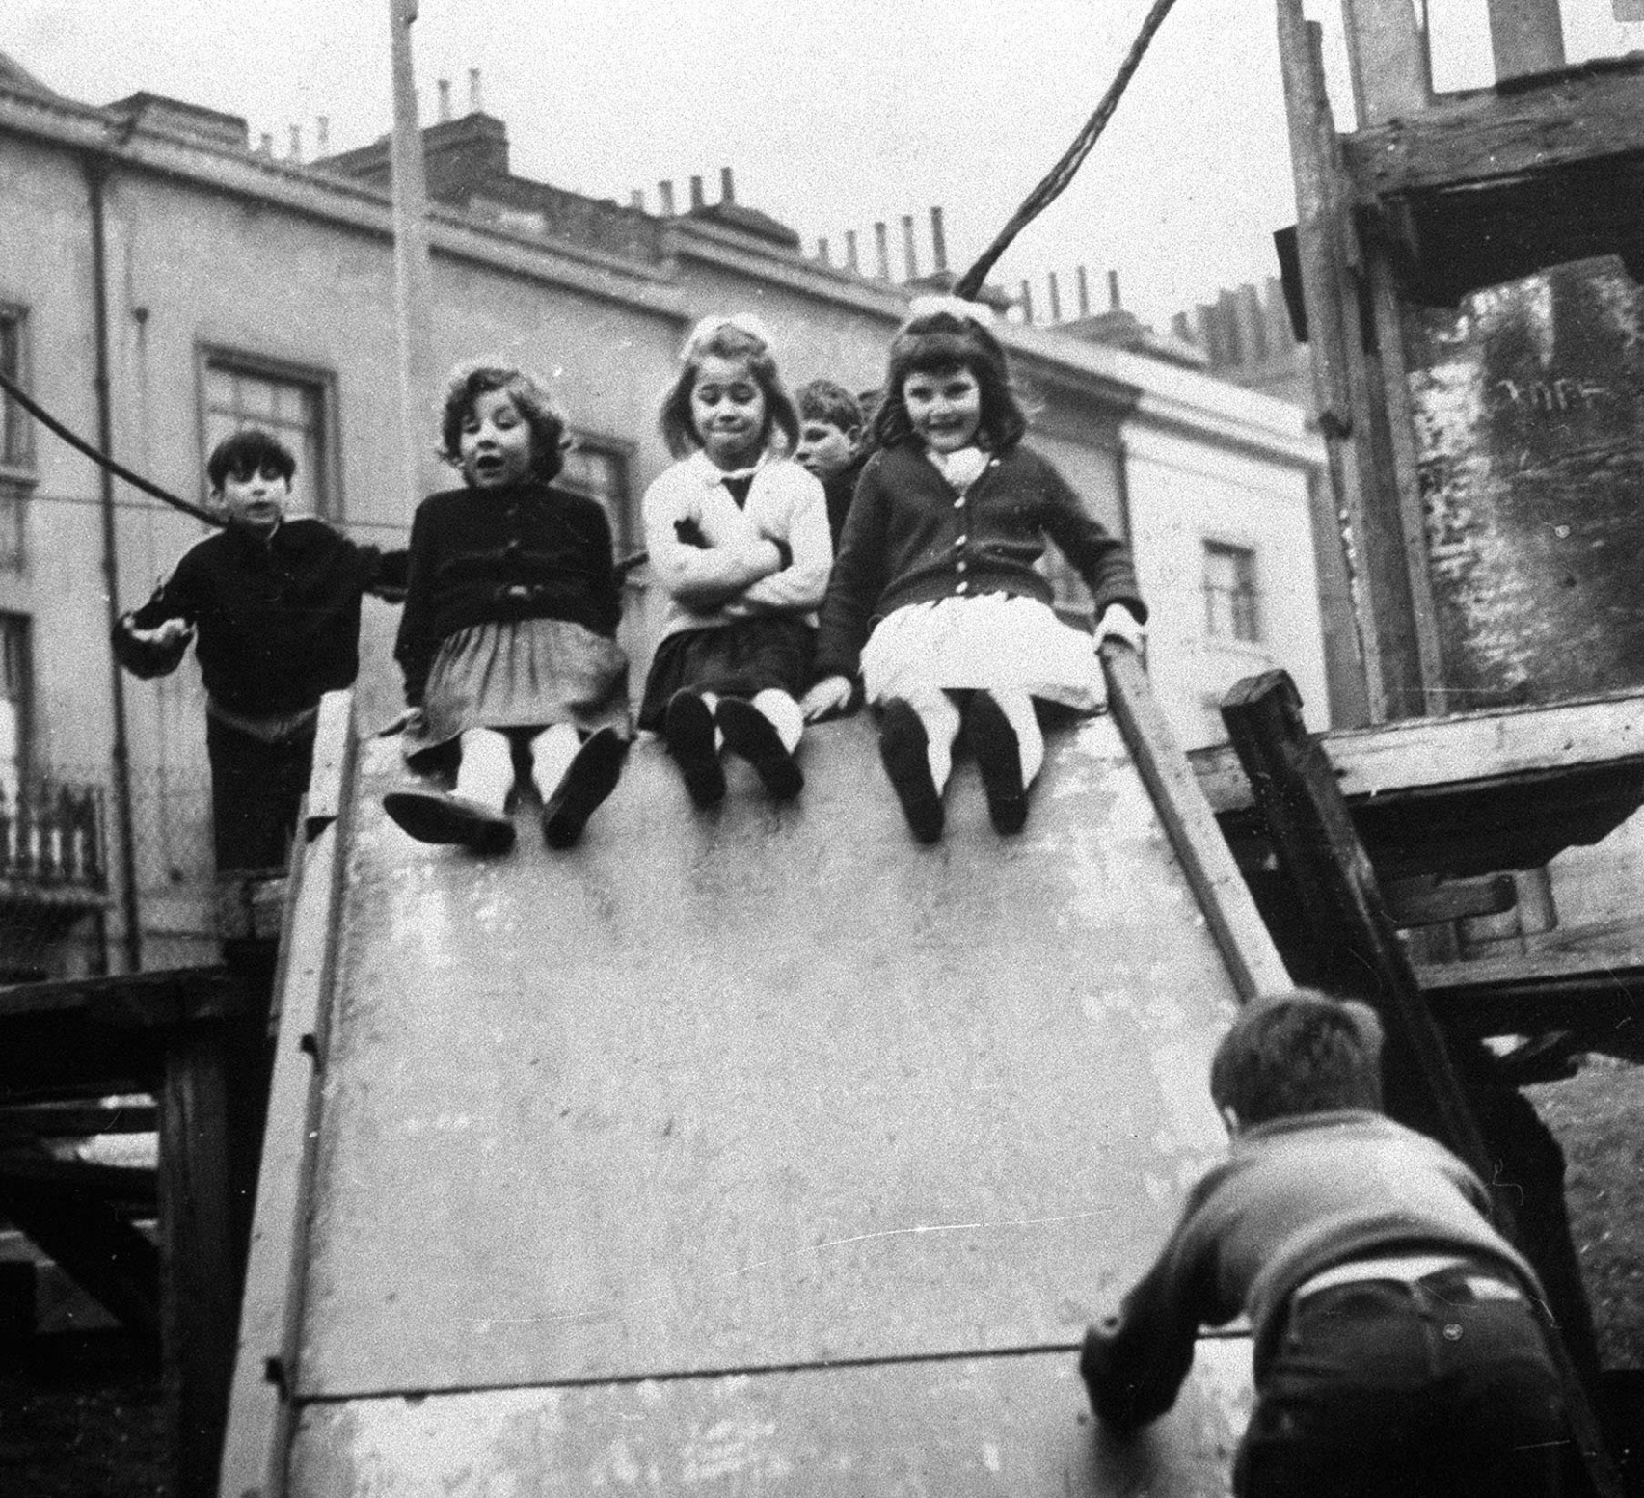
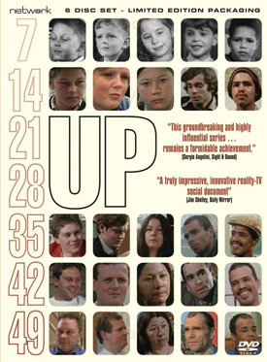
1964

Slide 36
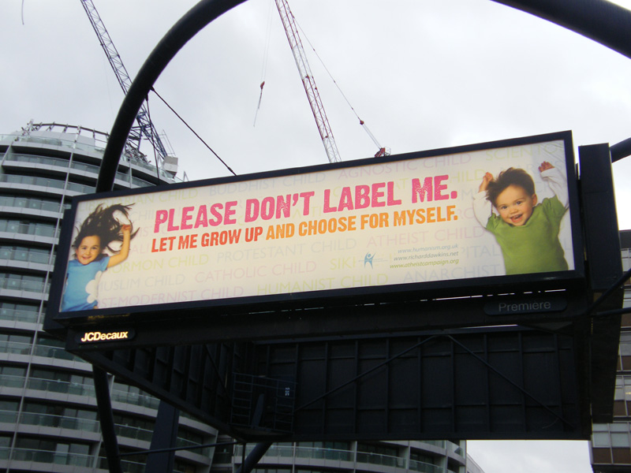


Counteracting Sectarian Education

Slide 37
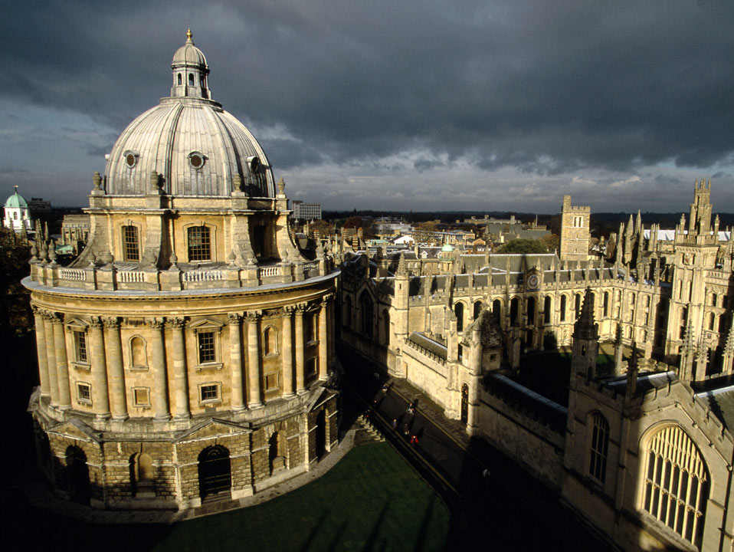
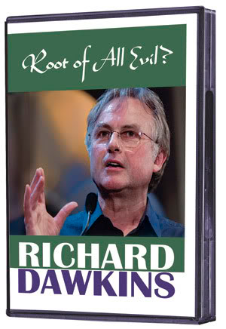
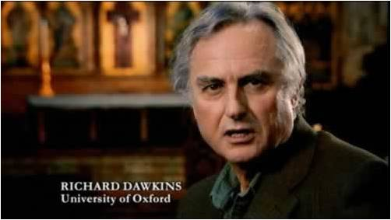

Slide 38
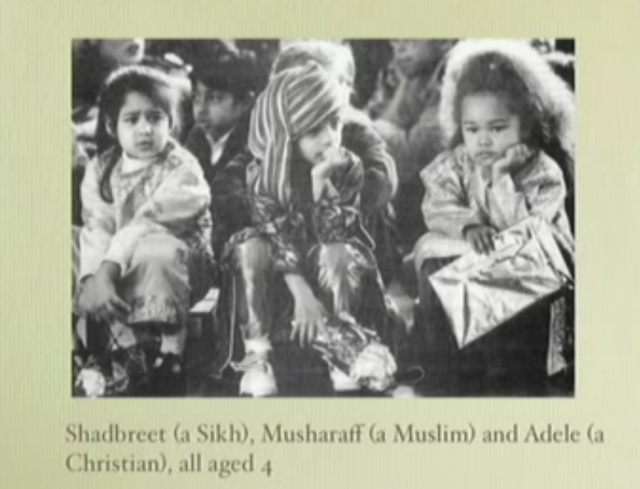

Slide 39
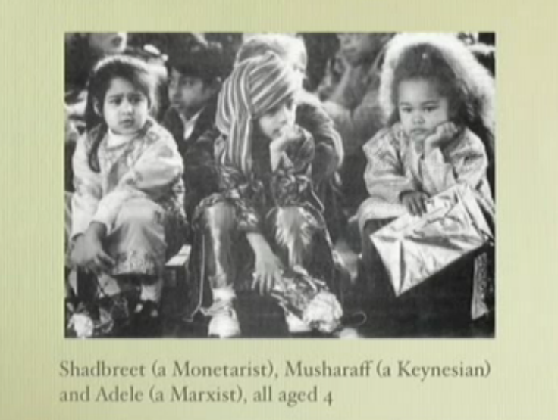

Slide 40
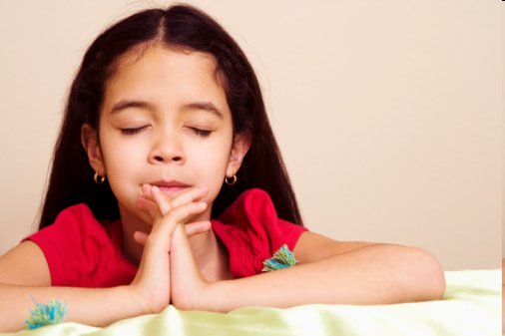
Let children acquire reason and critical thinking, then introduce them to religion and let them choose for themselves
What religion has ever said that?
They would not dare—David Eller

Slide 41
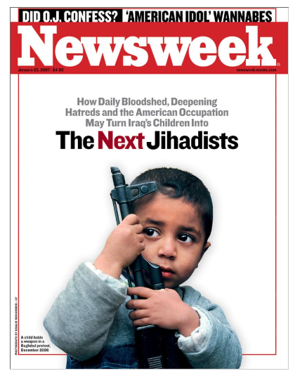


Slide 42
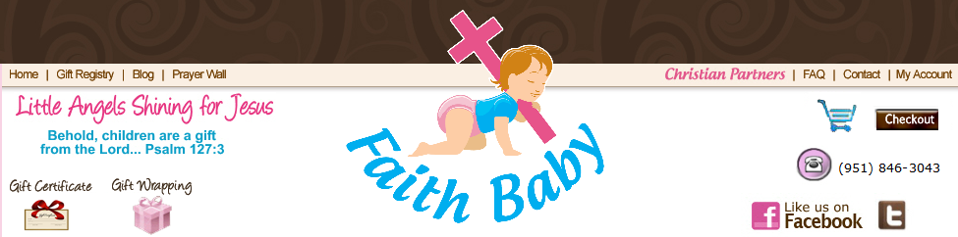
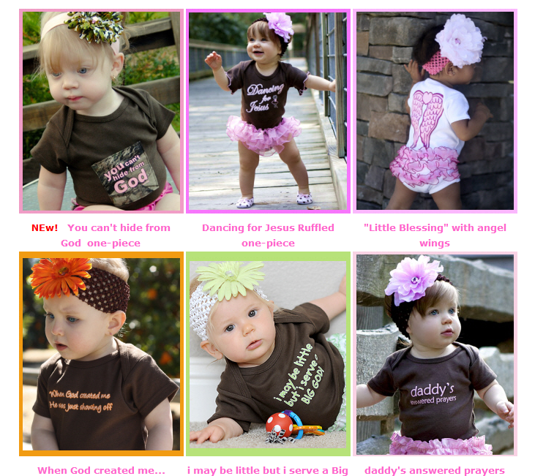

Slide 43
Thoughts?

Slide 44
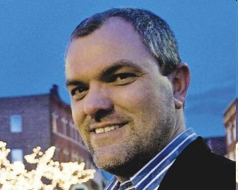
Secular Humanist = Philosophy of Humanism
  Virtue = promoting human well-being
  Moral Action—driven by our social instincts
  Social instincts = our innate altruistic co-operative tendencies
  In the absence of the divine we have to take care of each other

Slide 45
Seven Secular Virtues
Compare the original seven virtues (faith, hope, charity, courage, justice, temperance, and wisdom) to McGowan’s seven (humility, empathy, courage, honesty, openness, generosity, and gratitude)
What are their respective strengths and weaknesses as moral imperatives?
How much common ground is evident?
Are there any you would add or subtract from McGowan’s list?

Slide 46
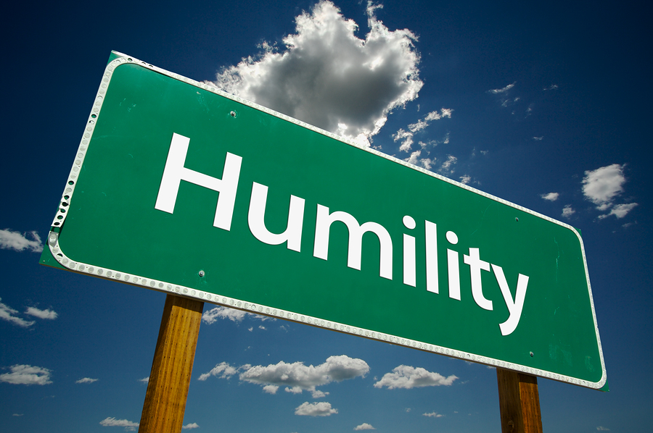
Pride vs Arrogance
Caring about what others think and feel

Slide 47
Pride vs Arrogance
Humility is the natural consequence of religious disbelief

Slide 48
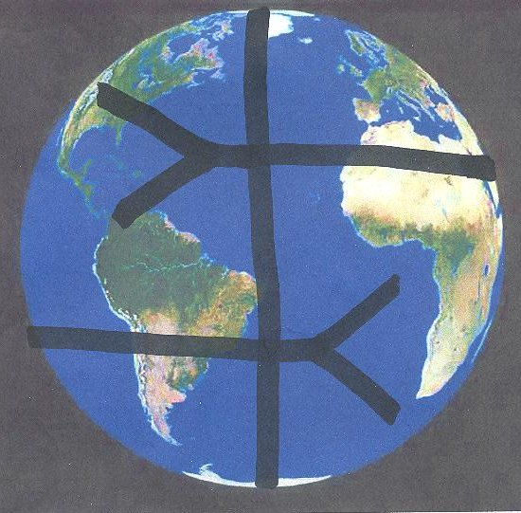
Empathy
Understand how someone else feels—care
Allow children see poverty up close
Travel to other countries
Value difference & recognize sameness
Understand religion—realities gave birth to religion and keep it alive
Comfort in the face of death

Slide 49
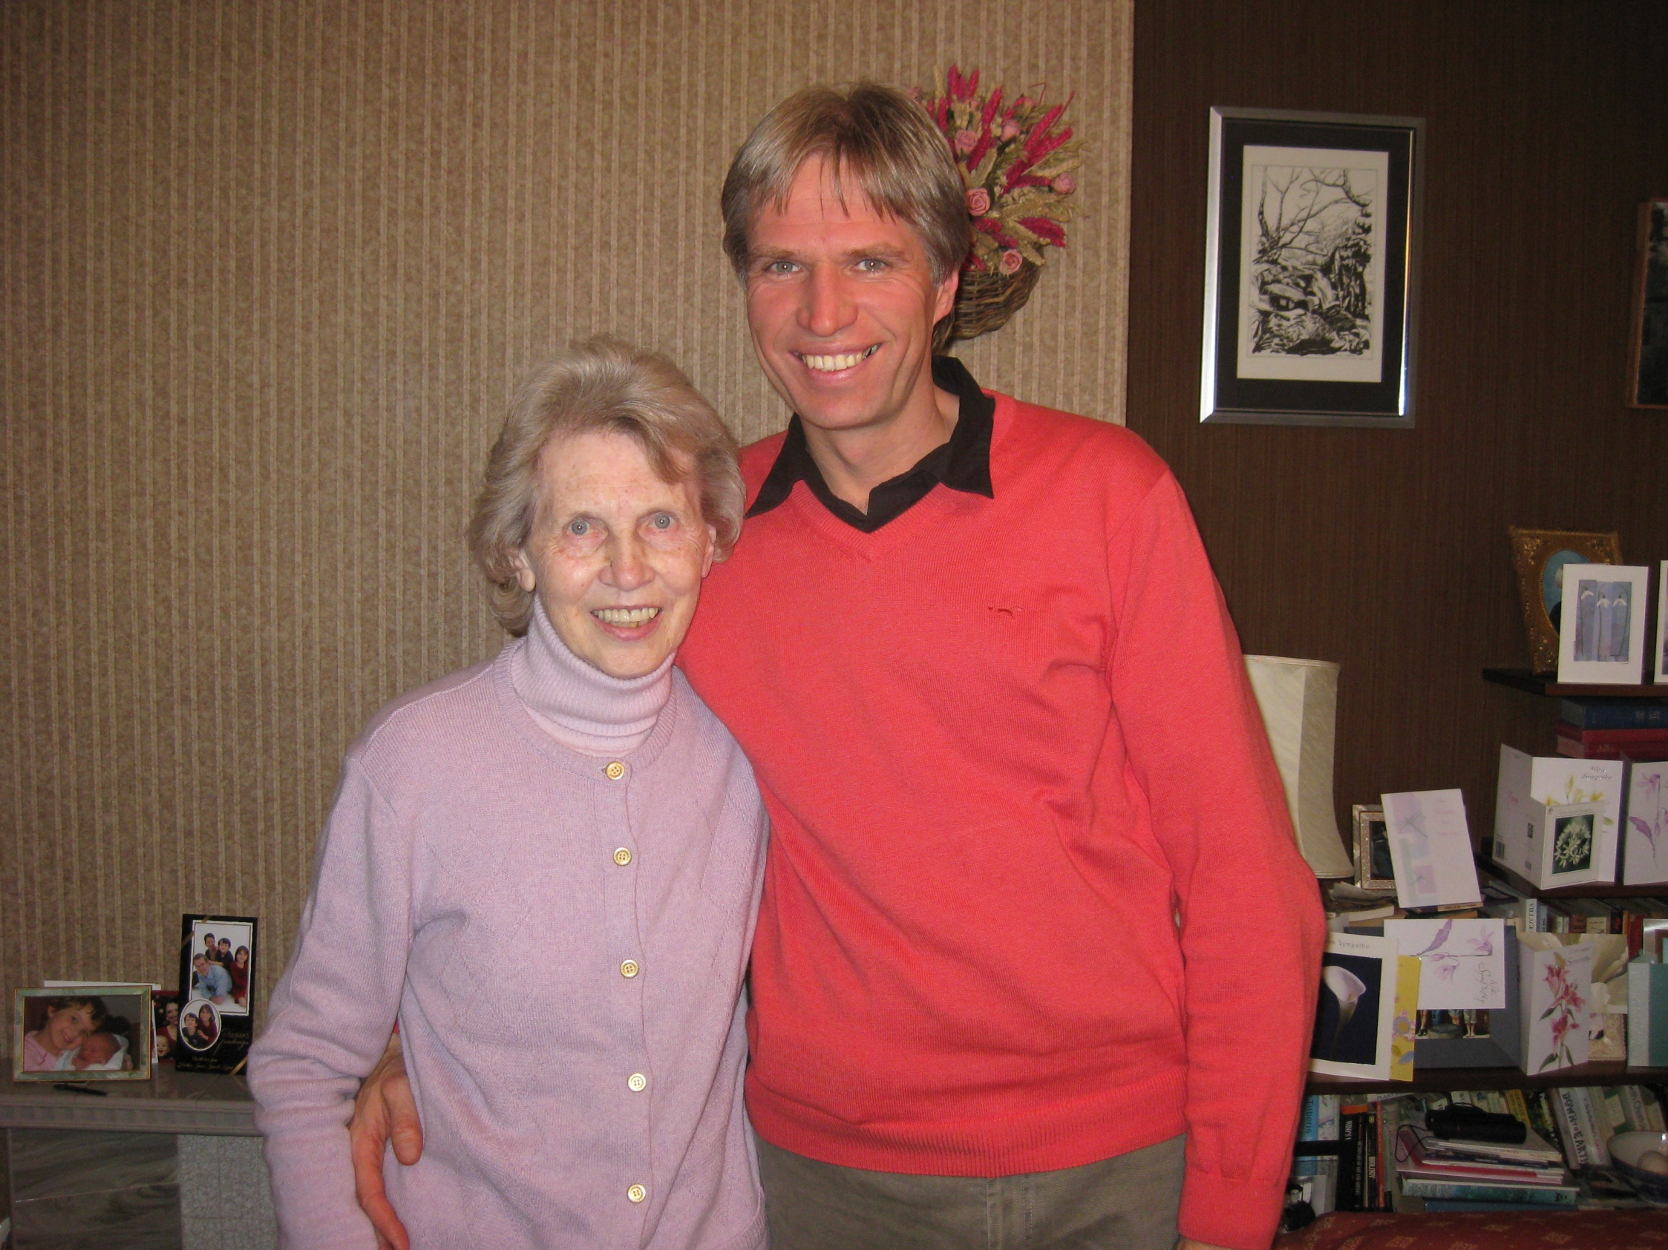

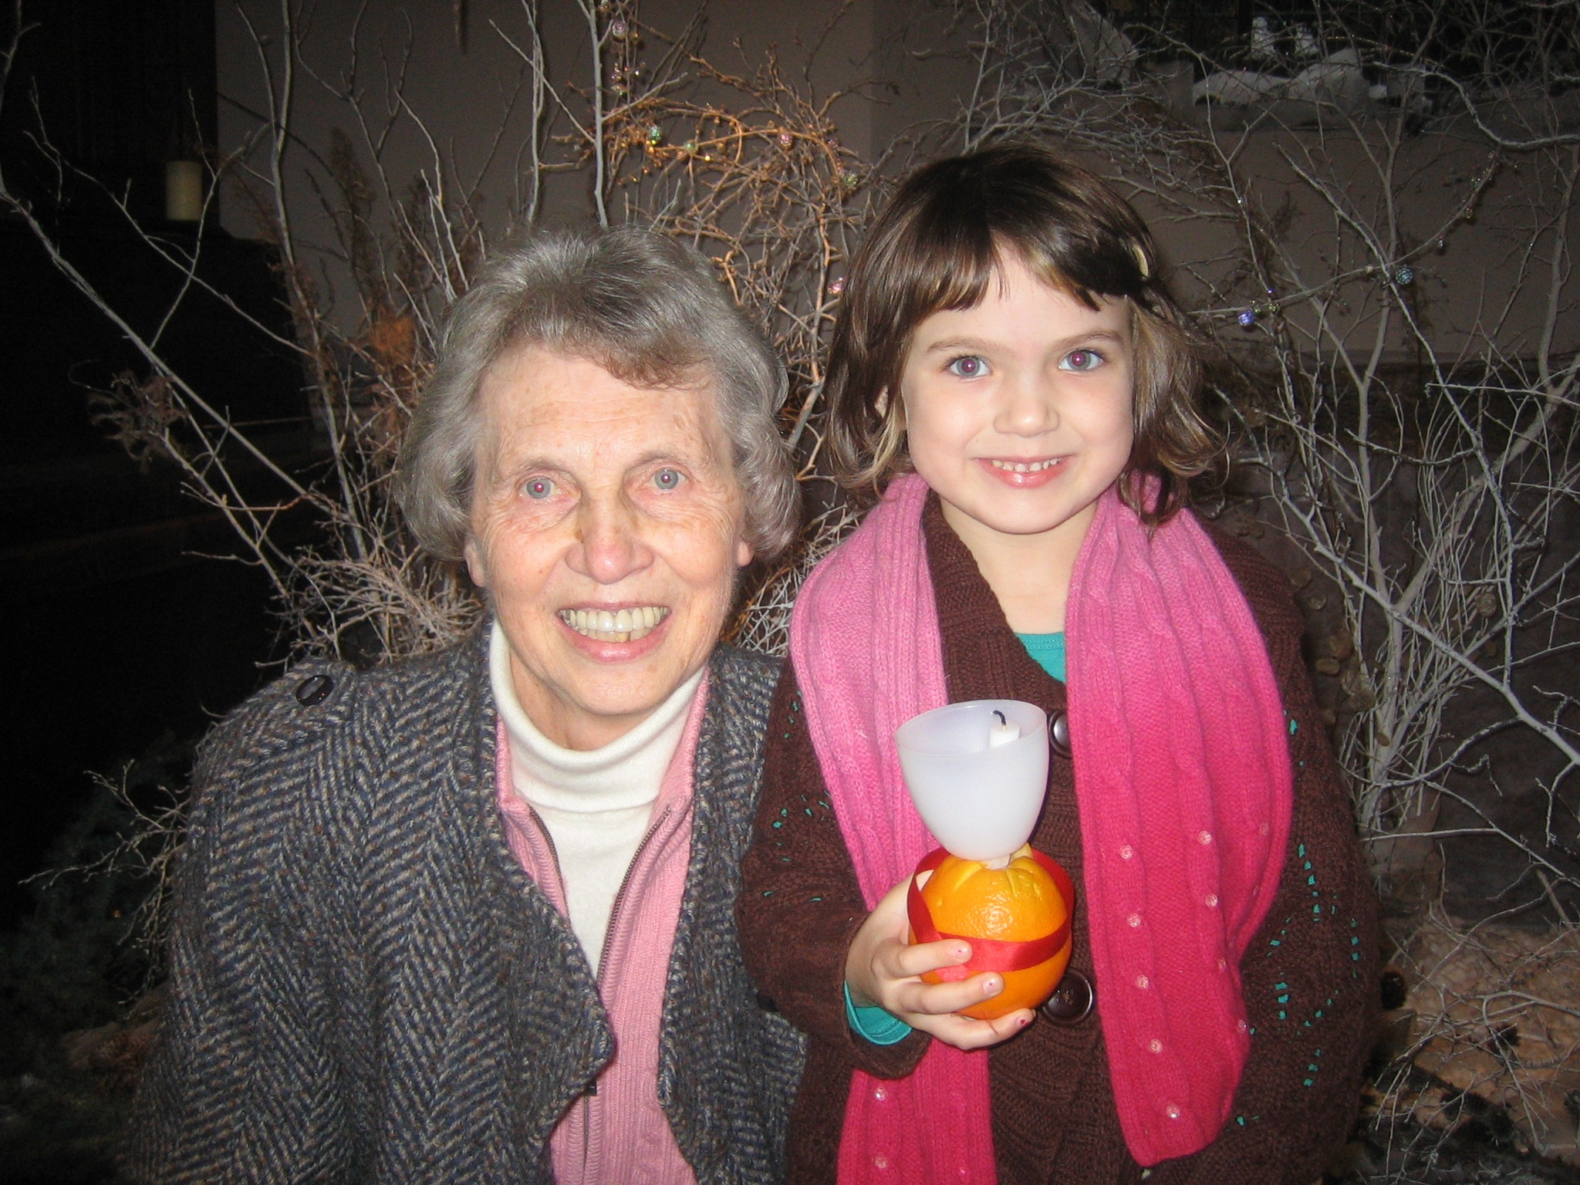

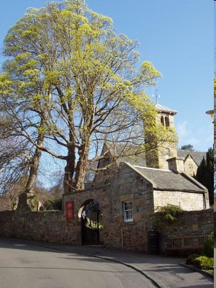

Communicating Across Lines of Religious Difference

Slide 50

Nonconformity Requires Courage
Religion evolved not to provide answers but to console fears

Slide 51


“What We Believe”
It’s expedient to pressure children to conform
It encourages community

Slide 52


Obedience
Conforming to dictates of authority figures had advantages
Parents, teachers knew more than we did
Following their advice was beneficial
Their positions speak of greater access to information and power

Slide 53


Religion = evolutionary by-product
Children’s brains—believe your elders without question
Flip side of trusting obedience = slavish gullibility

Slide 54


Slide 55


Essence of Secularism
Teach your children to choose their beliefs honestly then to honestly and proudly own them

Slide 56



Slide 57



Slide 58


Attitude towards Difference
Many “good ways” to be— embrace diverse approaches to life
Reject choices that harm others

Slide 59


Slide 60


Slide 61


Slide 62


Generosity

Slide 63

82% volunteerism—“church maintenance”
Volunteerism within, for the benefit of, church building and immediate church community

Slide 64


Slide 65

Denmark & Sweden 80% population “Secular”
Rank highest in generosity to poor countries

Slide 66

In what ways would you encourage gratitude as a virtue in your children?

Slide 67

Elevator Speech

Slide 68
Relax! … children arrive at moral values “reliably, and on time”

Slide 69



Slide 70

Without God, life has no purpose, and without purpose, life has no meaning Without meaning, life has no significance or hope

Slide 71



Slide 72




Slide 73



Slide 74
How might you encourage children to find their own meaning/purpose?

Slide 75


Asking, “If there is no God, what is the purpose of life?” is like asking, “If there is no master, whose slave will I be?”

Slide 76
Purpose comes from solving problems
As long as there are challenges, there is purpose in life
Life is its own reward
To reach outside your life for meaning is to abandon the value of what is inside your life

Slide 77
Find something you hate and work against it
Find something you love and work for it

Slide 78

Death

Slide 79


Slide 80

Challenging Three Myths
Myth #1 Religion cures fear of death
Myth #2 Children less able than adults to think about death
Myth #3 We can or should be comfortable with the idea of death

Slide 81


Slide 82
Idea of immortality survives and spreads because it caters to wishful thinking
Human psychology has a near-universal tendency to let belief be colored by desire

Slide 83


Death comes too soon for most of us, before our interest in the world, and in those we care about, is exhausted
We are creatures of narrative; the next installment of the story interests us crucially; therefore death, either of someone we love, or as the infinite prospect of our own absence from the story, typically counts as evil

Slide 84
Being dead is not something we experience
“Me-floating-in-darkness-forever”
What seems frightening is the prospect of dying
Humanist—honesty is better than comforting illusions

Slide 85

We hide from death, and we hide death from us, until the last moment; and especially until we have to face the deaths of others
Our forms of dealing with death are often too stiff and awkward to give real comfort
This might be different if we thought about death and its meanings more carefully, and provided ourselves with an unvarnished, uncompromising portrait of it as the greatest fact of life

Slide 86
Discussion Questions
What messages do you think children should hear when contemplating death?
What would you say to someone who suggests that talking openly about death with children is “morbid”?

Slide 87

Death of a Pet

Slide 88

Visit Cemeteries

Slide 89

Death in the News

Slide 90

Symmetry …
We’ve been there before

Slide 91


Be Honest
Share emotions
Be patient
Listen
Reassure
Speak openly
Let your children know what you believe & why
Encourage your children to question their own beliefs and the beliefs of others, including yours

Slide 92




Slide 93


Creative Rituals

Slide 94




Slide 96



Slide 97





Slide 98



Slide 99



Mason Crumpacker

Slide 100


CQTX

Slide 101



Slide 102



Slide 103




Slide 104



Slide 105





Slide 106



Slide 107
Four Arguments for Religious Literacy
Necessary to understand world
Knowledge is Power
Necessary for informed decision about one’s own worldview
Avoid “teen epiphany”

Slide 108

Exposure to multiple religions is the key to information without indoctrination

Slide 109
Basic creation stories, many traditions
Read myths and legends of many traditions
Church on occasion with trusted relatives
Age-appropriate movies

Slide 110




Slide 111




Slide 112



Slide 113

Freethought
versus
Fearthought

Slide 114
Guidelines of Questioning
Make questioning itself enjoyable
Encourage an unconditional love of reality
Respond in a variety of ways
RESIST URGE TO MAKE CONSTANT CORRECTIONS

Slide 115

Dale’s “Nine Best Practices”

Slide 116
Review
Attitudes towards Atheists
Evolved tendency toward moral behavior
Labeling
Seven Secular Values
Meaning of Life
Death & Life
Best Practices

Slide 117
Personal Reflections II Essay

