Slide 1

God's Song

Slide 2


Slide 3



Critical Perspectives

Slide 4

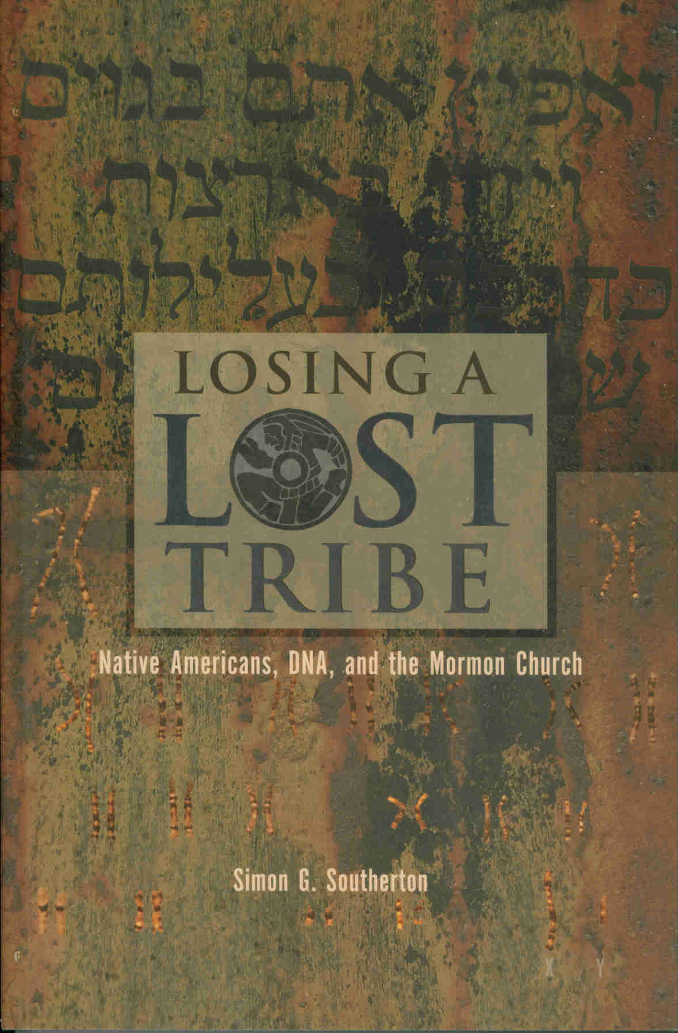
Group B

Slide 5

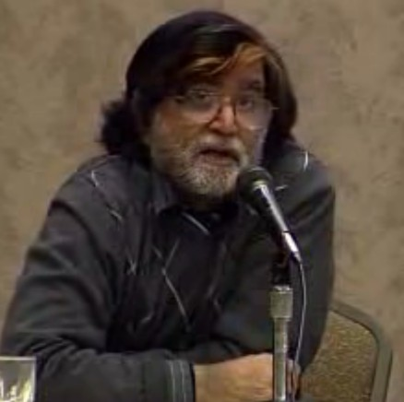
Group C

Slide 6
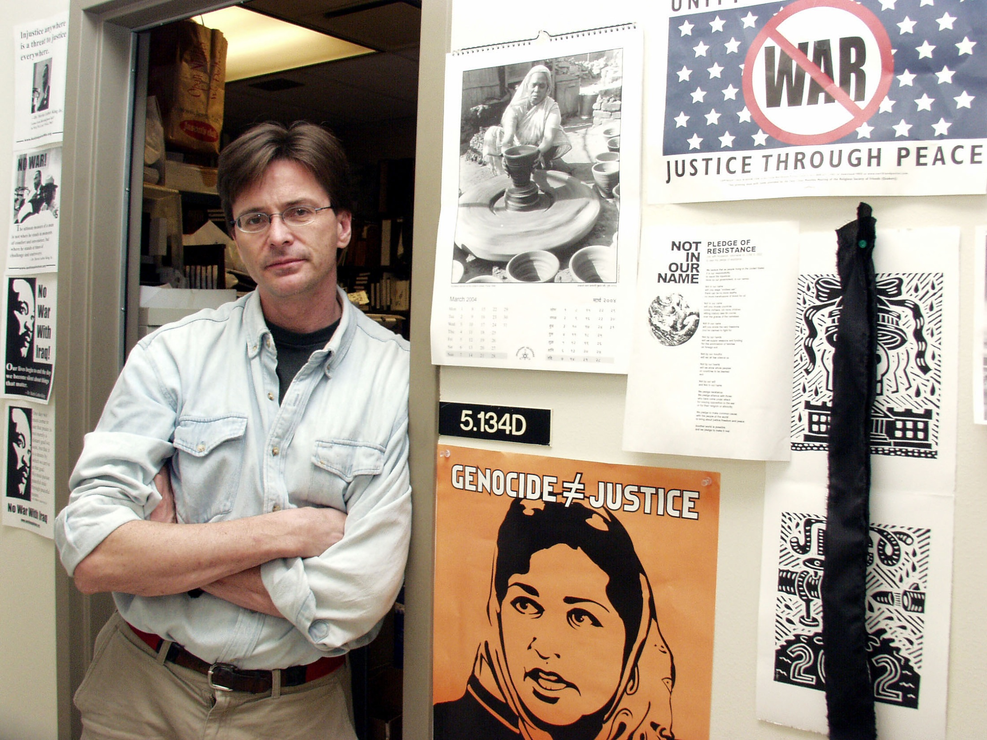


Slide 7

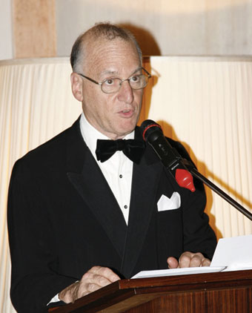
Father Bernard Lynch

Slide 8
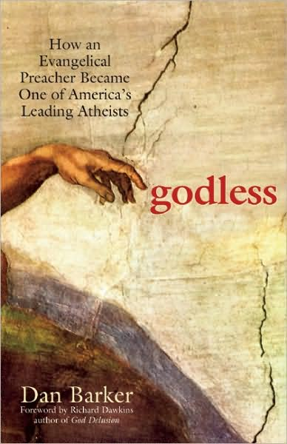
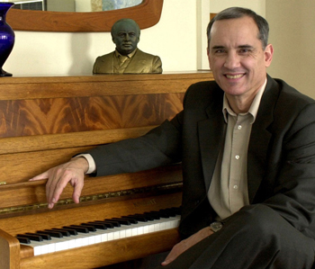

Critical Perspectives
Chs 5-9

Slide 9


Age of Reason?

Slide 10
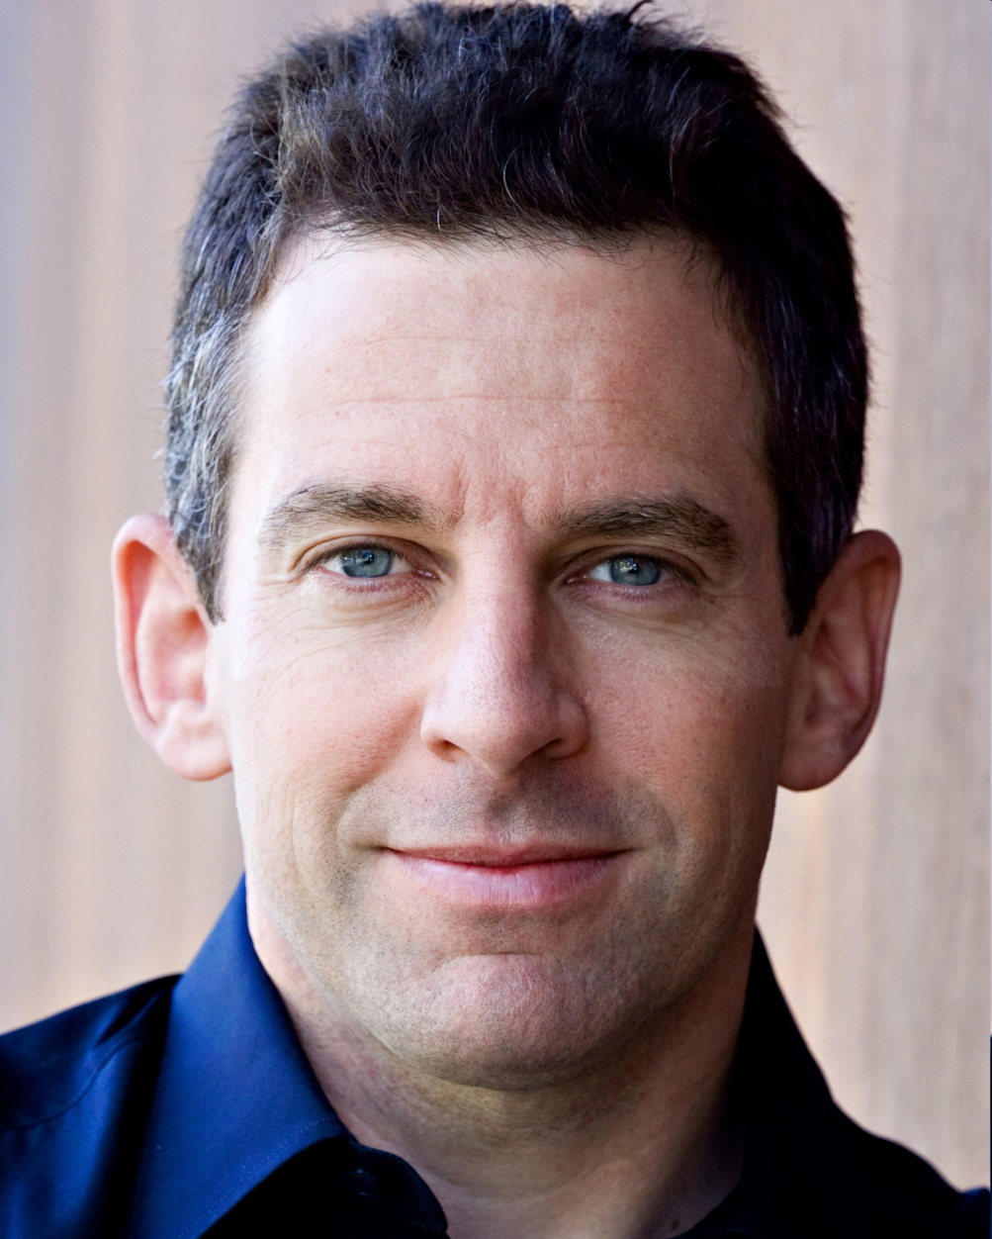
We need a public discourse that encourages critical thinking and intellectual honesty
Learn to meet our emotional needs & invoke power of ritual without lying to ourselves about the nature of reality

Slide 11
Religious unreason should acquire an even greater stigma in our discourse, given that it remains among the principle causes of armed conflict in our world
Challenge Christians to present evidence of God’s existence

Slide 12

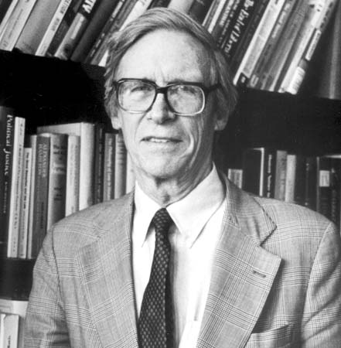
When we enter the public square, we are obliged to talk to each other in terms we can share and understand, not in ways that are tied to our specific “comprehensive doctrines”

Slide 13
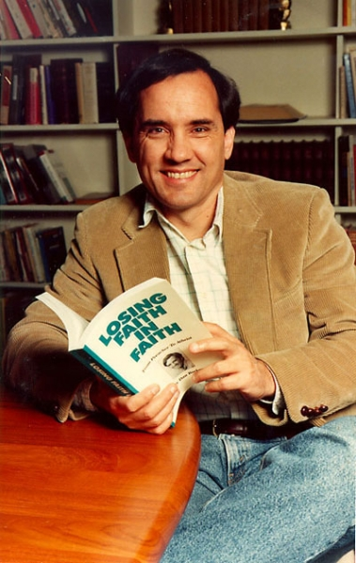
Reasonable Propositions
Verification (what evidence or observations confirm it?)
Repeatability (can anyone replicate the results?)
Falsifiability (what would disprove it?)
Parsimony (simplest explanation)
Logic (free of contradictions)

Slide 14
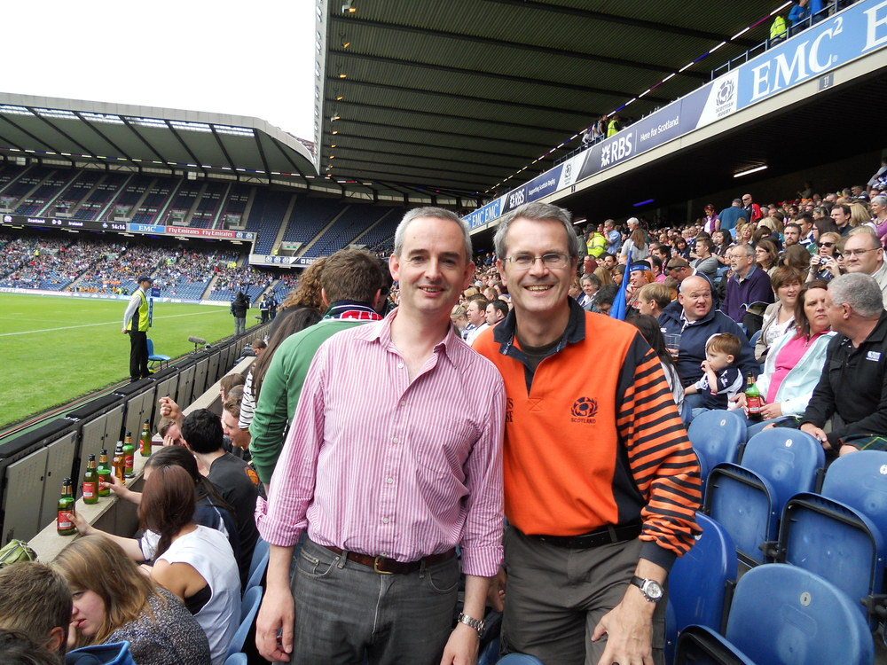
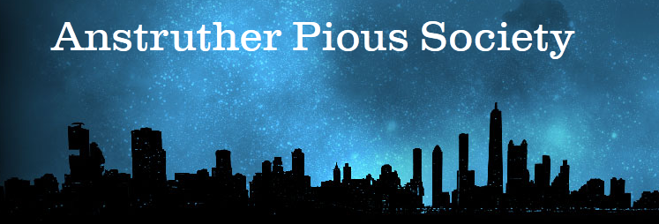

Slide 15
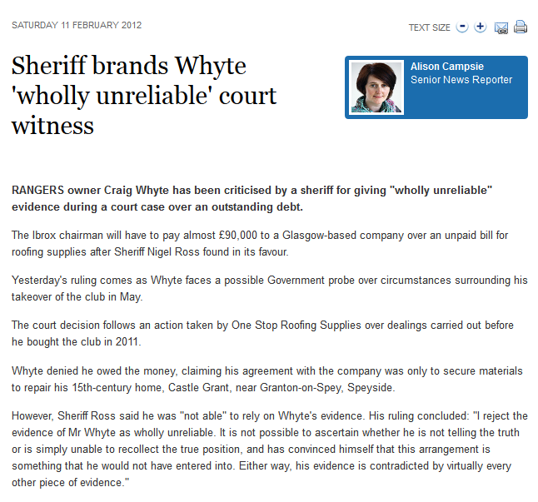

Slide 16
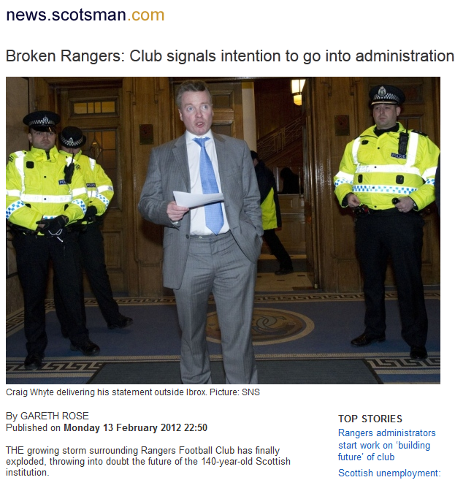

Slide 17
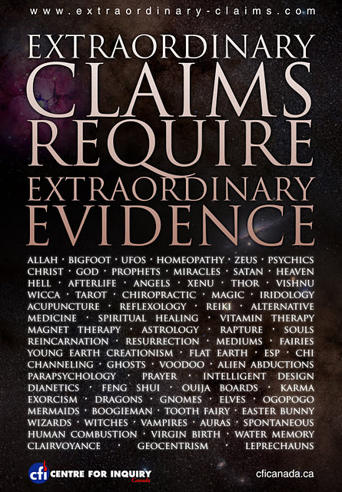
What evidence would change your mind about your position be it religious, agnostic, or atheist?

Slide 18
Accurate Science in Religious Texts:
If the bible referenced the laws of electromagnetics; the germ theory of disease; quantum mechanics; atomic theory or scientific knowledge that the people of the time could not possibly have known but was accurately described or prophesied in the bible, then I could be persuaded it was divinely inspired

Slide 19
Miraculous occurrences, especially if brought about through prayer: If a roomful of amputees regrew limbs as a result of intercessory prayer, and if these medical “miracles” were objectively verifiable I could be persuaded of a divine power

Slide 20
Accurate Prophecies in Sacred Texts: If any sacred text in any religion made clear, unambiguous, accurate prophecies about the future—and did so consistently—I could be convinced a divine being existed

Slide 21
Any direct manifestation of the divine: If God communicated an unambiguous message to me in person that I could be sure was not a hallucination. There would have to be multiple independent and reliable witnesses to the event

Slide 22
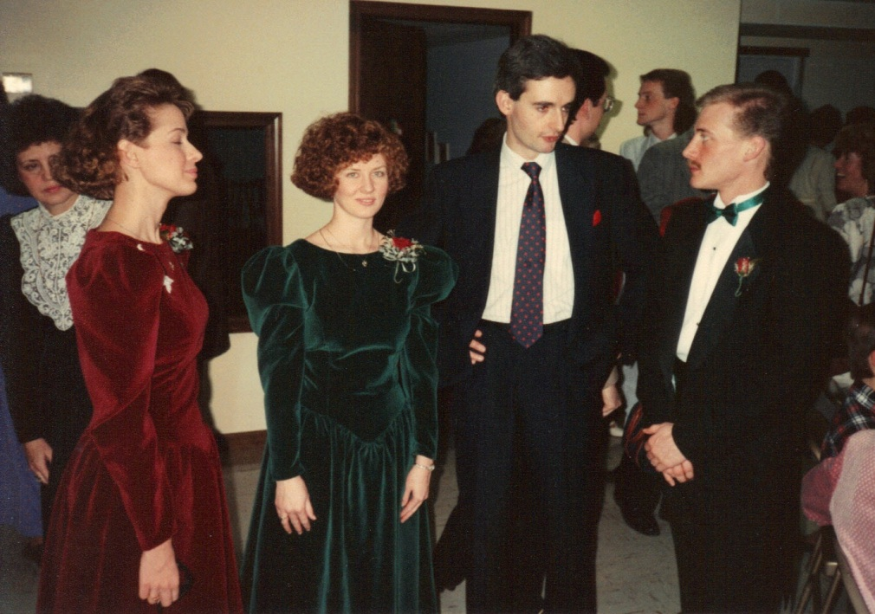
The main thing that would compel me to rethink would be a total failure of the promises of the bible. Those, unfortunately, are largely posthumous. If I die, and they’re not true, I will be seriously pissed off, and your little pile of dust gets bragging rights over my little pile of dust

Slide 23
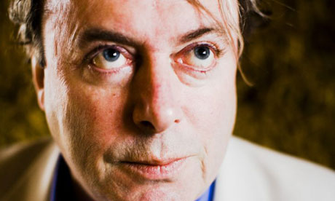
What’s the harm in people believing they will go to heaven after they die?
Promise 72 virgins and they’ll kill to get there
Credulous and deluded people = easy to exploit
Belief in heaven not private:
  Try to convert you; teach children pseudoscience; prevent access to contraception
  Try to inflict delusions on other people

Slide 24
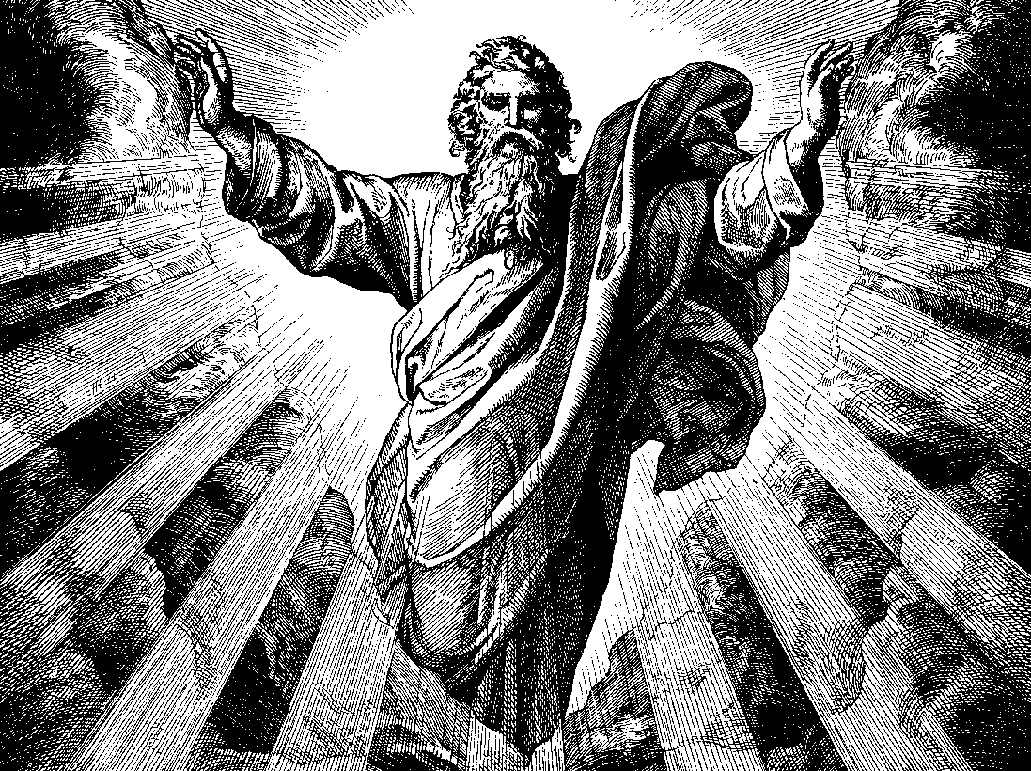
In Groups
Of the proofs for God described by Dan Barker, in your opinion which one is the most persuasive?

Slide 25
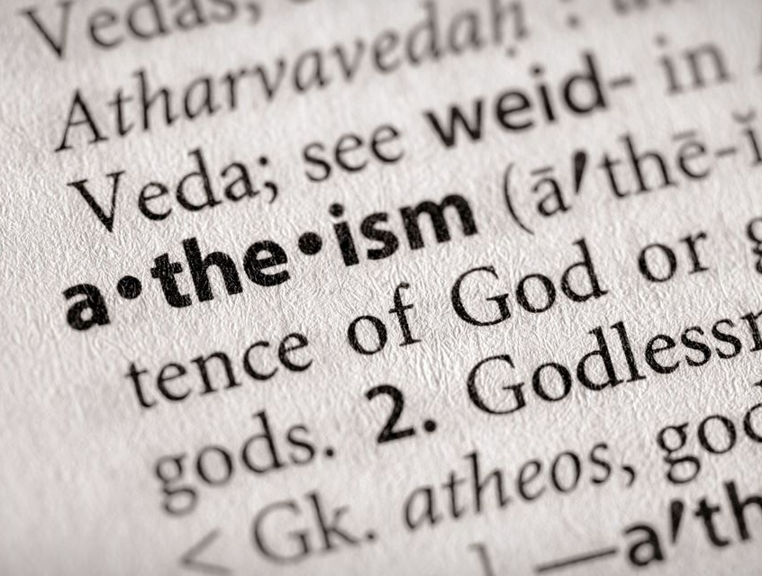
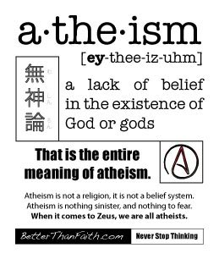

Slide 26
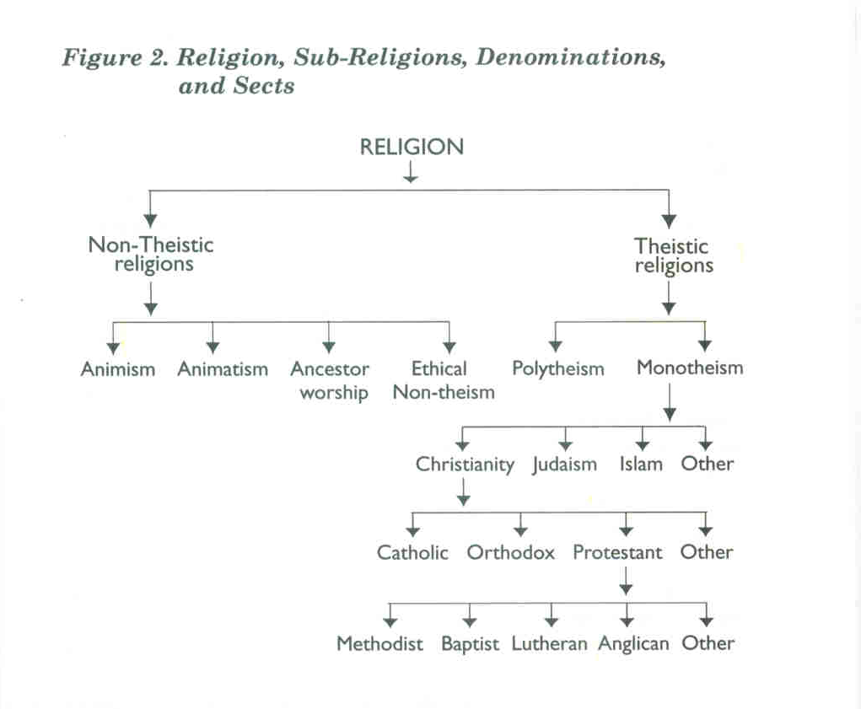
Atheism = most common form of religion
Most religions are a-theisms—do not include a god concept
Nature Spirits, Dead Ancestors, Supernatural Forces—lack gods

Slide 27

Address Most Profound Human Questions

Slide 28
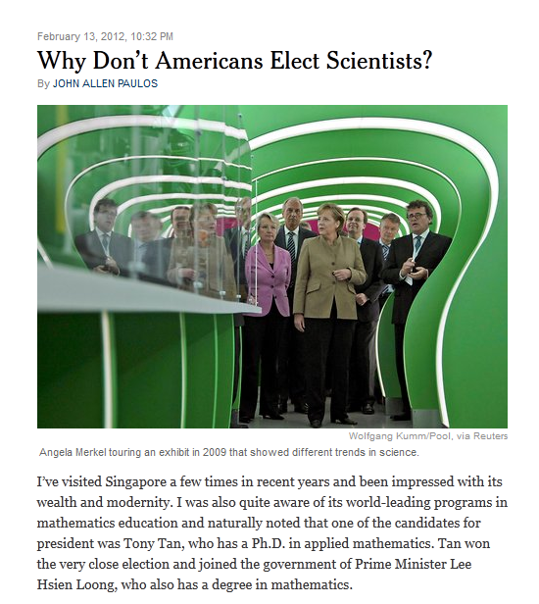
Physicists

Slide 29
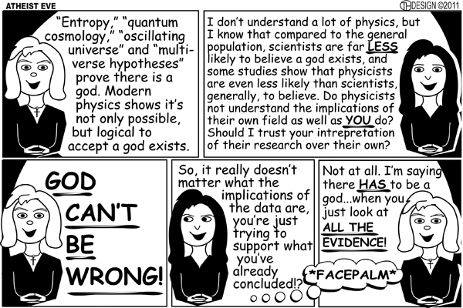

Slide 30
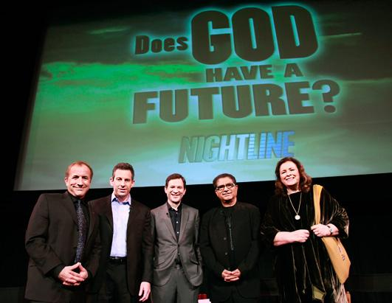
Harris

Slide 31
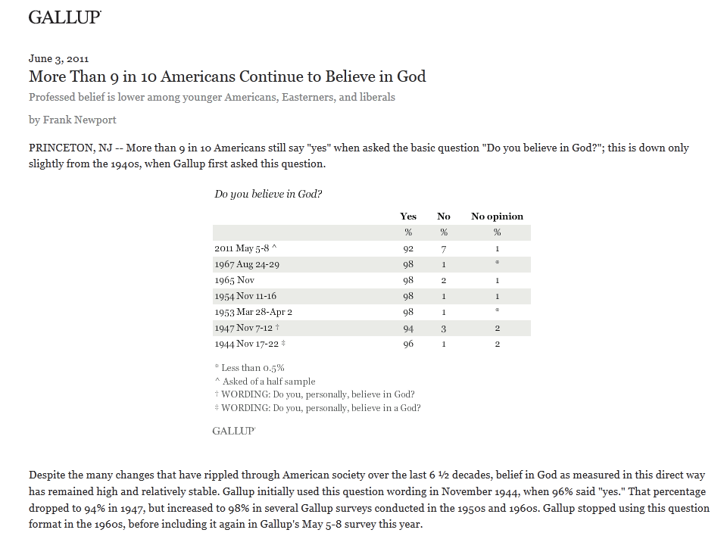

Slide 32
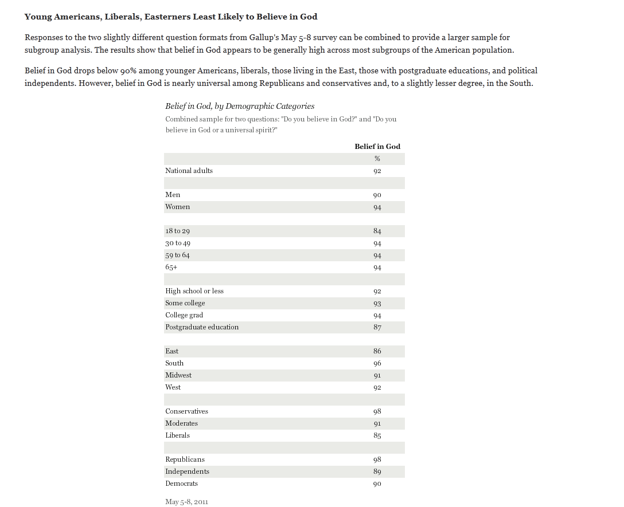

Slide 33


Slide 34
Atheist = Believes that the 260 million Americans (87% of the population) claiming to “never doubt the existence of God” should be obliged to present evidence for his existence

Slide 35
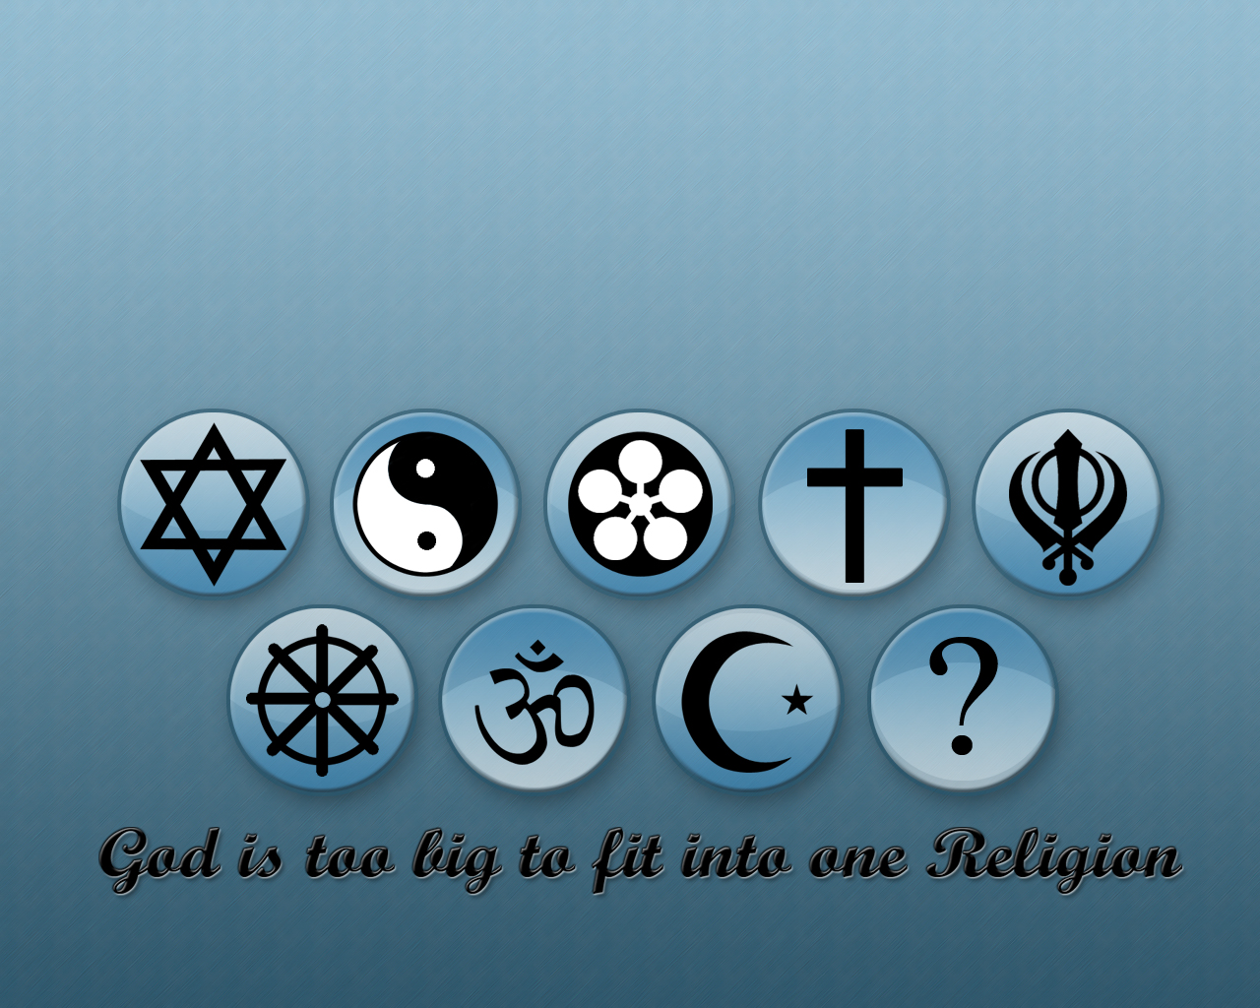
Religious beliefs, to be beliefs about the way the world is, must be based on evidence

Slide 36
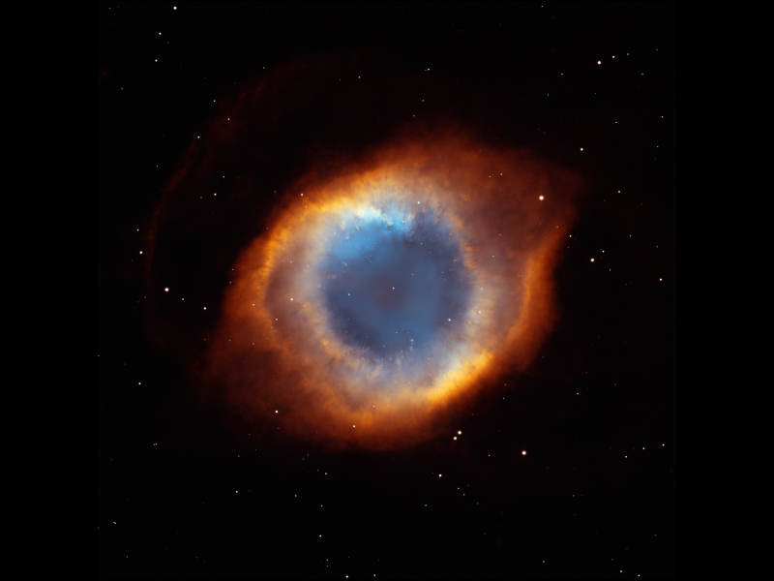
You can be certain of God with zero evidence
Either you have good reasons for what you believe or you don’t
Religion is the only area of our lives where having no reasons, or tenuous reasons, is considered a benefit

Slide 37


Faith = believing strongly without evidence
Faith in God = immense prestige
Faith = pretending to be certain about things no human being could possibly be certain about

Slide 38
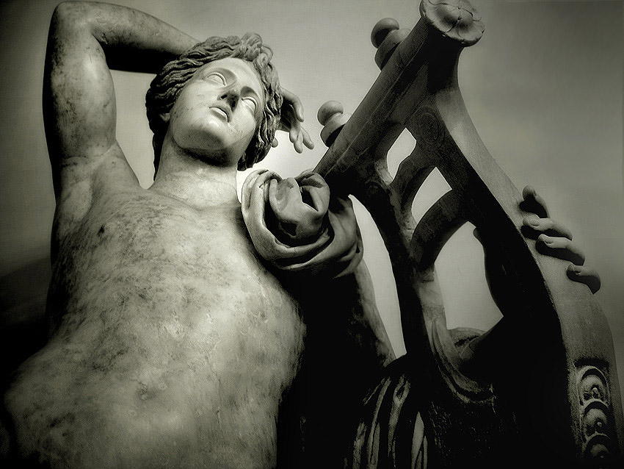
Words like “God” and “Allah” must go the way of “Apollo” and “Baal” or they will unmake our world

Slide 39
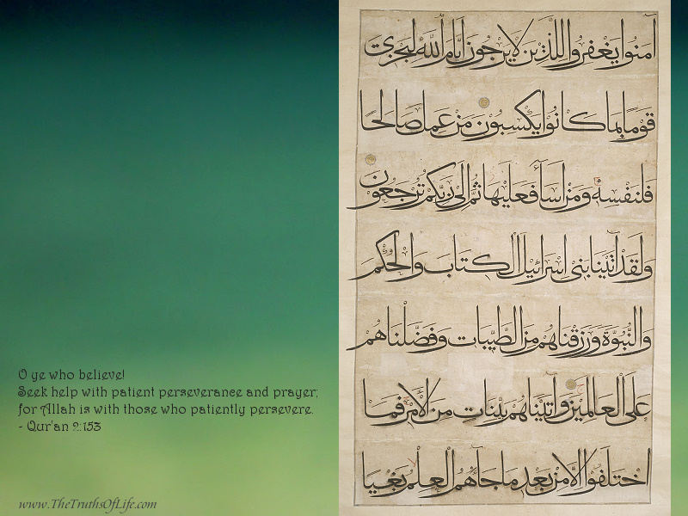
Because most religions offer no valid mechanism by which their core beliefs can be tested and revised, each new generation of believers is condemned to inherit the superstitions and tribal hatreds of its predecessors

Slide 40
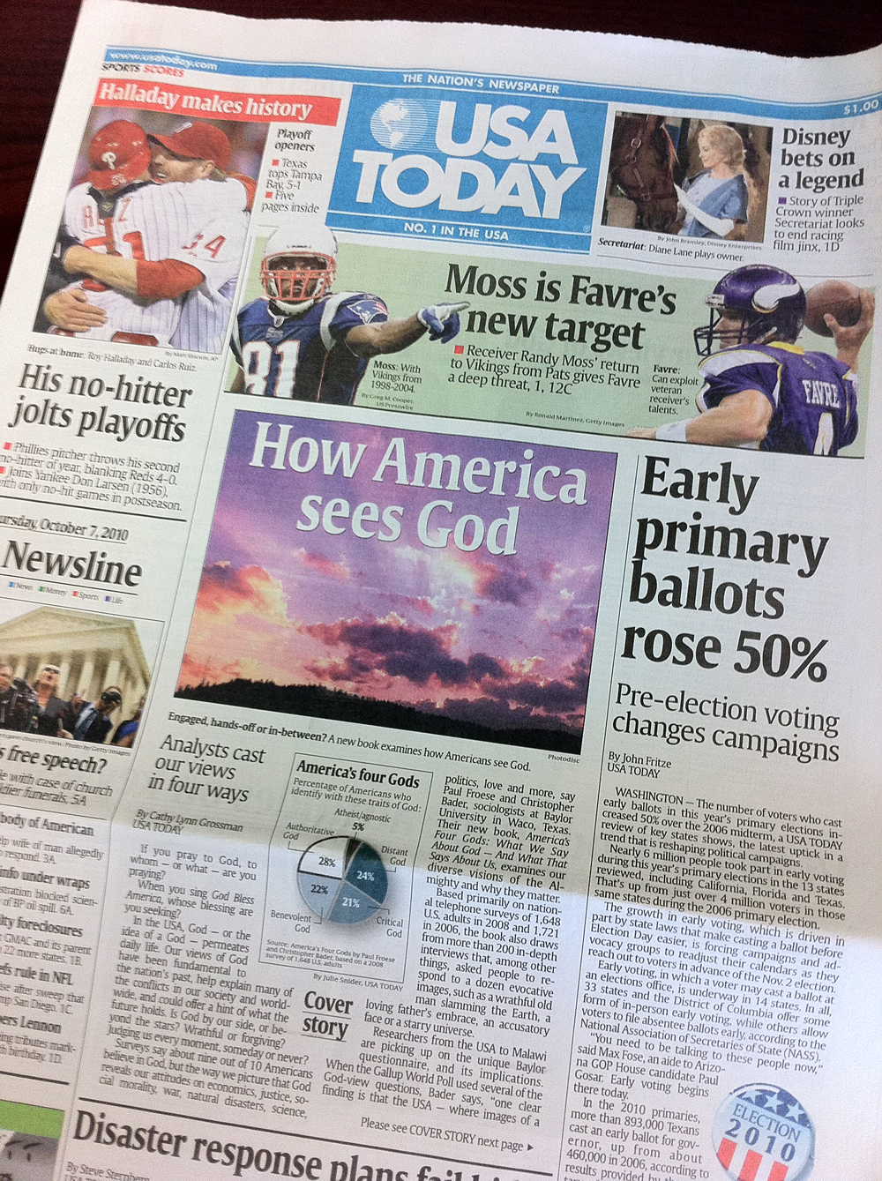
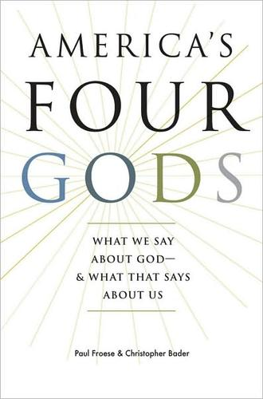
Views of God

Slide 41
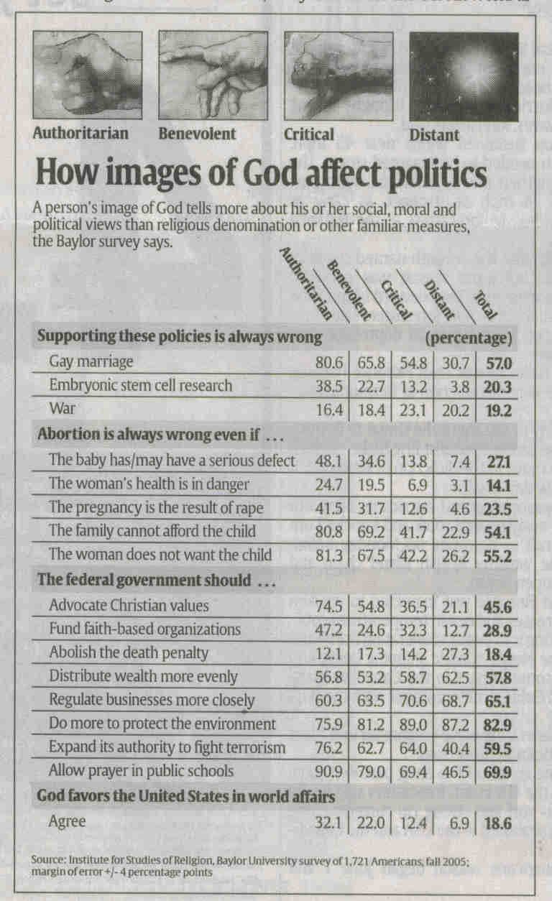

Slide 42
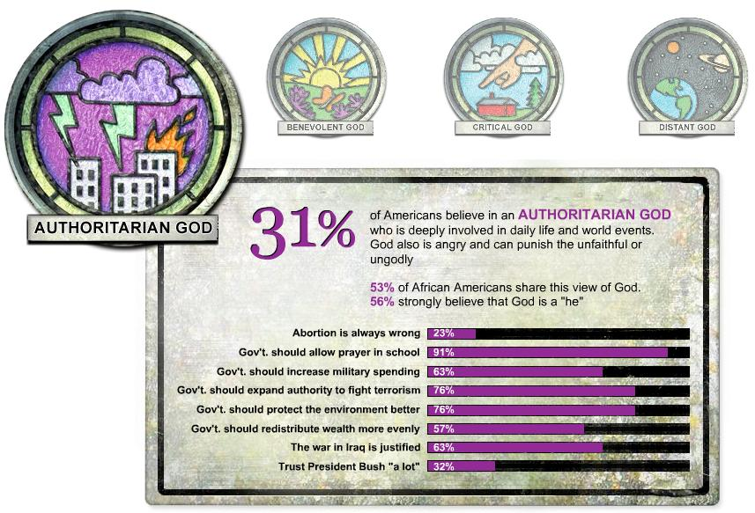

Slide 43
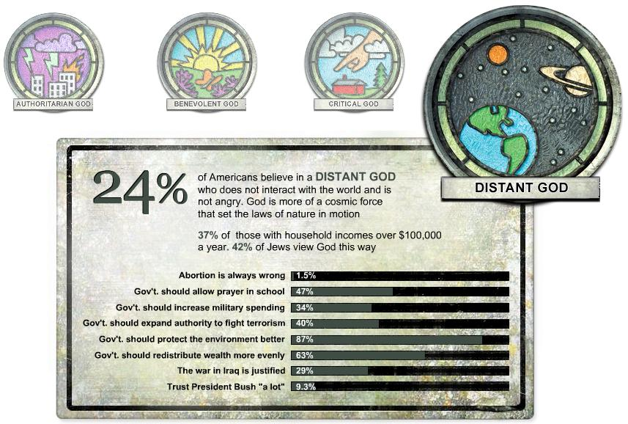

Slide 44
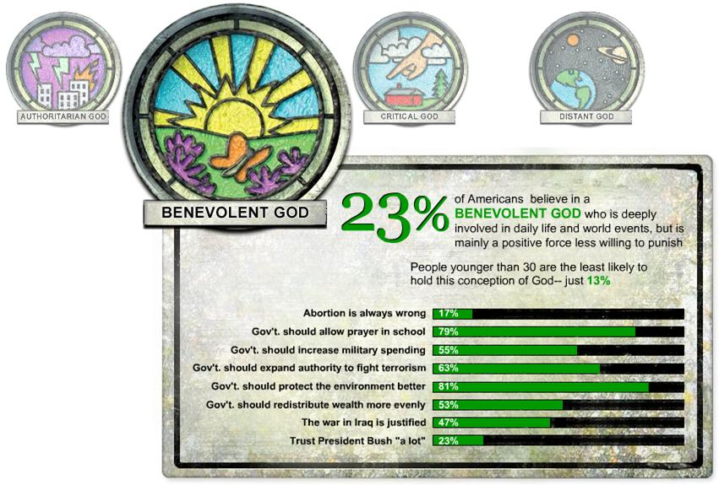

Slide 45
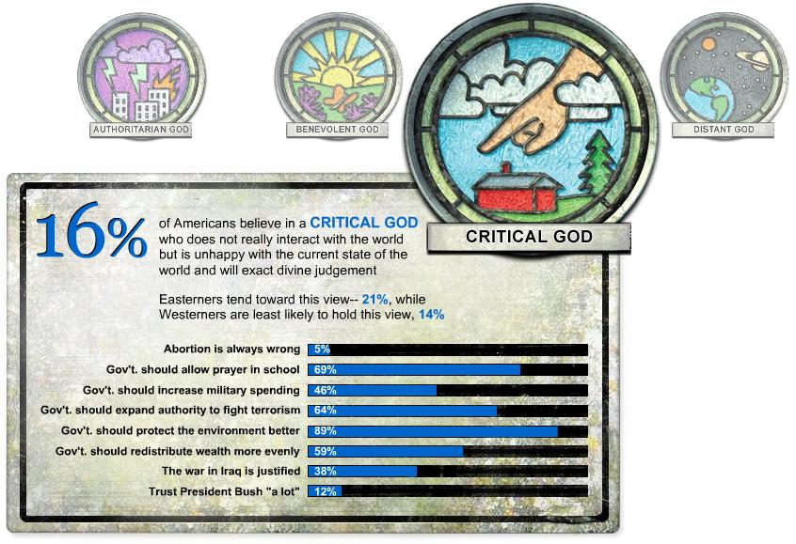

Slide 46
The Former United States
The United States of Northeast America
  Freedom of religion
The Christian Heartland Republic
  Laws against homosexual marriage, abortion, contraception, pacifism, learning foreign languages (Spanish & Chinese)
The Southwest Christian Republic
  Similar alliance minus Spanish language ban
The Secular Pacific Alliance
  Banned public exercise of religion (Canada)

Slide 47
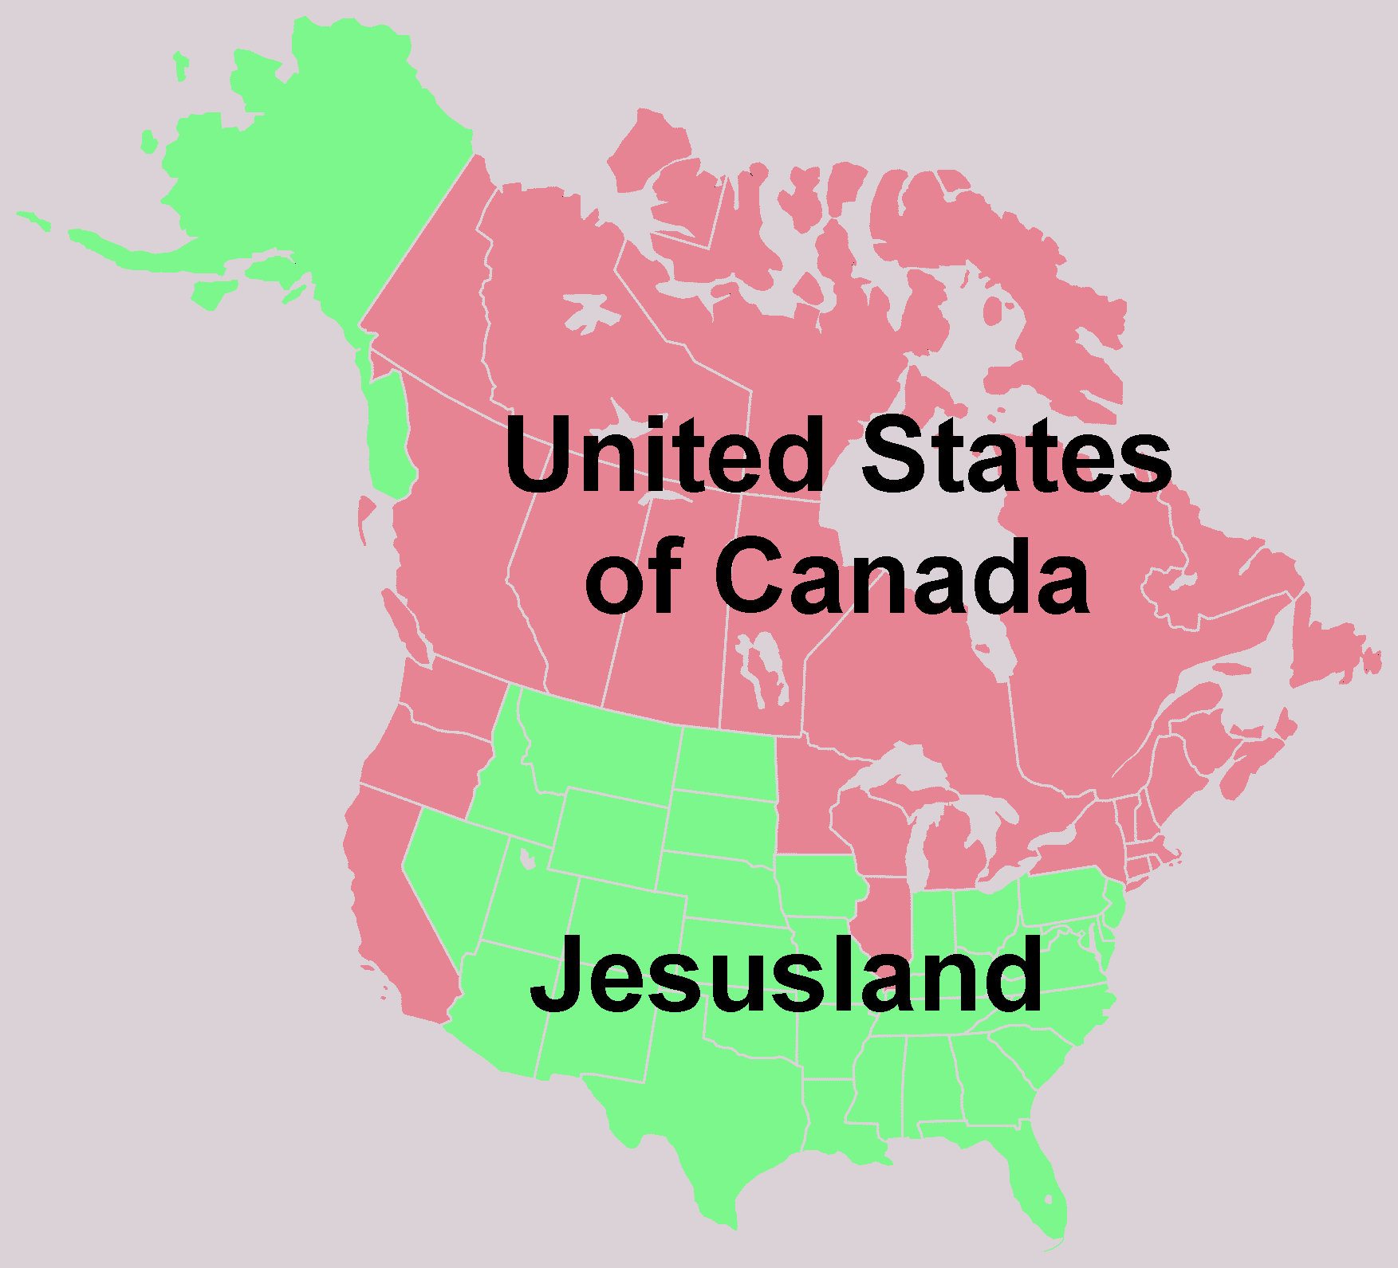
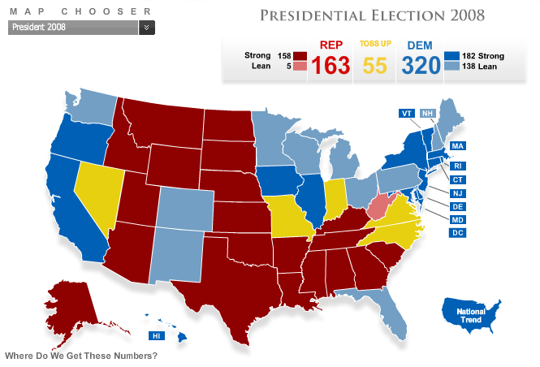
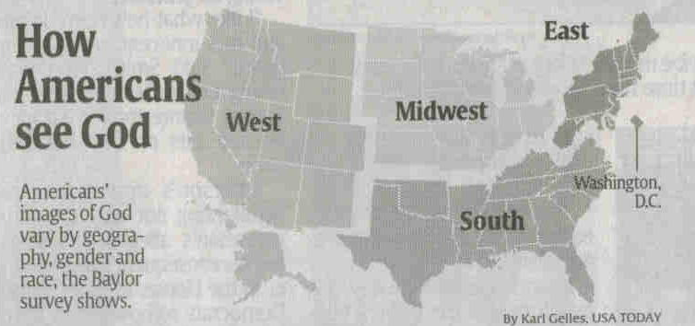

Slide 48
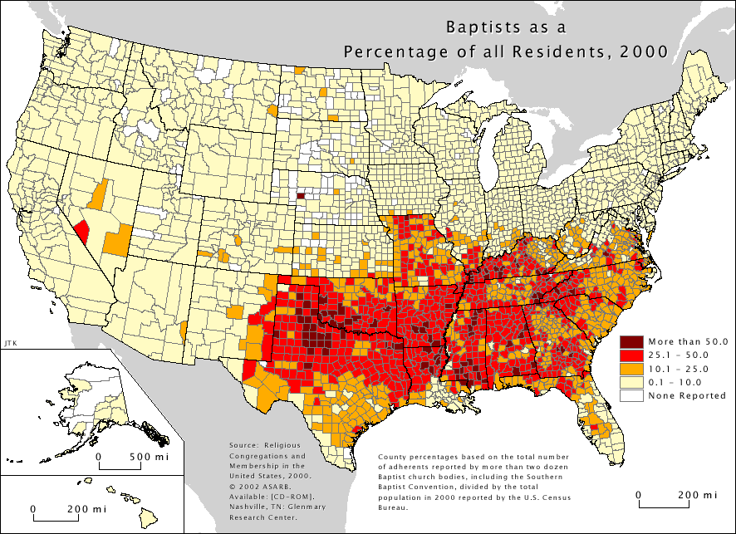

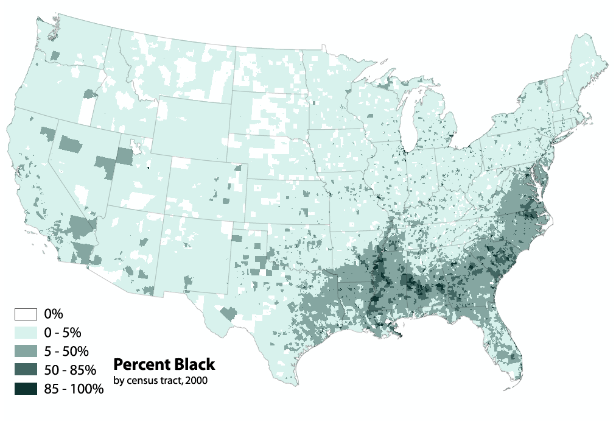

Slide 49
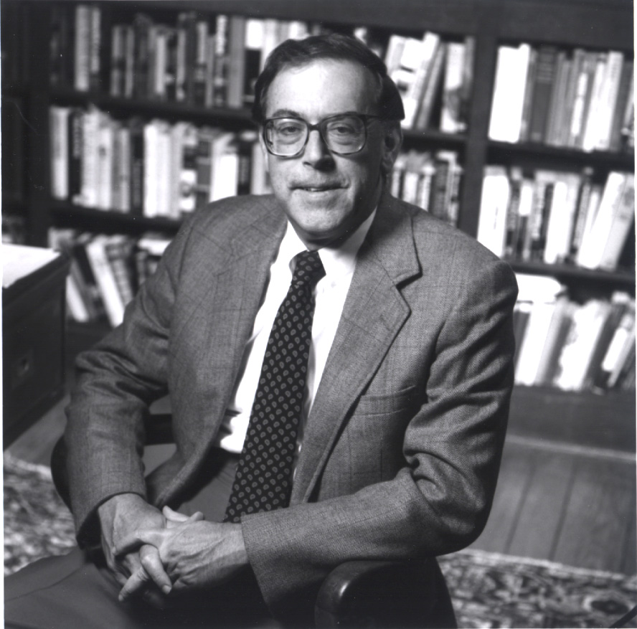

1969

Slide 50


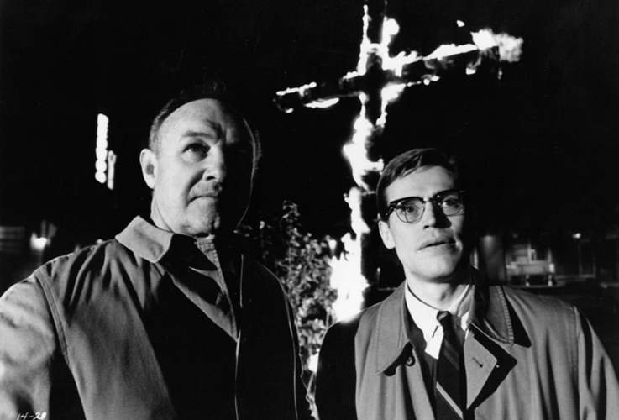
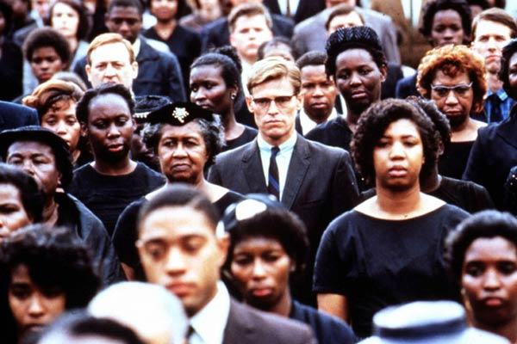

Slide 51
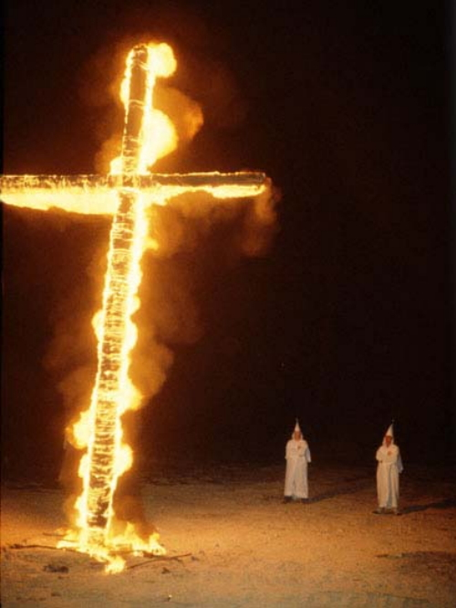

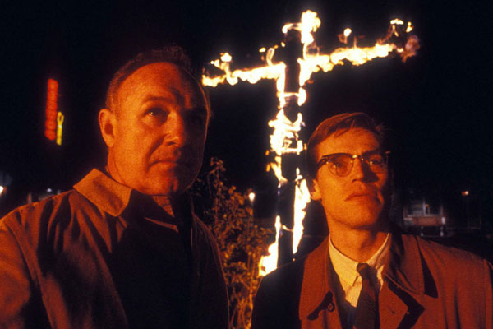


Slide 52
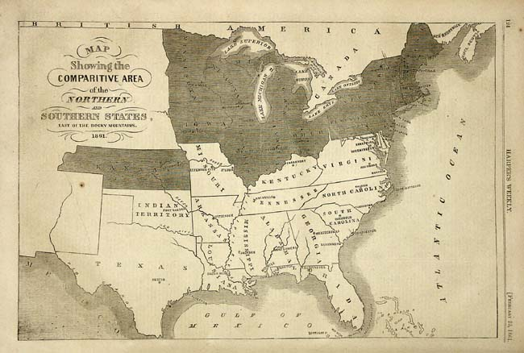
South = “Rooted culture”
North = Anonymous and socially indifferent

Slide 53




Slide 54




Slide 55

Southern Tradition
Agrarian and feudal
Code of chivalry
Concept of the gentleman
“Unintellectual” religiosity

Slide 56




Slide 57
What We Already Know

Slide 58

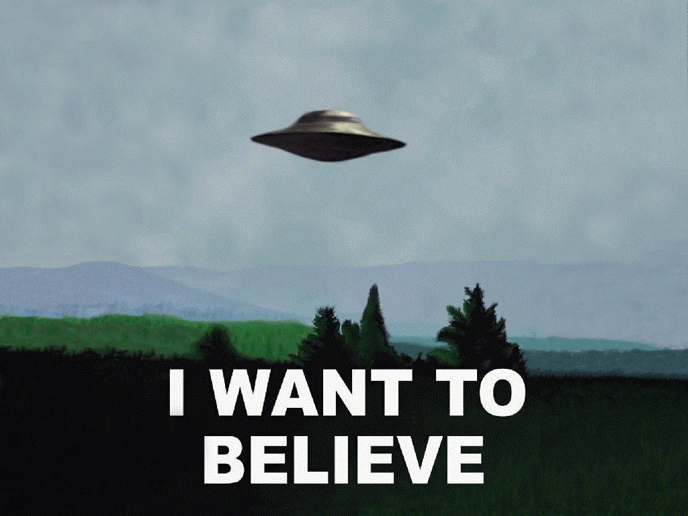
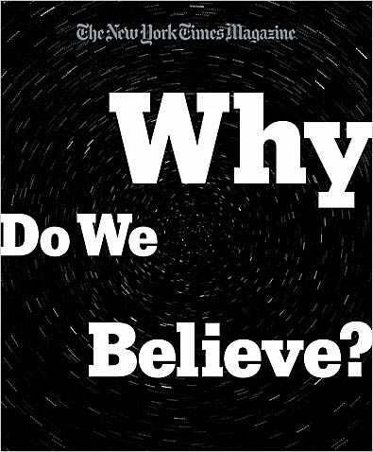

Slide 59
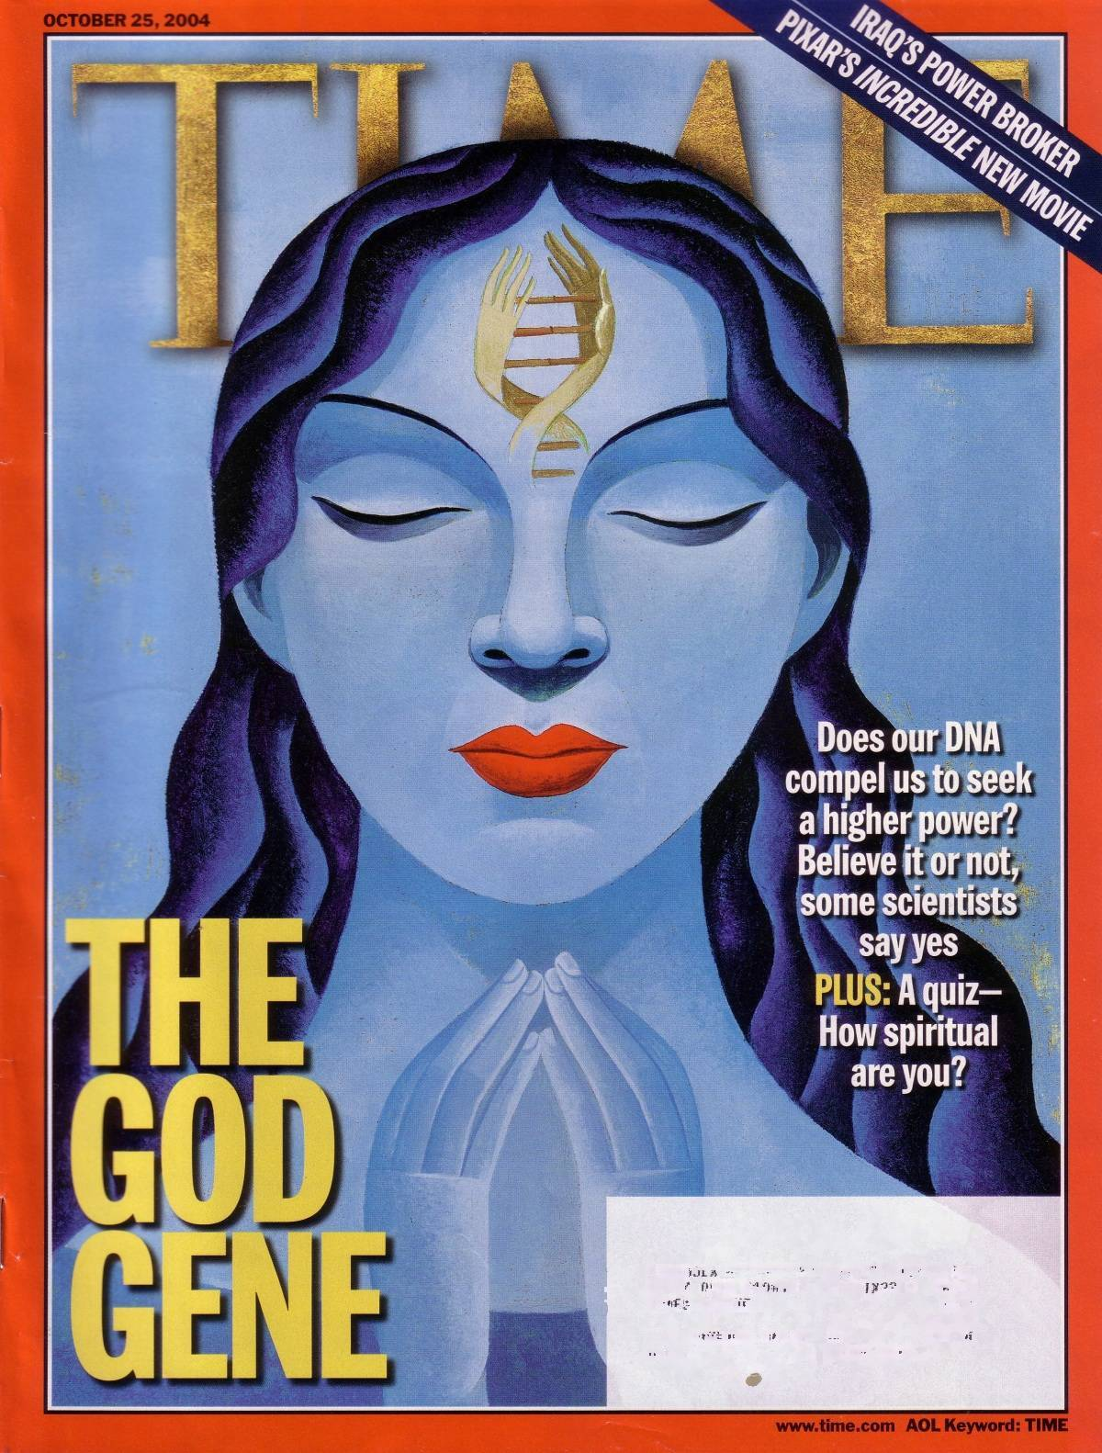

Slide 60


How mind & brain work to generate & sustain religious belief
Evolutionary Explanation
Mr. Deity

Slide 61


Debunks the popular myth that all religions are “different paths to the same God”

Slide 62

Each religion attempts to solve a different human problem:
–Islam: the problem is pride / the solution is submission
–Christianity: the problem is sin / the solution is salvation
–Confucianism: the problem is chaos / the solution is social order
–Buddhism: the problem is suffering / the solution is awakening
–Judaism: the problem is exile / the solution is to return to God

Slide 63


My ideas about God were formed in childhood
The word “God” contains a whole spectrum of meanings some of which are contradictory or even mutually exclusive
Each generation creates the image of God that works for it

Slide 64


The concept of “God” has undergone such significant transformation that “if we tried to converse with the ancients about God, we would find a large chasm separating us”

Slide 65

“God” has Evolved
Polytheistic - Monotheistic

Slide 66


Slide 67


Slide 68



Slide 69


Slide 70


Slide 71


Slide 72


Slide 73


Slide 74


Slide 75
Old Testament Jehovah, or Yahweh, was quite definitely a super-man (a He, not a She) who could take sides in battles, and be both jealous and wrathful. You could literally listen to God and literally sit beside Him

Slide 76

Few are comfortable acknowledging just how far we’ve come from the God of Genesis.
Nowadays we prefer to speak of a Higher Power whose characteristics are beyond comprehension. Does the Higher Power have (creative) intelligence? In what way? Does It (not He or She) care about us? About anything? The fog of mystery has descended conveniently over all the anthropomorphic features that have not been abandoned outright

Slide 77
Few are comfortable acknowledging just how far we’ve come from the God of Genesis.
When it comes to God, there is no straightforward way of cutting through the fog of misunderstanding to arrive at consensus about the topic under consideration. And that’s the beauty of the concept, “The mists of incomprehension and failure of communication are not just annoying impediments to rigorous refutation; they are themselves design features of religion”

Slide 78
Few are comfortable acknowledging just how far we’ve come from the God of Genesis.
How do you know God exists? A feeling, an intuition, a belief in belief in God. It is mysterious, complicated, incomprehensible, incommunicable, unfathomable, and unknowable, but, hey, it’s the Truth

Slide 79


Celebration of Subjectivity
Religions traffic in “feeling realities”
Rely on our hearts, not our heads
Heed the voice of our own experience
Proof = Passion inspired in believers

Slide 80
Celebration of Subjectivity
The feeling of knowing
A sense of faith
Claim: Individual experience leads to universal truth
Therapy = handmaiden of religion

Slide 81

“Conviction” (faith) that Nicole Kidman is in love with me
My feeling = only evidence of her infatuation
My feeling = Nicole & I must have a special, even metaphysical connection
Camp outside her house to make the necessary introductions

Slide 82

Religious Faith = unjustified belief in matters of ultimate concern

Slide 83

Male Divinity
2,500 years

Slide 84

Female Divinity?
25,000 years

Slide 85

Venus von Willendorf
24,000-22,000 BCE
Women’s values dominant for 25,000 years
  Creation honoring
  Women honoring
  Earth Nurturing
Goddess = sacred in the world, not outside

Slide 86

The Da Vinci Code argues that seeing God in solely masculine terms misrepresents and limits the divine

Slide 87
The Christian Church, by asserting the male principle and denying the female, has brought two thousand years of chaos and violence

Slide 88


“Heaven” and the “morally contingent afterlife” are Christian adaptations from Egyptian religion, particularly the Osiris and Isis cults, spelled out more than a millennium earlier in the ‘Egyptian Book of the Dead’

Slide 89

God has Evolved
The Feeling of Knowing
Belief in Belief

Slide 90
Moyers
Belief in Belief

Slide 91


Slide 92

50% Americans “negative” or “highly negative” view of people who do not believe in God
70% think important for presidential candidates to be “strongly religious”

Slide 93


Slide 94
The belief that belief in God is so important that it must not be subjected to the risks of disconfirmation or serious criticism has led the devout to save their beliefs by making them incomprehensible even to themselves

Slide 95
The result is that even the professors don’t really know what they are professing. This makes the goal of either proving or disproving God's existence a quixotic quest … but also for that reason not very important

Slide 96

Evidence for God = Cultural, Historical
Myth-making process
We have grown up … should now be satisfied with natural explanations for myth

Slide 97
Truth does not ask to be believed, it asks to be tested

Slide 98
Faith is what you use when you don’t have knowledge

Slide 99
With faith, everybody is right

Slide 100



Slide 101
God is Silent
God is Inert
Wrong Evidence
Wrong Universe

Slide 102

If he wants something from me he would tell me, not have someone else do it
Doctor wants patient to get well— not vague … I’m not going to tell you because it would violate your free will!

Slide 103

If God existed we would all hear from God himself the same message of salvation

Slide 104

God is Inert
Capable of creating & destroying anything
Suspending Laws of Nature
God does nothing to alleviate needless suffering
Failing to act in a loving way would be unbearable for a loving being

Slide 105
God is Inert
God would not tolerate children being treated cruelly
God would not hide a cure for AIDS
We observe a dumb, mechanical universe that blindly treats everyone with the same random fortune and tragedy regardless of merit or purpose

Slide 106
God is Inert
Invisible

Slide 107

Omniscient?
Omnipotent?
Omnipresent?
Omnibenevolent?

Slide 108

Epicurus
Obstacles to Happiness
Fear of Death
Fear of Pain
Fear of the Gods
341-270 BCE
Why Call Him God?

Slide 109


Slide 110



Slide 111

Religion divorces morality from reality of human and animal suffering
30% of US sex-ed programs teach abstinence only
American girls 4-5 times more likely to become pregnant, have a baby, or get an abortion

Slide 112

If God exists, He is the most prolific abortionist of all

Slide 113

50% of all conceptions end in spontaneous abortion
20% of all recognized pregnancies end in miscarriage

Slide 114

God is not Omnipotent or Omniscient
Electricity?
DNA?
Age & Size of the Universe?

Slide 115



Slide 116



Slide 117


Slide 118

Kalam Cosmological Argument

Slide 119


Slide 120


Lawrence Krauss:
Internationally renown theoretical physicist

Slide 121
Lawrence Krauss:
Internationally renown theoretical physicist
Something Nothing

Slide 122



Slide 123

A loving God who wanted to create a universe solely to provide a home for human beings would never have invented this universe

Slide 124
What need does an intelligent engineer have of billions of years and trillions of galaxies filled with billions of stars apiece? That tremendous waste is only needed if life had to arise by natural accident

Slide 125



Slide 126
God has Evolved
God is Silent
God is Inert
Wrong Evidence
Wrong Universe

Slide 127
Belief in … Belief in God

Slide 128


Slide 129


