Slide 1

South Park
South Park

Slide 2


Slide 3
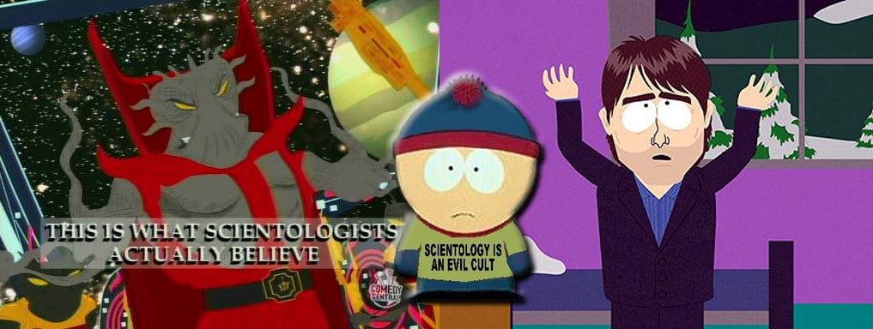
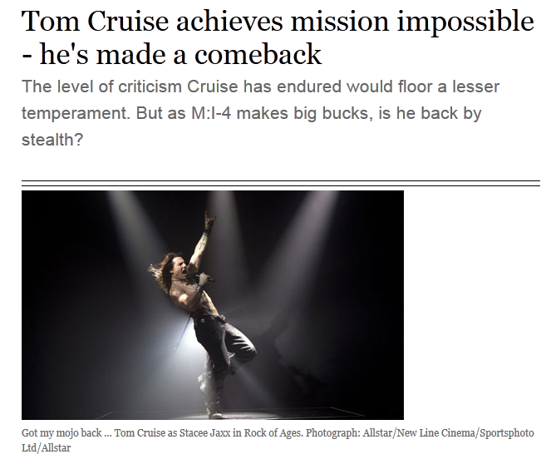
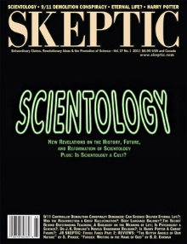
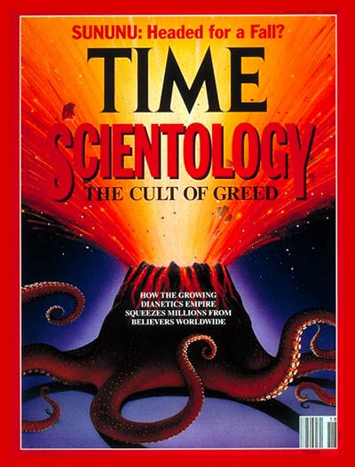

Slide 4
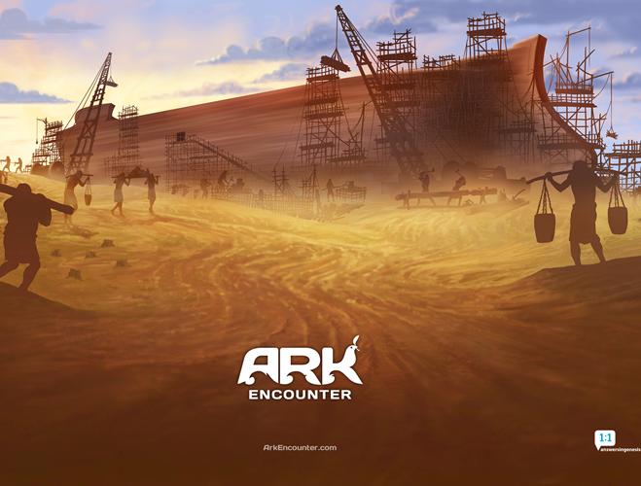
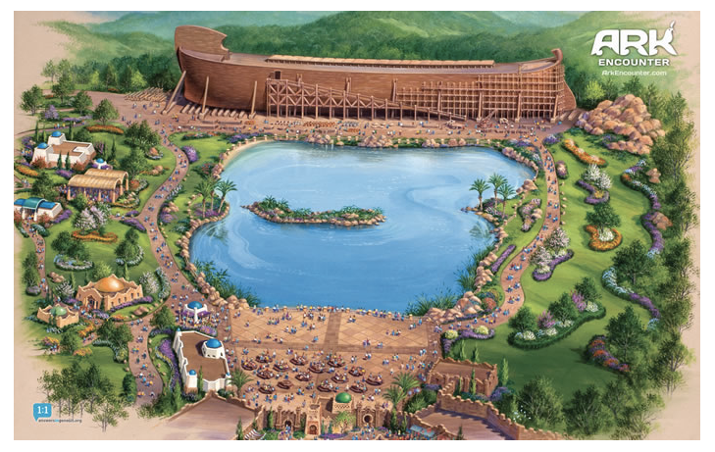

Preview

Slide 5
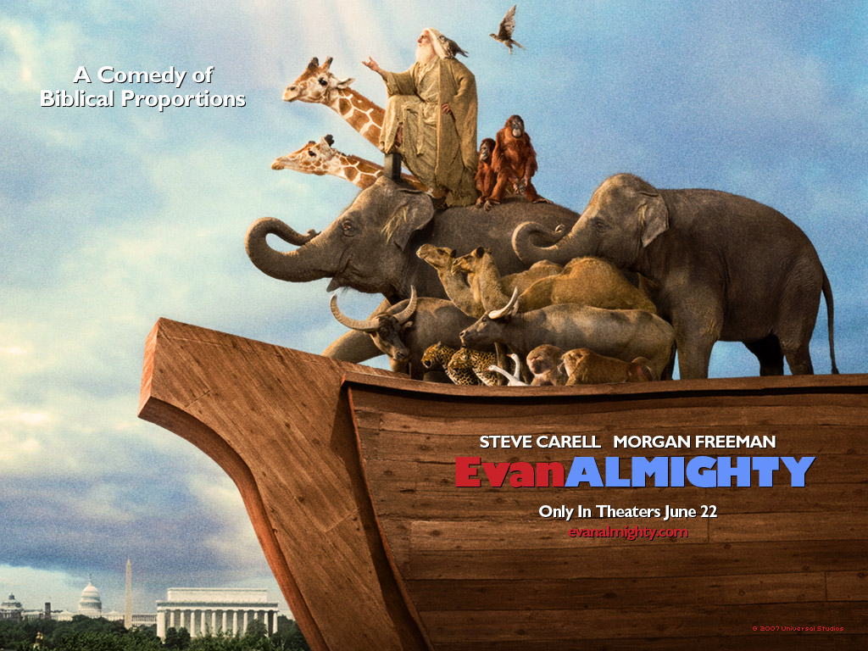
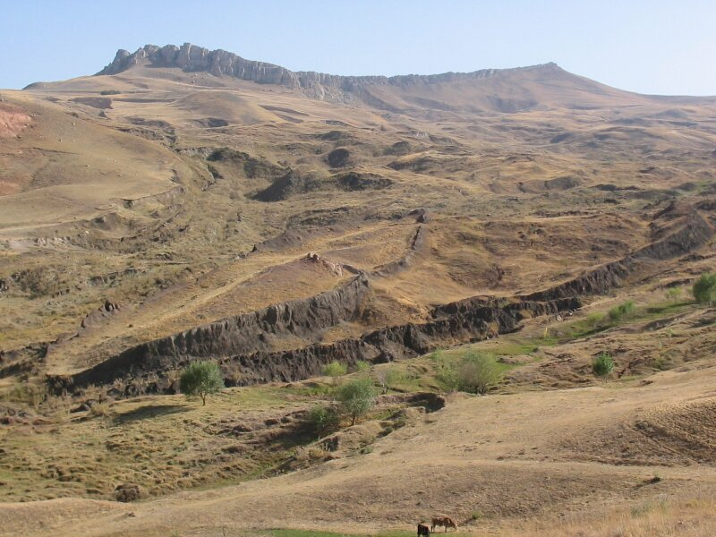

Slide 6
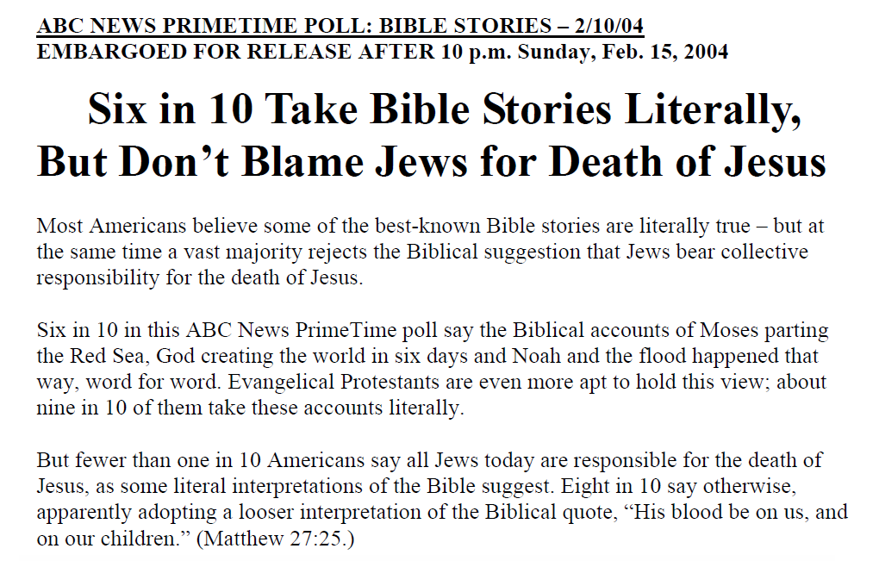

Slide 7
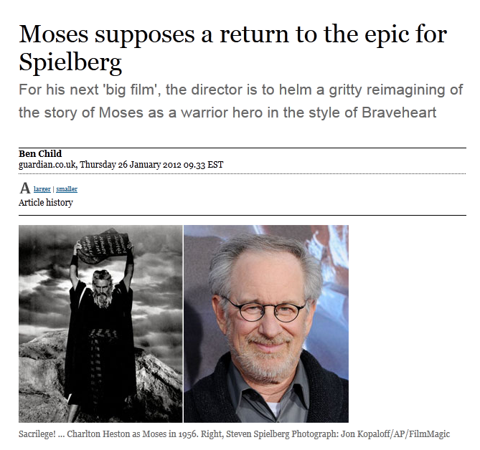

Slide 8
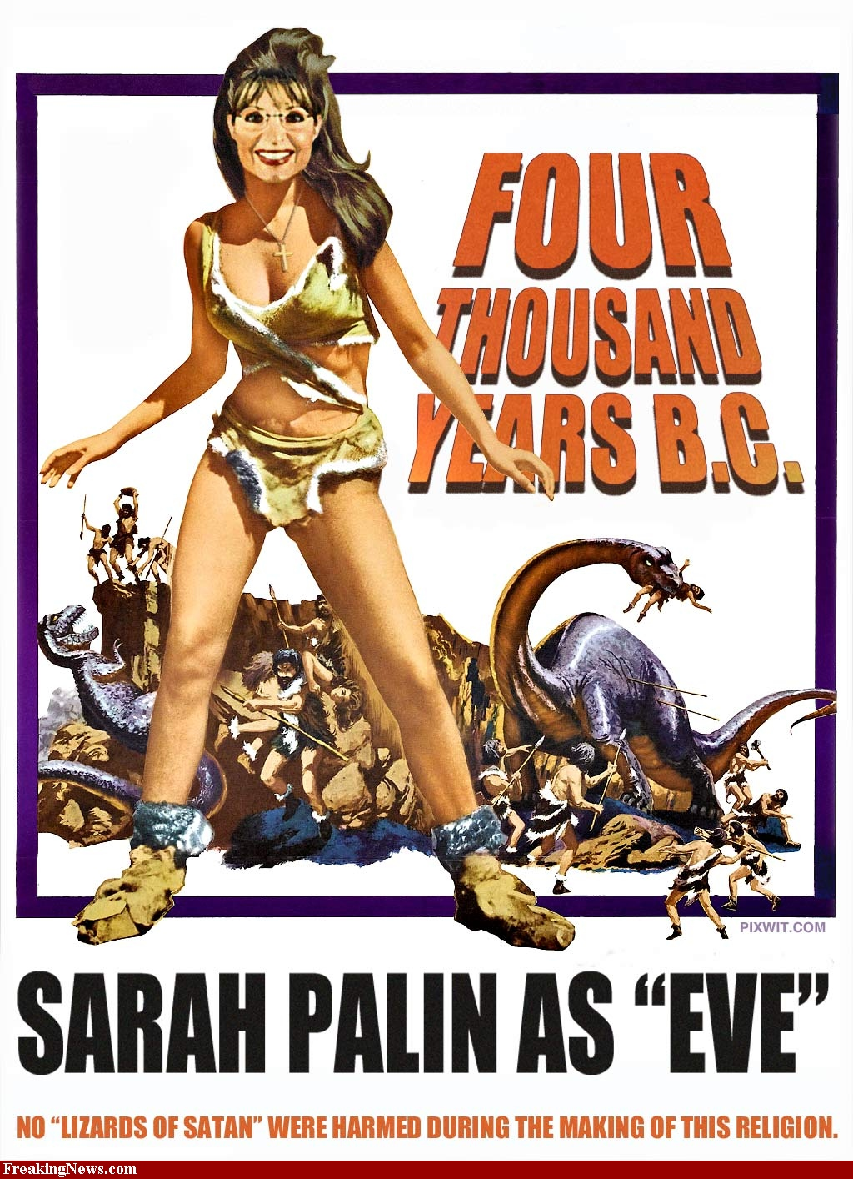
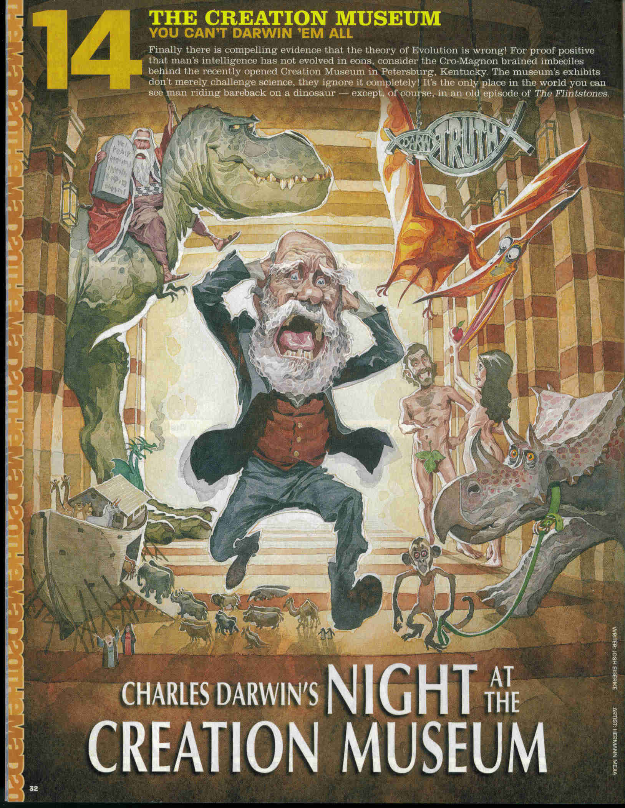

Slide 9
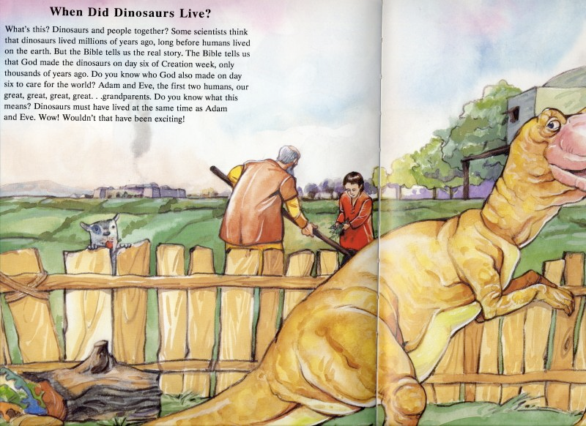
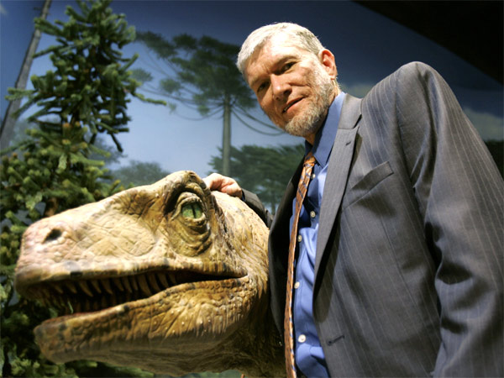

Slide 10
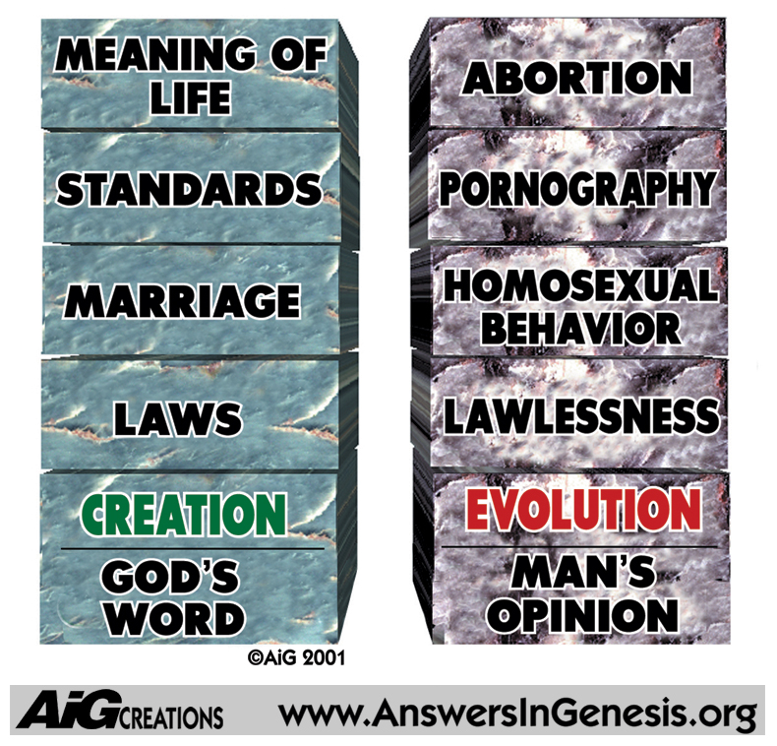

Slide 11
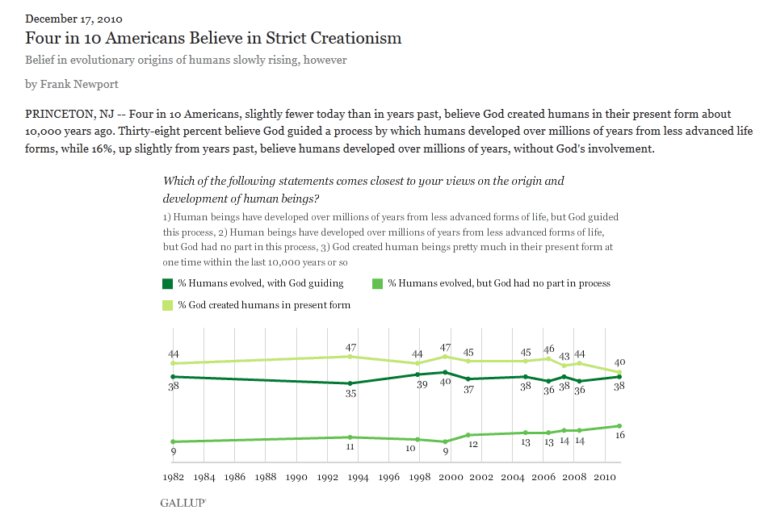

Slide 12
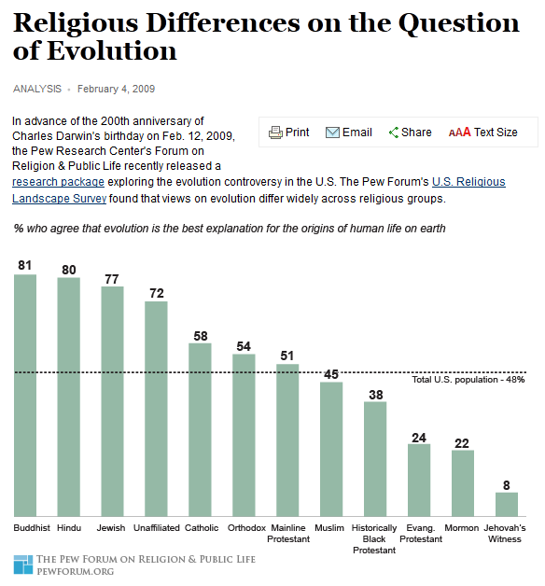

Slide 13
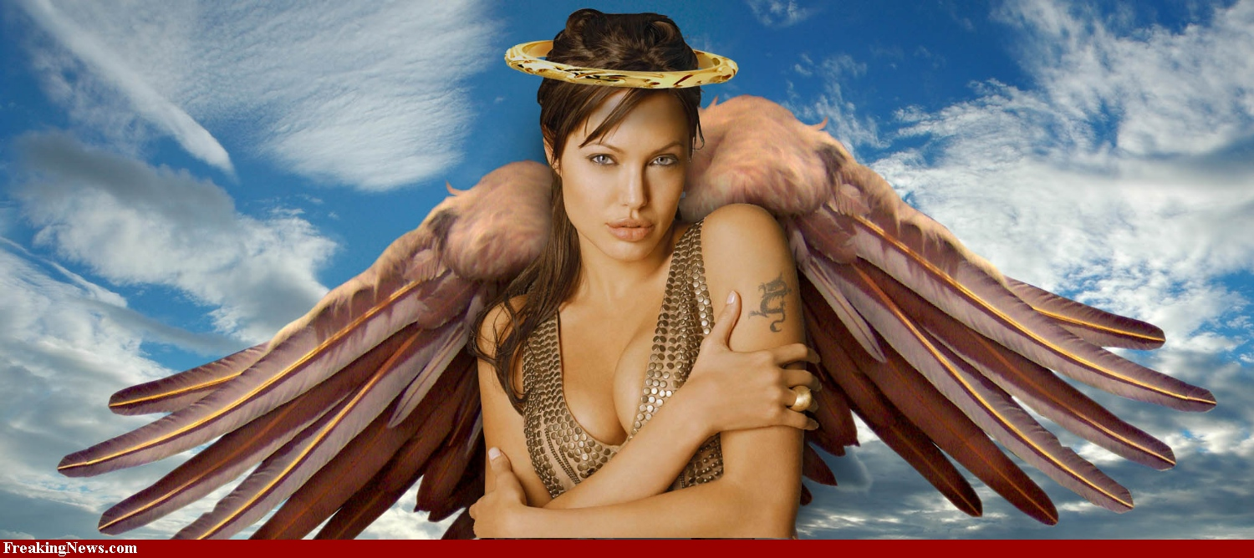
40% Americans believe in evolution
72% believe in angels

Slide 14
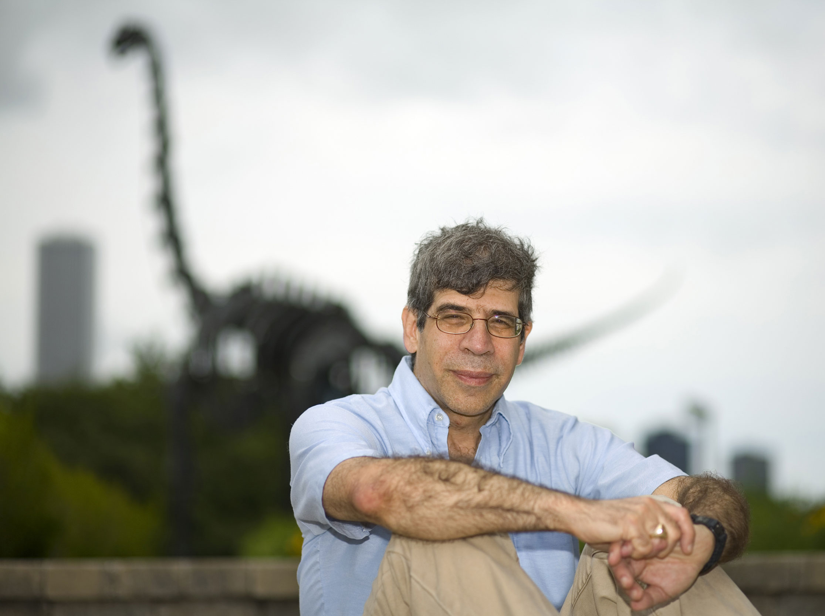
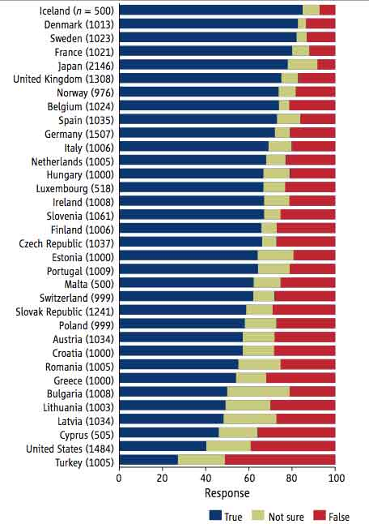
US ranks 33rd out of 34 Western countries for the acceptance of evolution
“Most people in America have a neighbor who thinks the Earth is 10,000 years old”

Slide 15
1 in 8 believe that evolution should be taught without including creationism

Slide 16
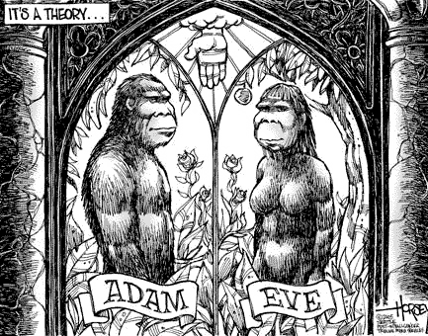
80% typically accept evolution in other industrialized countries
In Japan, 96% accept evolution
Pope John Paul II in 1996 endorsed idea evolution and religion can coexist

Slide 17

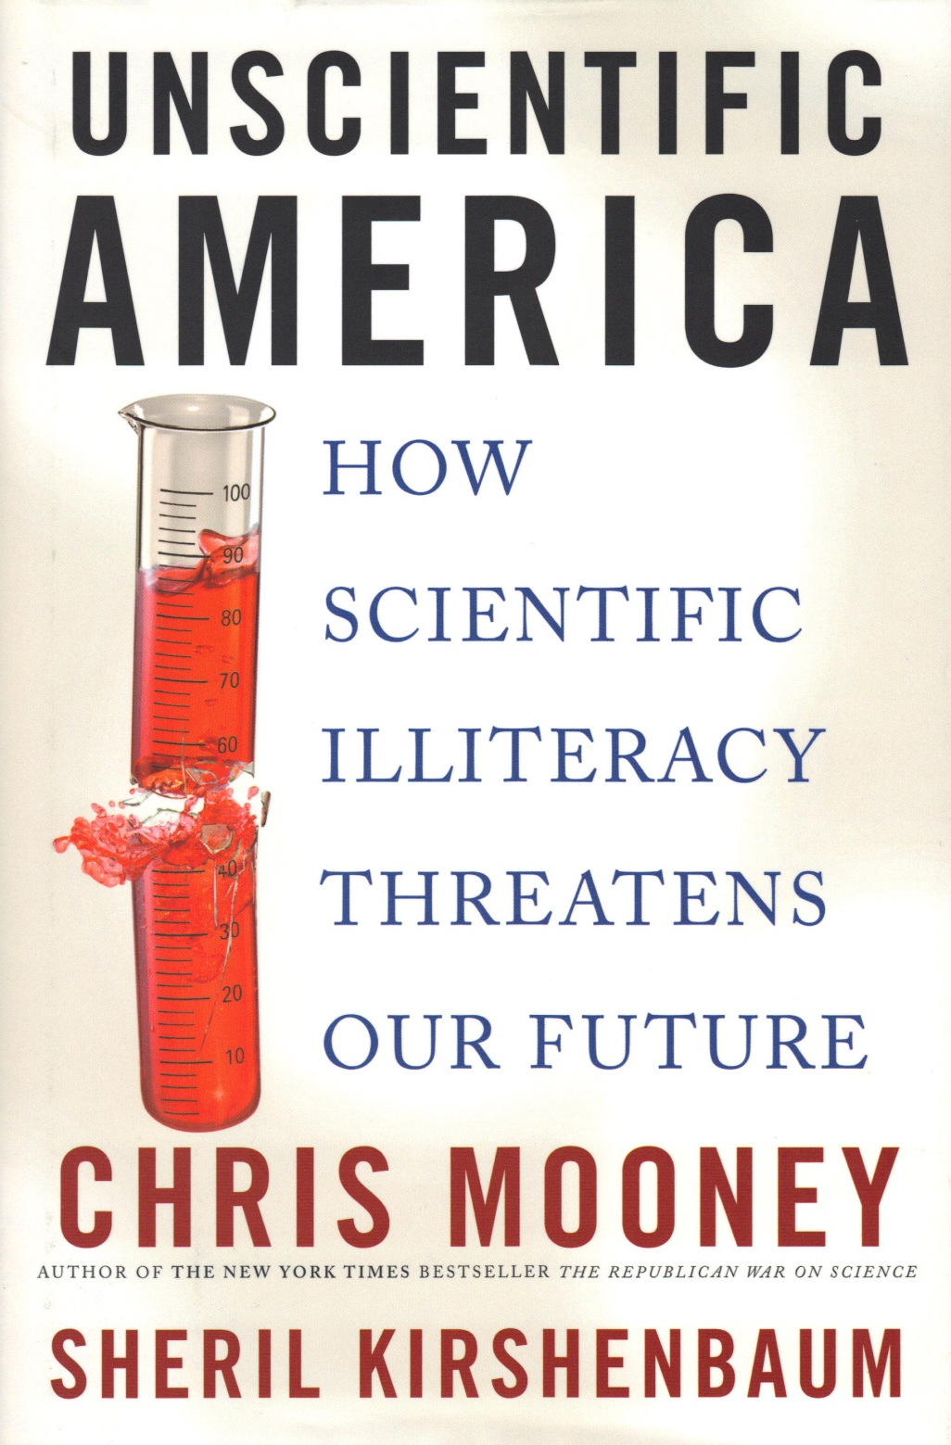
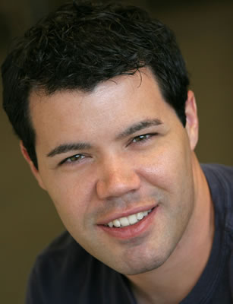

Slide 18
Scientific Knowledge
46% Americans believe Earth less than 10,000 years old
Only half adult populace knows the Earth orbits the Sun once per year
For every 5 hours of cable news, 1 minute devoted to science
Number of newspapers with science sections has shrunk by 2/3rds in last 20 years

Slide 19
Scientific Knowledge
80% of Americans can’t read the New York Times science section due to failure to understand basic high school level science
Just 18% of Americans know a scientist personally
Polled in late 2007 asked to name scientific role models, 44% respondents didn’t have a clue

Slide 20
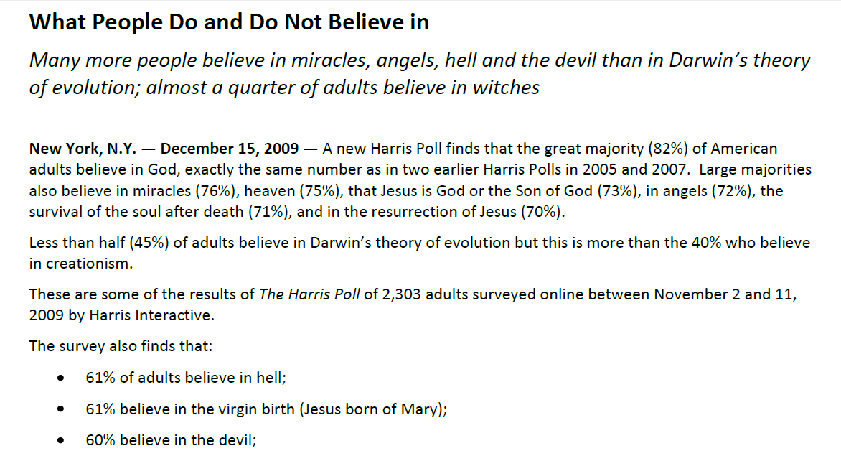
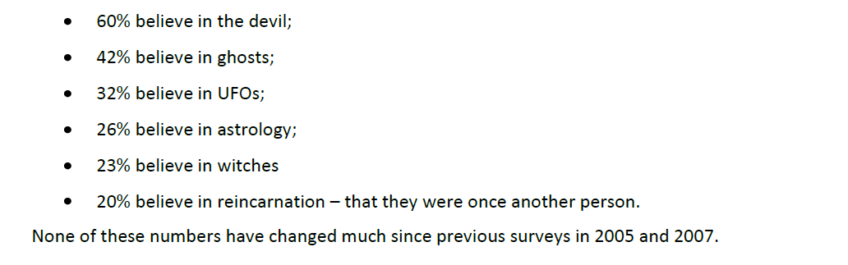

Slide 21
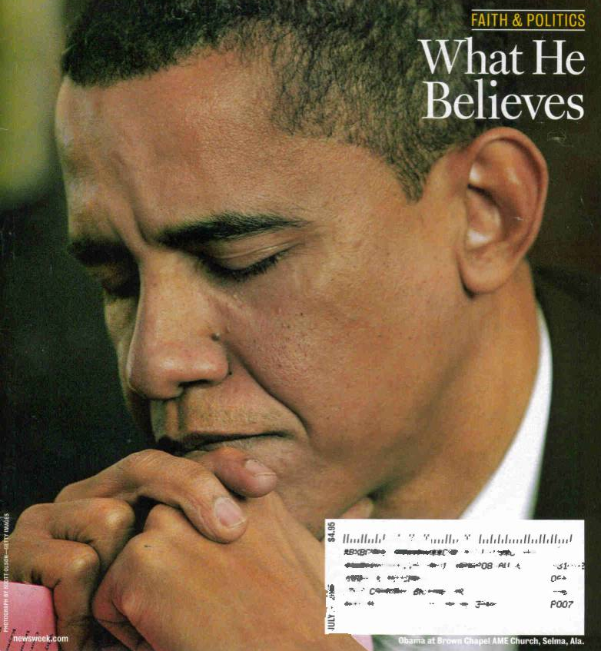
We live in a country in which a person cannot get elected president if he openly doubts the existence of heaven and hell

Slide 22
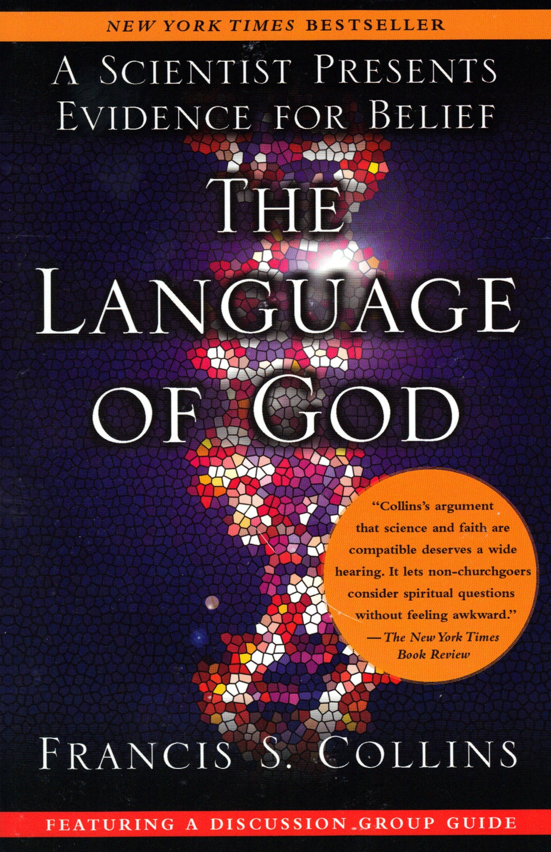
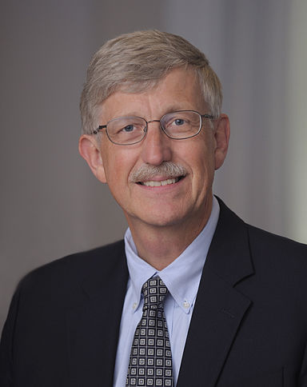
90% Americans
40% Scientists

Slide 23
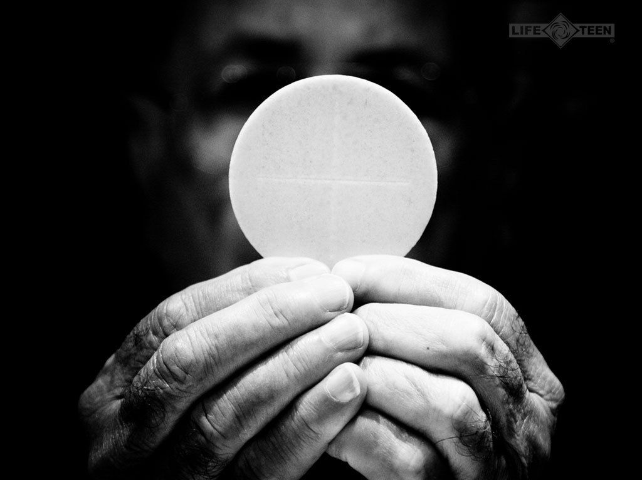
Define our vision of the world
Dictate our behavior
Determine our emotional response to other human beings
Beliefs

Slide 24
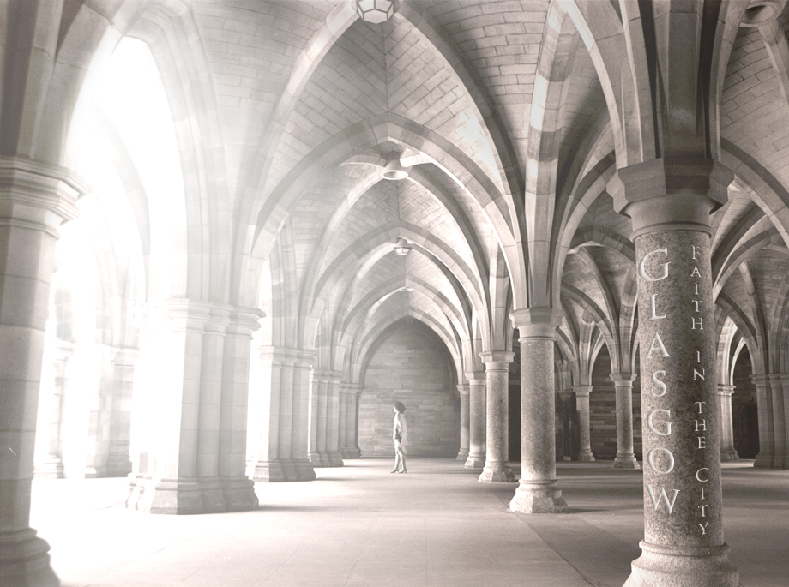
Human beings generally reluctant to change their minds
To have faith = to believe, to trust
“The assurance of things hoped for, the conviction of things not seen”

Slide 25

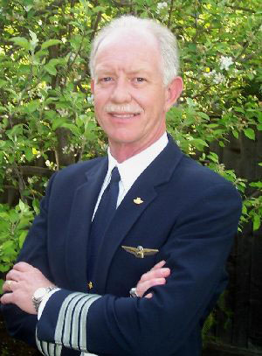
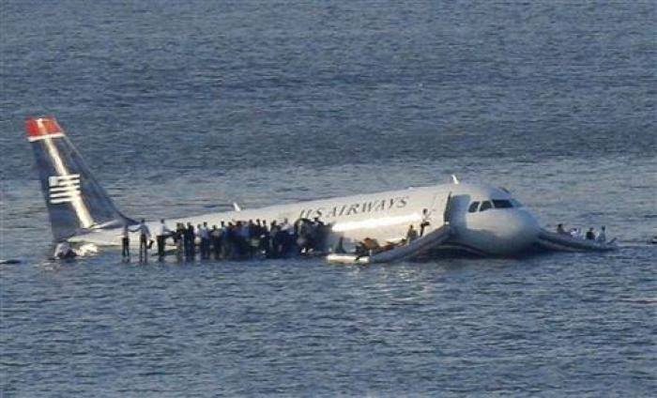
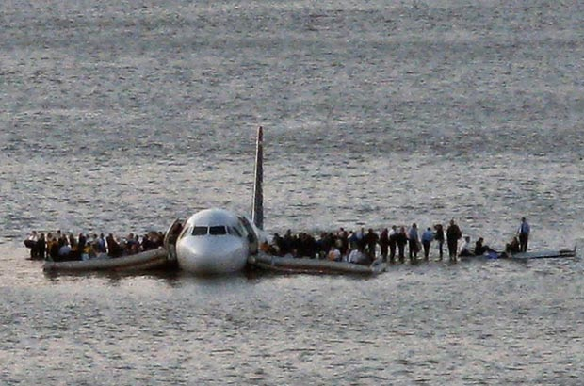
Chesley Sullenberger

Slide 26

the activity of creating, reinforcing, modifying, or extinguishing beliefs, attitudes, intentions, motivations, and/or behaviors
Persuasion

Slide 27
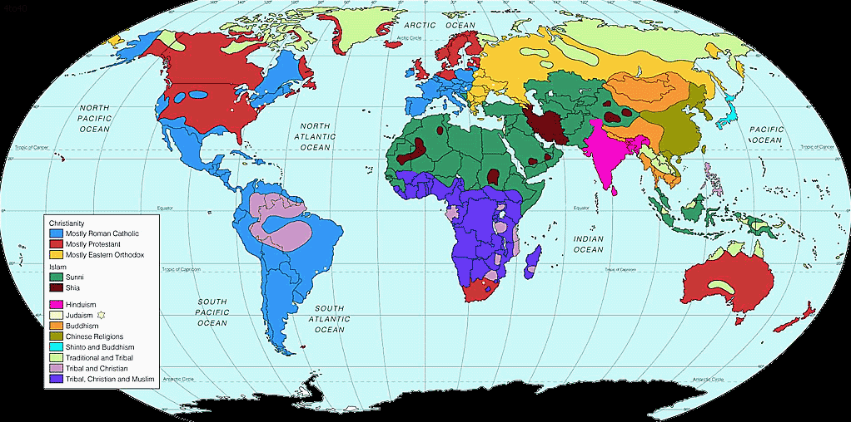
All know cultures concept of god
or central mystical figure

Slide 28
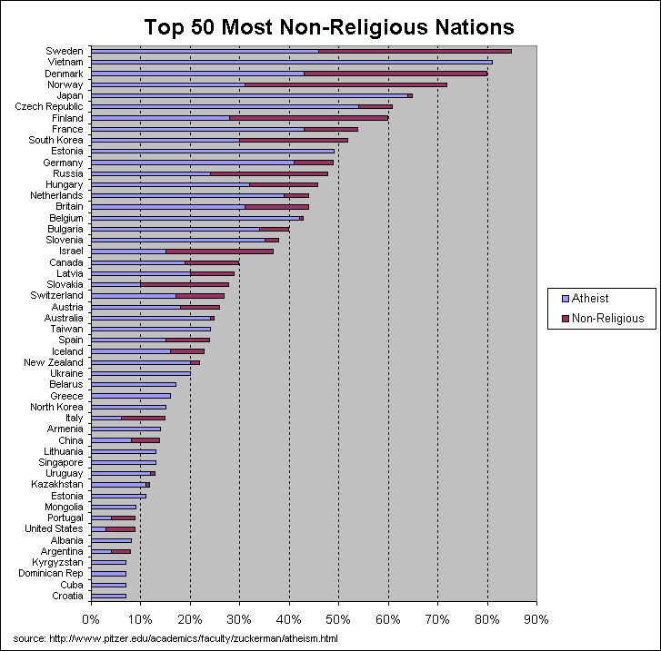

Slide 29
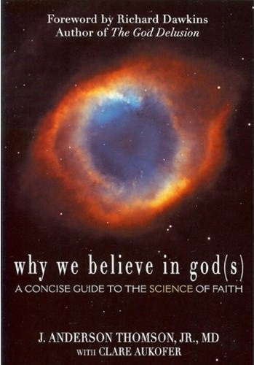
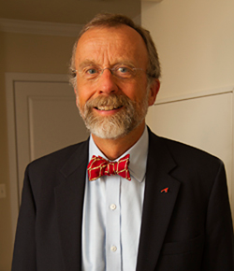
How mind & brain work to generate & sustain religious belief
Evolutionary Explanation
Preview

Slide 30
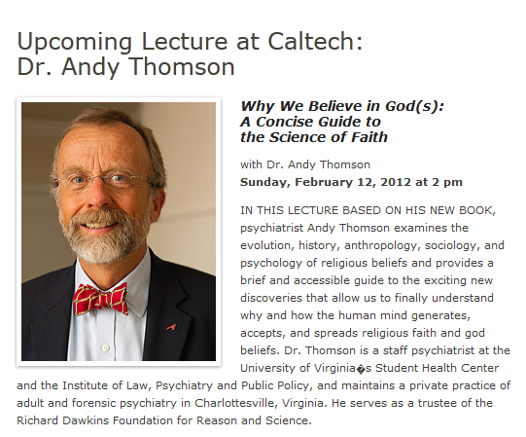

Slide 31
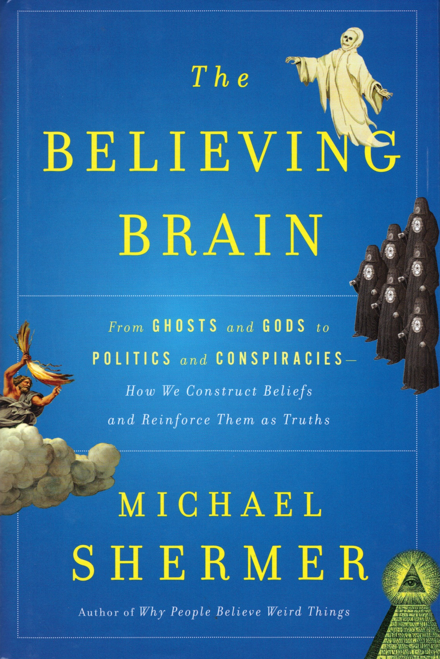
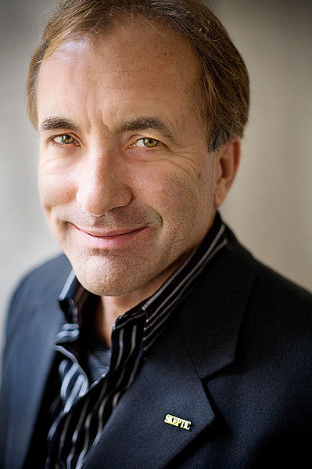
Brain = Belief Engine

Slide 32
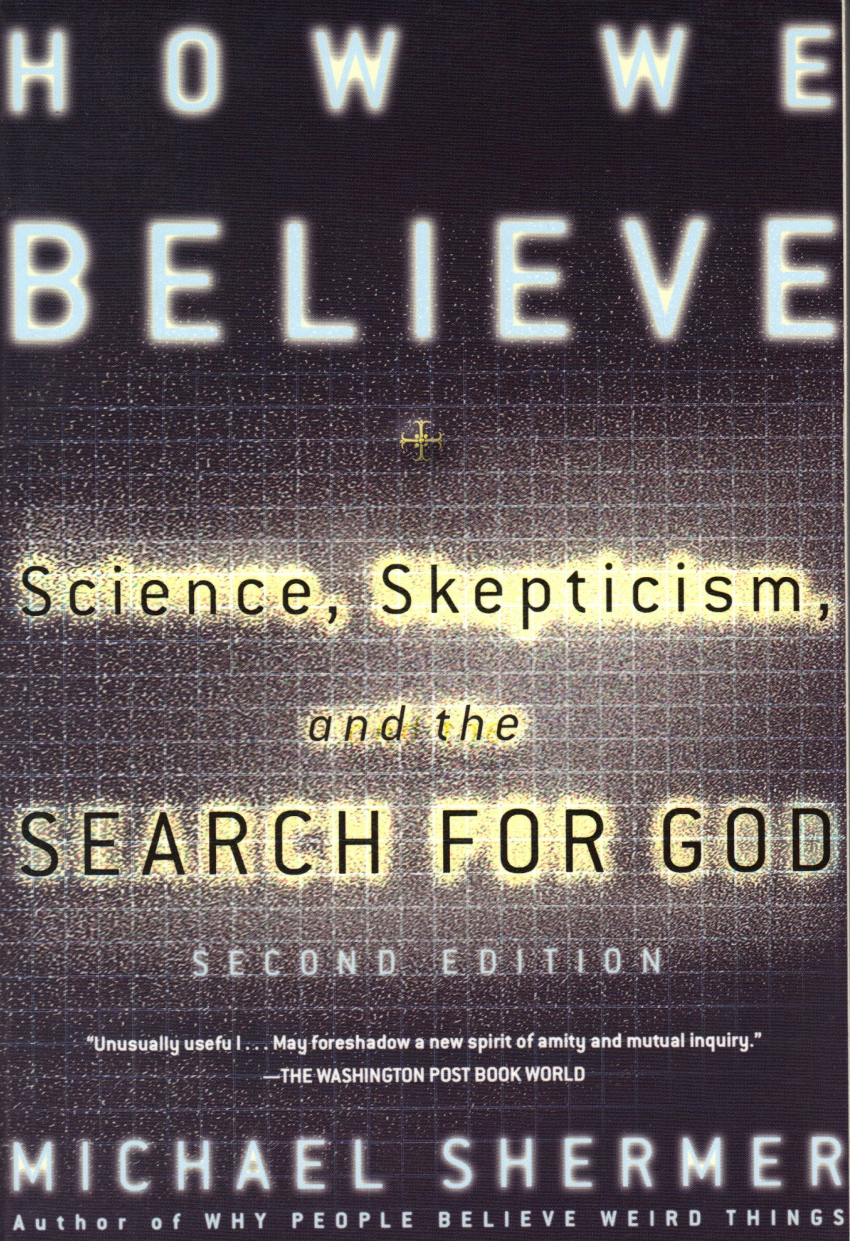
Pattern-Seeking Primates

Slide 33
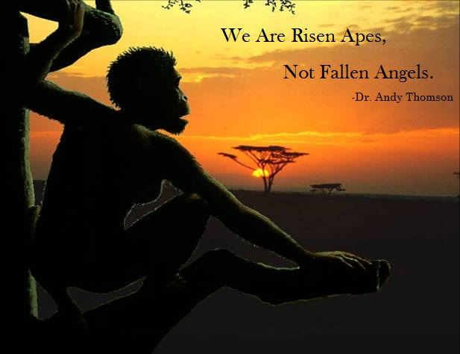

Slide 34
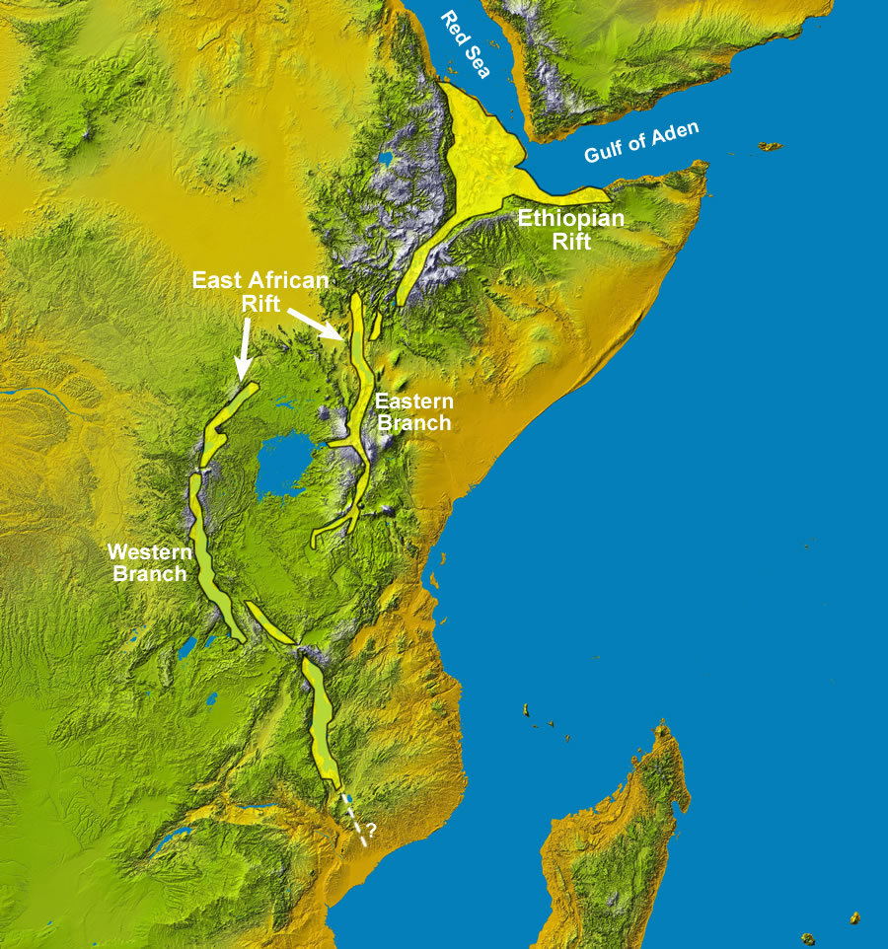
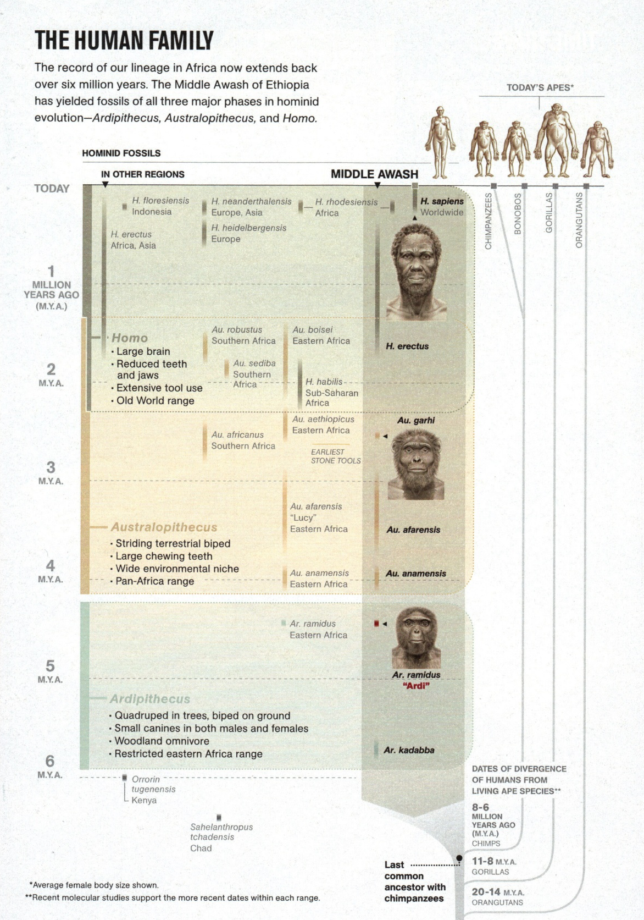
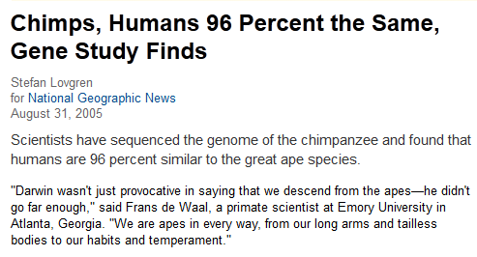

Slide 35
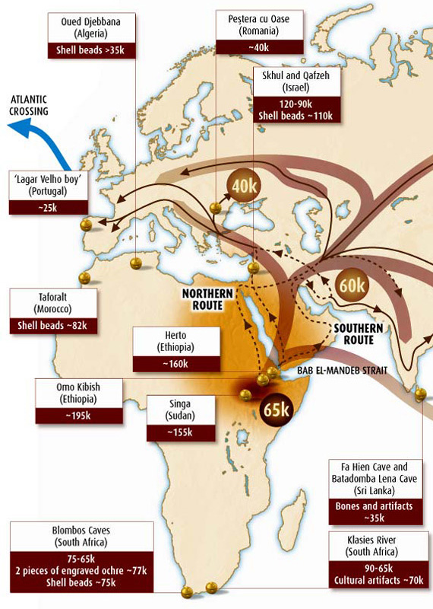


Slide 36
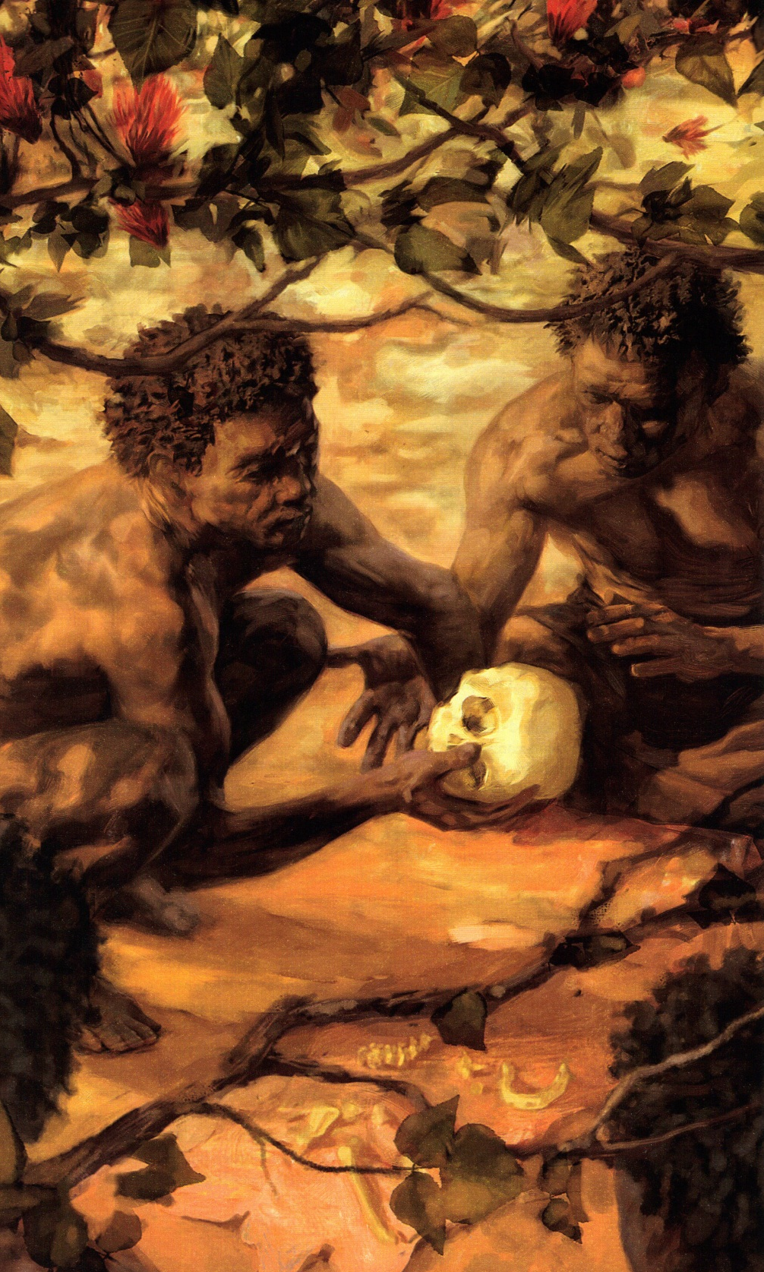
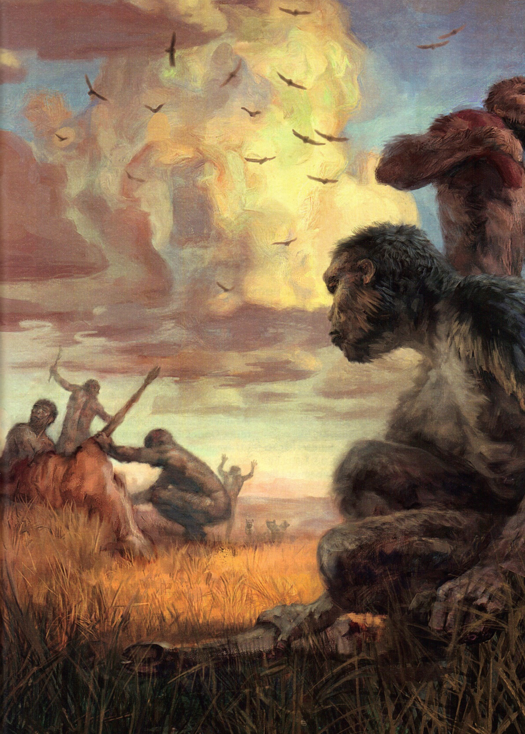

Physical Survival required Social Survival

Slide 37
Most challenging part environment—each other

Slide 38
Small tightly-knit bands of kin sculpted us into people we are today

Slide 39
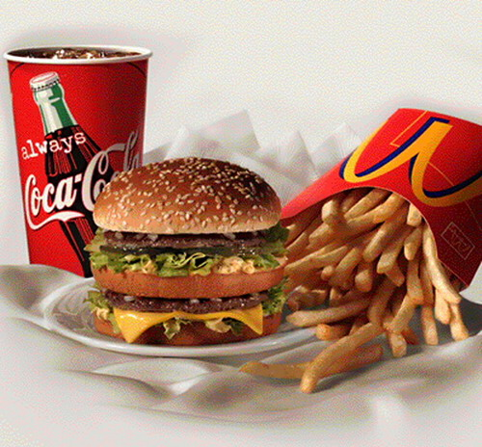
Craving?

Slide 40
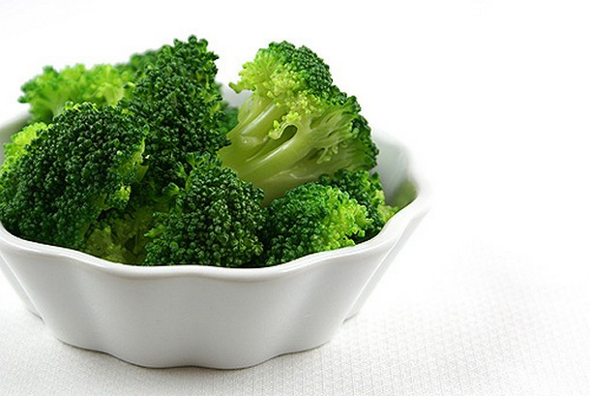
Craving?

Slide 41


We evolved adaptations to crave food crucial & rare
Sugars of ripe fruit
Fat of lean game meat
Salt

Slide 42
Religious Belief = by-product of adaptations evolved for social interactions

Slide 43
Religious Belief = by-product of cognitive mechanisms designed for other purposes

Slide 44
Just to believe in god our mind bounces off no fewer than 20 hardwired adaptations evolved over eons of natural selection

Slide 45
Attachment System
Dualism
HADD (Hyperactive Agency Detection)
Empathy & Morality
Over-reading Determination
Costly Signaling

Slide 46

Attachment System
Distress— turn to caretaker
Child-Parent bond
Adults— romantic love
Feelings of safety & security

Slide 47
Attachment System
Religious people— caretaker god
Unchanging, loving, eternal
“Father”—considerate, loving, accepting

Slide 48



Never lose longing for a caretaker

Slide 49
Protect loved ones from starvation, illness, disaster, death, life’s misfortunes

Slide 50


Man in his arrogance thinks himself a great work, worthy the imposition of a great deity. More humble and I believe true to consider him created from animals
Voyage 1831-36

Slide 51

Engaged to Emma Wedgewood, first cousin

Slide 52

Married January 1839
“My reason tells me that honest conscientious doubts cannot be a sin, but I feel it would be a painful void between us”—November 1838

Slide 53
February 1839
“May not the habit in scientific pursuits of believing nothing till it is proved influence your mind too much in other things which cannot be proved”

Slide 54
February 1839
Handwritten at bottom of letter: “When I am dead, know that many times I have kissed any cryed over this”—CD

Slide 55

Woman Greatest Parental Investment
Biologically based female importance & choosiness = affront to males
Constantly devise ways to control female reproduction

Slide 56


Slide 57

Trailer

Slide 58

The Nightmare Henry Fuseli 1781

Slide 59
40% experienced crushing weight on chest, sensing evil presence, seeing strange figures in darkness
Incubus—demon forces itself on sleeping women

Slide 60




Believe in Ghosts?
UK: 30% believe
15% experienced one
Apparitions only 1% sightings
Do you want to see a ghost?

Slide 61


Slide 62

Afterimage—Black-White neurons: quiet on left image; overexcited on right

Slide 63


Slide 64



1848 Hydesville NY
11-year-old Kate 14-year-old Margaretta

Slide 65
Bedsteads & chairs shake, ghostly footsteps, knocking from walls … rapping messages
Moved away from Hydesville but spirits followed two girls

Slide 66


Spiritualism offered proof of afterlife & allowed communication with dead loved ones

Slide 67
New religion swept across America
Fox sisters celebrities

Slide 68


Table Tipping

Slide 69
1888 sisters admitted faked the entire affair
Received $1500 from New York World for story
End of 8 million-strong Spiritualist religion?
Distanced from supporters

Slide 70


Died in pauper’s graves a few years later

Slide 71


Slide 72




Slide 73


Out-of-Body experiences
Talking with the Dead
Ghost-Hunting
Prophecy

Slide 74


Slide 75
Cognitive Mechanisms
Decoupled Cognition
Dualism
HADD (Hyperactive Agency Detection)

Slide 76

Thought about another conversation while listening

Slide 77

Ability to create complex interactions with unseen others

Slide 78




Slide 79


½ of all 4-year-olds

Slide 80

Mind/Body
Natural to think of disembodied minds
Hardwired Ability
Other people’s intentions, beliefs, desires feelings
Don’t need physical presence to think about someone

Slide 81


Slide 82



Slide 83

Patternicity—tendency to find meaningful patterns in both meaningful & meaningless noise

Slide 84


You hear a rustle in the grass …
Wind? Dangerous Predator?

Slide 85
TYPE I Error
Believe Dangerous Predator when it’s just the Wind (low cost)

Slide 86

TYPE II Error
Believe just the Wind when it’s a Dangerous Predator (lunch!)

Slide 87
Default …
All patterns are real, All rustles are predators

Slide 88
Natural Selection …
We are decedents of most successful patternicity primates

Slide 89



Slide 90



Slide 91



Slide 92



Slide 93

Inferential reasoning—we fill in blanks

Slide 94

Pattern-finding skills—find connections between unrelated events

Slide 95



Slide 96

Athletes notoriously superstitious
Batters fail 7 out of 10

Slide 97

Over-Reading Determination

Slide 98

Children spontaneously adopt concept of god & created world

Slide 99

Belief comes naturally & quickly

Slide 100
Disbelief requires effort

Slide 101



Slide 102
Anthropomorphize—ascribe humanlike power (agency)

Slide 103



Slide 104



Slide 105
Souls, Spirits, Ghosts, Gods, Demons, Angels, Aliens, Intelligent Designers, Govt. Conspiracies & all manner of invisible agents are believed to haunt our world and control our lives

Slide 106



Slide 107

Religious Rituals harness powerful brain chemicals

Slide 108



Slide 109

Religion = Latin “religare” “to bind”
Tied people together; Social Bonding

Slide 110



Slide 111


Slide 112

Kin Psychology
“Fathers” “Sisters” “Brothers”

Slide 113

Costly Signaling

Slide 114


Signals of commitment & sacrifice

Slide 115


Demonstrate Commitment

Slide 116


Empathy—feel others’ pain

Slide 117



Suffering Elicits Empathy

Slide 118
Attachment System
Dualism
HADD (Hyperactive Agency Detection)
Empathy & Morality
Over-reading Determination
Costly Signaling

Slide 119
Just to believe in god our mind bounces off no fewer than 20 hardwired adaptations evolved over eons of natural selection

Slide 120

Religion integrated into same brain networks evolved for social cognition

Slide 121

Belief systems—powerful, pervasive, enduring

Slide 122
Meaningful patterns become beliefs—shape our understanding of reality

Slide 123
Once formed, brain looks for confirmation in support of beliefs—feedback loop

Slide 124
Religion—powerful force
Religious belief—deeply ingrained

Slide 125
Supernatural—All in the Mind

Slide 126

On God

Slide 127


Slide 128

Superbowl Ad

