Slide 1
DOES SUPERSTITIOUS BEHAVIOR
EFFECT YOUR LUCK?
Charles DeLoach
Paarth Trivedi
Eli Goodman
Brady Serwitz
Sara Owens

Slide 2
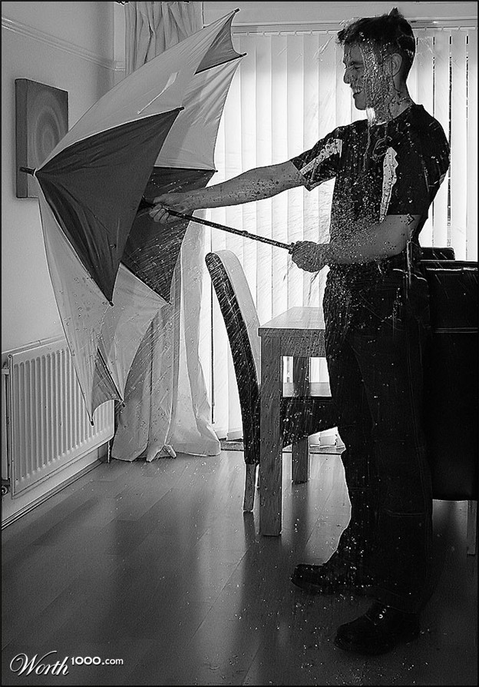
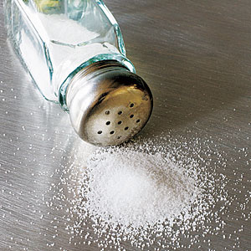
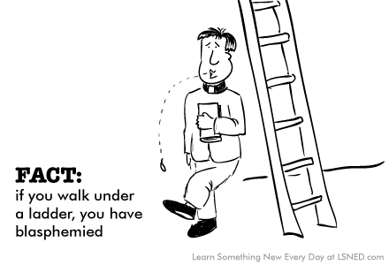
What We’re Testing
There are countless ways to cause bad luck, but do they actually effect anything?
We specifically chose to test the effects of:
  Walking under a ladder
  Opening umbrellas indoors
  Spilling salt

Slide 3
Reasons for superstition
A Kansas State University undergraduate research, done in 2010, focuses on personality traits that lead to superstition
In first study, the researchers conducted questionnaires with 200 undergraduates, asking about how pessimistic they were, whether they believed in chance or fate, if they liked to be in control, etc.
One of the major discoveries was that people who believe that chance and fate control their lives are more likely to be superstitious.
Clinicallypsych. "New Research Probes Superstitious Behavior | Clinically Psyched." Clinical Psychology News. Web. 12 Dec. 2011. <http://clinicallypsyched.com/psychology-superstitious-behavior/>.

Slide 4
How We Tested It
For each situation we used a before and after styled test of flipping a coin twenty times to see if any “bad luck” actually effected what we were doing.
We compared the results of flipping the coin before and after our experiments
  If the results were similar then the “bad luck” had no effect

Slide 5
Ladder superstition
The belief that walking under a ladder will bring bad luck stems from the ladder forming a triangle with the wall and the ground.
This represents the "Holy Trinity", and if you violate this by entering the space, it puts you in league with the devil, and you're likely to incur God's wrath.
Before gallows were utilized, murderers in some societies were instead hung on ladders.
  ladders were also undesirable because ghosts were claimed to have remained by the ladders.
  The bad luck is made even worse if someone drops something on you while walking under a ladder.

Slide 6
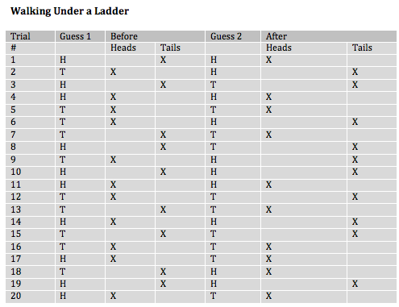
Trials for Ladder
Hits before: 9
Hits after: 8
Conclusion: The difference in the two results is not significant enough to prove that it is bad luck to walk under the ladder.

Slide 7
Salt superstition
Spilling salt was considered bad long before it was considered bad luck.
In ancient times salt was an expensive commodity, and one that had many useful purposes.
Wasting salt was therefore frowned upon, and so some suggest that the admonition of spilling salt being ‘bad luck’ came about as a way to stop the careless from wasting a precious spice.
People have to throw salt over their left shoulder because in some Christian beliefs the Devil hangs about over the left side of the body, and looking for an opportunity to invade.
Tossing said salt over the left shoulder puts it square in the devil’s face, just as he is on the attack.

Slide 8
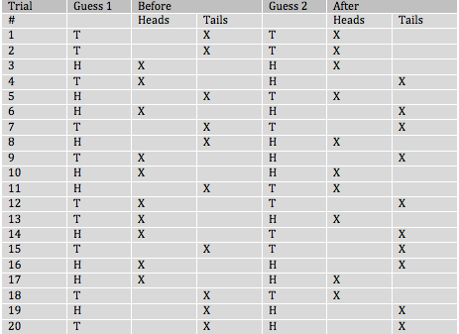
Trials for spilled salt
Hits before: 12
Hits after: 10
After spilling the salt Charles guessed 60%
After the salt was thrown over his shoulder Charles guessed 50%

Slide 9
Umbrella superstition
The European umbrella that was popular in the eighteenth century. These umbrellas were larger than modern umbrellas and had hard metal spokes and spring triggers.
The opening of these umbrellas could cause damage to objects or people that happened to be nearby.
It was considered bad luck to open an umbrella indoors, because of the many cases in which people broke something or injured someone with them

Slide 10
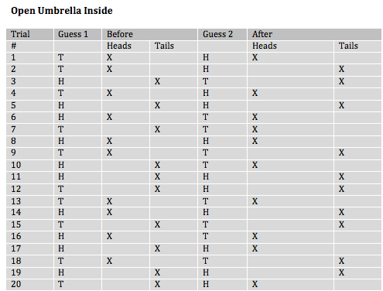
Trials for umbrella indoors
Before : 8
After: 9
Conclusion: The umbrella had no effect on his luck
He actually did better after the umbrella was opened

